Slide 1
Embedded Computing Processors
CSE 237D: Spring 2009
Topic #3
Ryan Kastner

Slide 2
What kind of embedded processor?
What are our options for processors in embedded systems?
What performance metrics are we worried about?

Slide 3
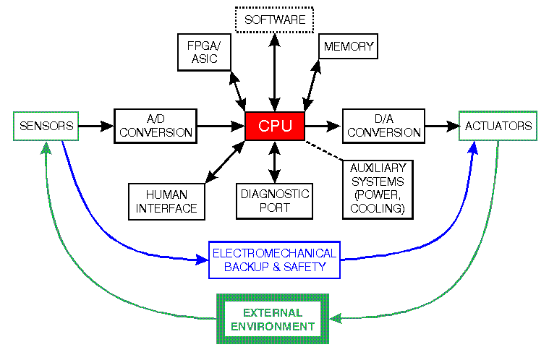
“Traditional” Software Embedded Systems = CPU + RTOS
Slide courtesy of Mani Srivastava®

Slide 4
“Traditional” Hardware Embedded Systems = ASIC
ASIC Features
  Area: 4.6 mm x 5.1 mm
  Speed: 20 MHz @ 10 Mcps
  Technology: HP 0.5 μm
  Power: 16 mW - 120 mW (mode dependent) @ 20 MHz, 3.3 V
  Avg. Acquisition Time: 10 μs to 300 μs
A direct sequence spread spectrum (DSSS) receiver ASIC
Source: Mani Srivastava®

Slide 5
A spectrum of options now
Microcontroller
Microprocessor
ASIP
  DSP
  Graphics Processor
  Network Processor
  Cryptoprocessor
  …
FPGA
ASIC

Slide 6
Microcontrollers Overview
A microcontroller (uC) is a small, lightweight CPU which is usually combined with on-board memory and peripherals
  Compact and low power (relatively)
Often used as a simple hardware to software interface as well as for in-situ processing
  Analog to digital gateway
  Allows for real-time feedback based on data
sensor
actuator
Microcontroller
(uC)
sensor
Analog to Digital
Digital to Analog
indicator
sensor

Slide 7
Microcontroller Features
Processor speed: Fundamental measure of processing rate of device
  Value of interest is in MIPS, not MHz
Supply voltage/current: Measure of the amount of power required to run the device
  Multiple modes (sleep, idle, etc)
It is possible to adjust the voltage and frequency of some devices in real time, thereby trading off speed and power usage
Notes:
3) Usually only for heavy ADC

Slide 8
Microcontroller Features
Internal memory: Sometimes divided between program and data memory, the amount of information that can be stored on board
  Can be supplemented with external memory
I/O Pins: Individual points for communication between the uC and the rest of the world
  Can be digital or analog, general or special purpose
Interrupts: Non-linear program flow based on event triggers from peripheral or pins
Memory
CPU
ROM RAM
I/O
Subsystems:
Timers, Counters, Analog
Interfaces, I/O interfaces

Slide 9
Microcontroller Peripherals
Timers: Internal registers (any size) in the uC that increment at the clock rate
Comparators: Input that effectively functions as a 1-bit ADC with an adjustable threshold
ADC: Most ADCs used in sensor data collection are integrated with uC
DAC: Digital to analog converters are also included in some data collection driven uC
  Mostly used for feedback and control
Notes:
Controlled by memory mapped registers

Slide 10
Microcontrollers Communication
UART: Basic hardware module which mediates serial communication (RS232)
  Simplest form of communication but limited by speed
  Most modules are full duplex
USB: High bandwidth serial communication between uC and a computer or an embedded host
  Usually requires chips with specialized hardware and firmware
  Host side issues
I²C: Half duplex master-slave 2-wire protocol for data transfer
  kbit transfer rates
  Tx/Rx based on slave addressing
  Can invert protocol with sensors as masters
RF: Radio frequency (>100 MHz) EM transmission of data
  Built in to some newer special-purpose uC
  Wireless spherical transmission
Notes:
1.2) Watch for full duplex uart but half duplex registers
2.2) Multiple host side issues. Need custom driver or fit standard device class.

Slide 11
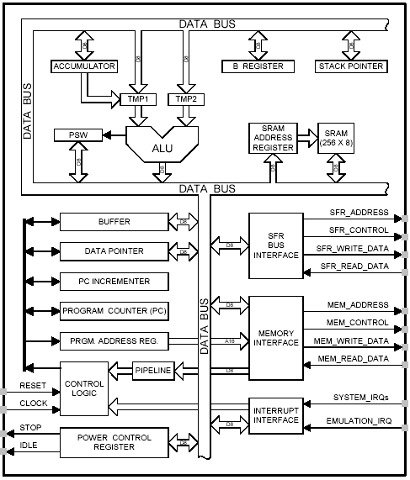
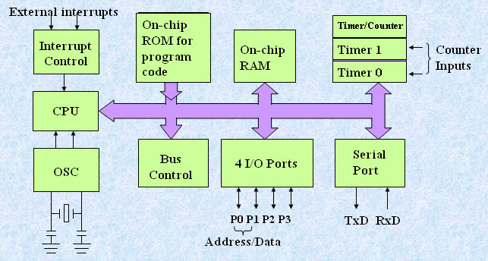
8051 Architecture
Notes:
SFR – special function registers used for I/O
SRAM – used for 8-bit registers and space for stack variables
PSW - Program Status Word contains status bits that reflect the current CPU state
"B" register - used by two 8051 instructions: MUL AB and DIV AB. Thus, if you want to quickly and easily multiply or divide A by another number, you may store the other number in "B" and make use of these two instructions. Also can be used for temporary storage

Slide 12
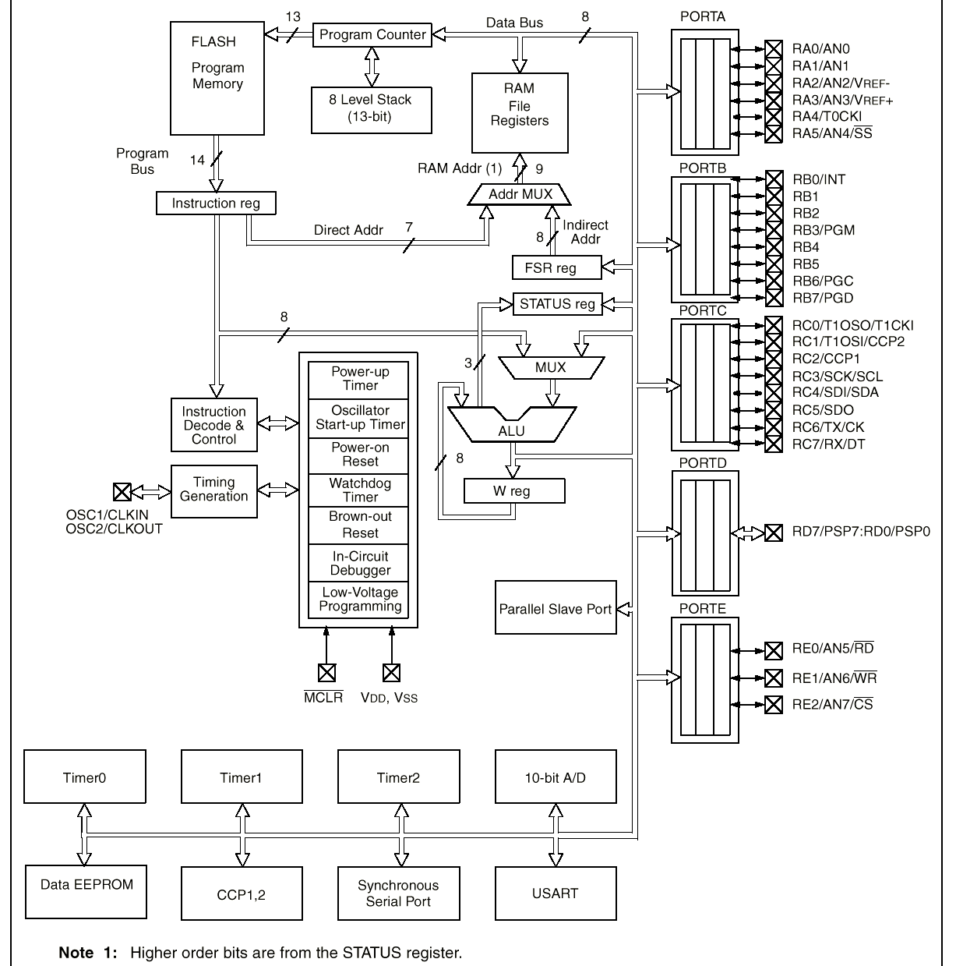
PIC Architecture
Notes:
Peripheral Interface Controller (PIC)
Harvard architecture – code and data space are separate
Instructions typically stored in EPROM, ROM, or flash ROM
ISA - 35 instructions for the low-end PICs to over 80 instructions for the high-end PICs

Slide 13
AVR
8-bit RISC series of microcontroller chips
  Large range of available devices covering many interfaces, speeds, memory sizes, and package sizes
  Large hobbyist development community with many available free toolchains and sample applications
General specs
  One MIPS per MHz
  Models available up to 20MHz
  Max 128K program space / 8K RAM
  ADC/LCD Driver/Motor Control
  UART/CAN/USB/IIC/SPI/DAC/LCD/PWM/Comparators
http://www.atmel.com/products/product_selector.asp
Notes:
a Modified Harvard architecture 8-bit RISC single chip microcontroller (µC) which was developed by Atmel in 1996. The AVR was one of the first microcontroller families to use on-chip flash memory for program storage, as opposed to One-Time Programmable ROM, EPROM, or EEPROM used by other microcontrollers at the time.
Atmel says that the name AVR is not an acronym and does not stand for anything in particular. But inside the walls of Atmel, the AVR is affectionately refered to as "Alf and Vegard's Risc".It is also sometimes speculated that AVR might be the acronym for "Advanced Virtual Risc". Officially, the creators of the AVR give no definitive answer as to what the term "AVR" stands for

Slide 14
TI MSP430
Proprietary TI low-power low-cost RISC chips
  Well supported by TI with good program chain
  Designed for intermittent sampling and fast startup
General specs
  Very low power (flexible)
  Max 32KHz / 8 MIPS
  Max 50K program space / 10K RAM
  Max 16 bit ADC
  UART/SPI/DAC/LCD/PWM/Comparators
http://www.msp430.com
Notes:
The Serial Peripheral Interface Bus or SPI (often pronounced "es-pē-ī or "spy”) bus is a synchronous serial data link standard named by Motorola that operates in full duplex mode.

Slide 15
Atmel ARM7
32-bit ARM microcontroller
  Low power (for 32-bit machines)
  Can run in 16-bit mode if needed
General specs
  Lots of memory (8-64KB RAM, 32-256KB flash)
  Variable speed up to 55MHz
  Packed with peripherals (USB, ADC, SPI, etc.)
  Common in systems that require more processing
http://www.at91.com/

Slide 16
Many Types of Programmable Processors
Past
  Microprocessor
  Microcontroller
  DSP
  Graphics Processor
Now / Future
  Network Processor
  Sensor Processor
  Cryptoprocessor
  Game Processor
  Wearable Processor
  Mobile Processor
Source: Mani Srivastava®

Slide 17
Typical Network Processor Architecture
SDRAM
(Packet buffer)
SRAM
(Routing table)
Bus
Bus
Input ports
Output ports
multi-threaded processing elements
Co-processor
Network Processor

Slide 18
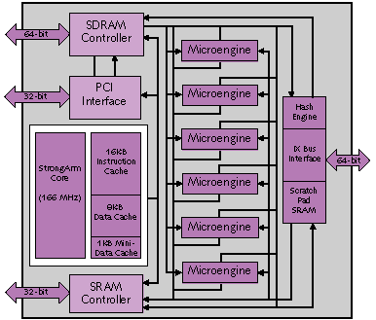
Intel IXP1200 Network Processor
StrongARM processing core
Microengines introduce new ISA
I/O
  PCI
  SDRAM
  SRAM
  IX : PCI-like packet bus
On chip FIFOs
  16 entry 64B each

Slide 19
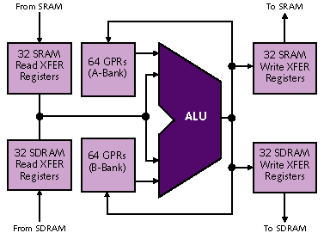
Intel IXP1200 Microengine
4 hardware contexts
  Single issue processor
  Explicit optional context switch on SRAM access
Registers
  All are single ported
  Separate GPR
  256*6 = 1536 registers total
32-bit ALU
  Can access GPR or XFER registers
Shared hash unit
  1/2/3 values – 48b/64b
  For IP routing hashing
Standard 5 stage pipeline
4KB SRAM instruction store – not a cache!
Barrel shifter
Notes:
The six microengines each provide the following features
Hardware multithreaded support for four contexts – context switching is non preemptive
Can hold 1024 instructions in the instruction control store
Five stage pipeline enables 1 clock cycle per instruction when fully loaded

Slide 20
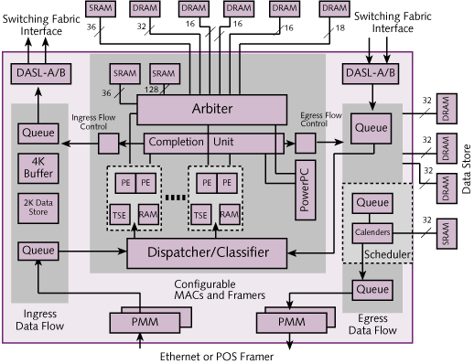
IBM PowerNP
16 pico-processors and 1 PowerPC
  Each pico-processor support 2 hardware threads
  3 stage pipeline : fetch/decode/execute
Dyadic Processing Unit
  Two pico-processors
  2KB Shared memory
  Tree search engine
Focus is Network layers 2-4
PowerPC 405 for control plane operations
  16K I and D caches
Target is OC-48
Notes:
OC-48 is a network line with transmission speeds of up to 2488.32 Mbit/s (payload: 2405.376 Mbit/s; overhead: 82.944 Mbit/s).

Slide 21
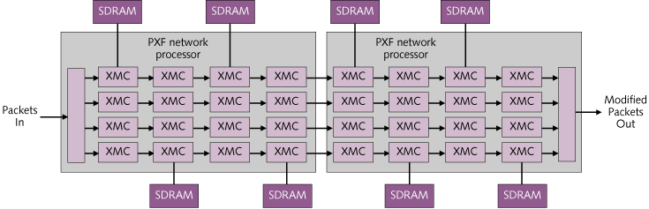
Cisco 10000
Almost all data plane operations execute on the programmable XMC
Pipeline stages are assigned tasks – e.g. classification, routing, firewall, MPLS
  Classic SW load balancing problem
External SDRAM shared by common pipe stages

Slide 22
From Processor to ASIP
Decoder
RF0
Source
Spatial bottleneck:
  not enough bandwidth
FU0
Control
Temporal bottleneck:
  Limited functionality
Result
Source: Tensilica®

Slide 23
Add Custom Functional Units
Decoder
RF0
Source routing
FU0
FU1
FU2
FU3
Control
Result routing
Source: Tensilica®

Slide 24
Customize Memory
Decoder
RF0
RF1
RF2
S0
S1
Source routing
FU0
FU1
FU2
FU3
Control
Result routing
Source: Tensilica®

Slide 25
Multicycle Instructions
Decoder
RF0
RF1
RF2
S0
S1
Source routing
FU0
FU1
FU2
FU3
Control
Result routing
Source: Tensilica®

Slide 26
Tensilica Xtensa Processor Options
Base ISA Feature
Configurable Function
Optional Function
Optional & Configurable
Advanced Designer
Defined Coprocessors
MMU
MMU
Instruction
ITLB
Cache
ITLB
Instruction
ITLB
Fetch / PC
Instruction ROM
Unit
Instruction ROM
Instruction RAM
Instruction RAM
External Interface
Write
Xtensa Processor
Buffer
Interface
(1 to 32 entries)
(PIF)
MMU
MMU
Data
DTLB
Cache
DTL
Data
DTL
TLB
TLB
Load / Store
TLB
Data ROM
Unit
Data ROM
Data RAM
Data RAM
Source: Tensilica®

Slide 27
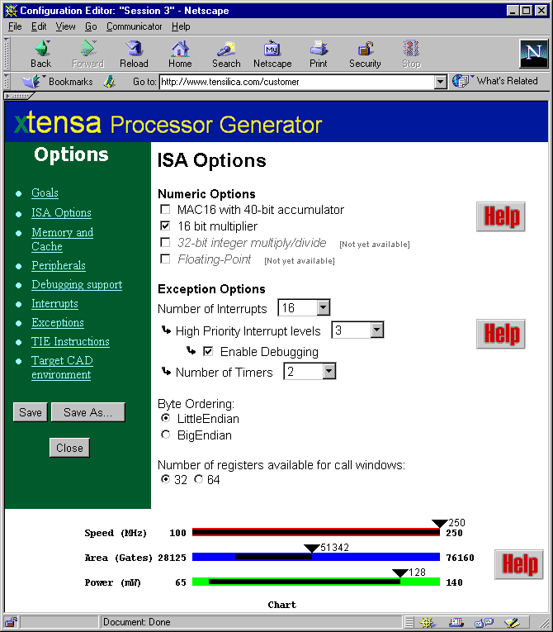
ASIP Design Flow
ALU
I/O
Pipe
Cache
Timer
Register File
MMU
Tailored,
synthesizable HDL uP core
Select processor options (FU, $, Registers, etc)
∗∗∗∗∗∗∗
∗∗∗∗
∗∗∗∗∗∗∗∗
∗∗∗
Use automated processor generator, create custom processor
Customized Compiler, Assembler, Linker, Debugger,
Simulator
Describe new
instructions
Source: Tensilica®

Slide 28
Architectural Design Space
Approaches to Parallel Processing
  Processing Element (PE) level
  Instruction-level
  Bit-level
Elements of Special Purpose Hardware
Structure of Memory Architectures
Types of On-Chip Communication Mechanisms
Use of Peripherals

Slide 29
Summary: ASIPs
Processors with instruction-sets tailored to specific applications or application domains
    Instruction-set generation as part of synthesis
    Customized processor options
Pluses:
    Customization yields lower area, power etc.
Minuses:
    higher h/w & s/w development overhead
        design, compilers, debuggers
        higher time to market
Source: Mani Srivastava®

Slide 30
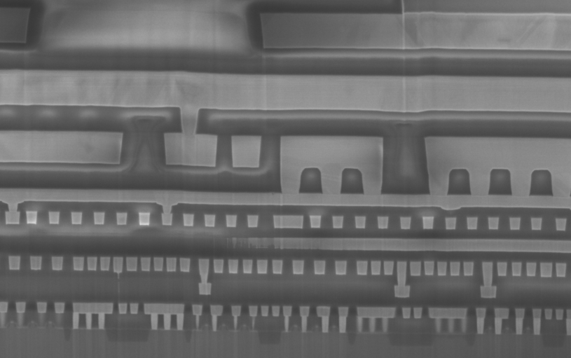
What is this?
90nm 9-layer Interconnect (from Altera FPGA)
Source: Altera®
Notes:
Answer: 90nm 9-layer Interconnect

Slide 31
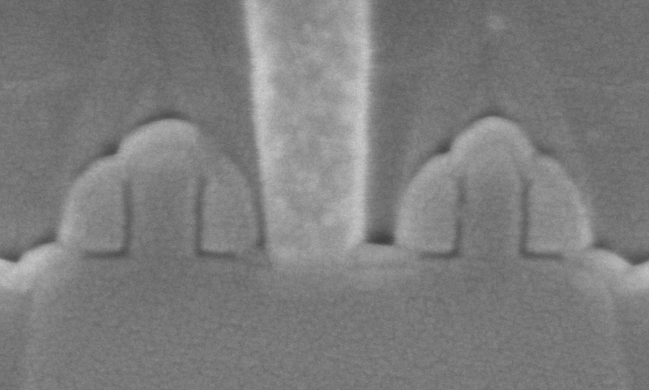
What is this?
Dielectric
Contact
Salicide
Spacer
Poly
Spacer
Diffusion
Isolation
Isolation
90nm Transistor (from Altera FPGA)
Source: Altera®

Slide 32
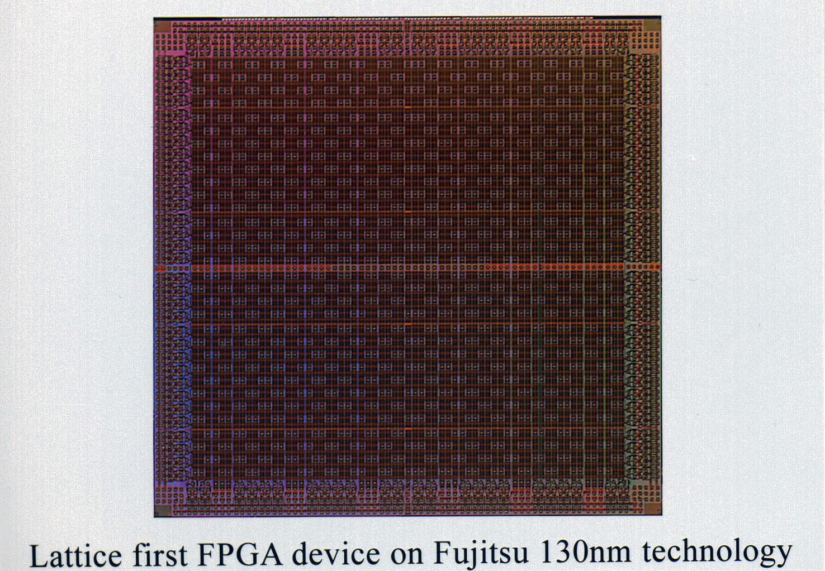
FPGA

Slide 33
FPGA
CLB
Switchbox
Routing
Channel
IOB
Routing
Channel
Configuration
Bit

Slide 34
Programmable Logic
Logic Element
Tracks
LE
LE
LE
LE
LE
LE
LE
LE
LE
LE
LE
LE
  Each logic element outputs one data bit
  Interconnect programmable between elements
  Interconnect tracks grouped into channels

Slide 35
Lookup Table (LUT)
Program configuration bits for required functionality
Computes “any” 2-input function
2-LUT
In Out
00 0
01 0
10 0
11 1
A
C=A ⋅ B
B
Configuration Bit 0
Configuration Bit 1
C
Configuration Bit 2
Configuration Bit 3
A
B

Slide 36
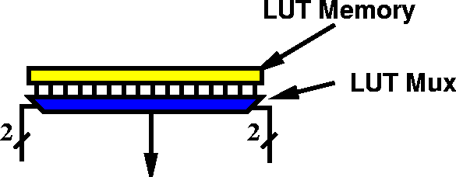
Lookup Table (LUT)
K-LUT -- K input lookup table
Any function of K inputs by programming table
Load bits into table
  2^{N} bits to describe functions
  => different functions

Slide 37
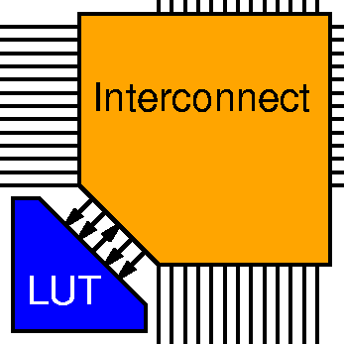
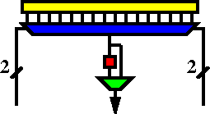
Lookup Table (LUT)
K-LUT (typical k=4)
w/ optional
output Flip-Flop

Slide 38
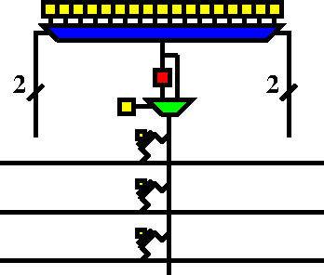
Lookup Table (LUT)
Single configuration bit for each:
  LUT bit
  Interconnect point/option
  Flip-flop select

Slide 39
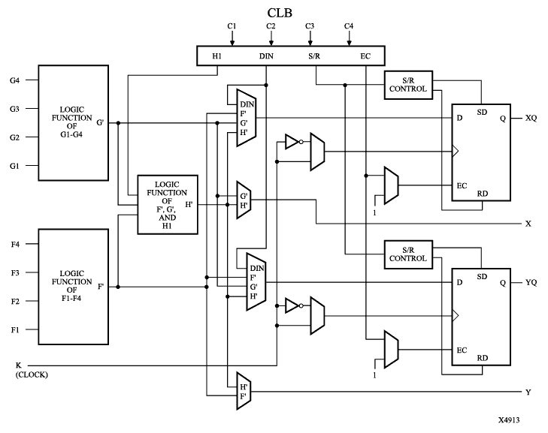
Configurable Logic Block (CLB)

Slide 40
Programmable Interconnect
Interconnect architecture
  Fast local interconnect
  Horizontal and vertical lines of various lengths
C L
B
C L
B
C L
B
Switch
Matrix
Switch Matrix
C L
B
C L
B
C L
B

Slide 41
Switchbox Operation
Before Programming
After Programming
6 pass transistors per switchbox interconnect point
Pass transistors act as programmable switches
Pass transistor gates are driven by configuration memory cells

Slide 42
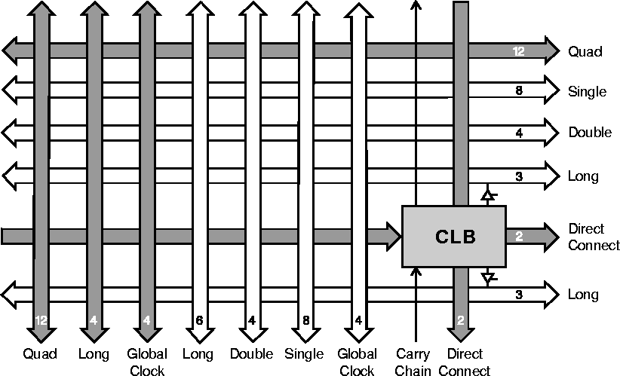
Programmable Interconnect

Slide 43
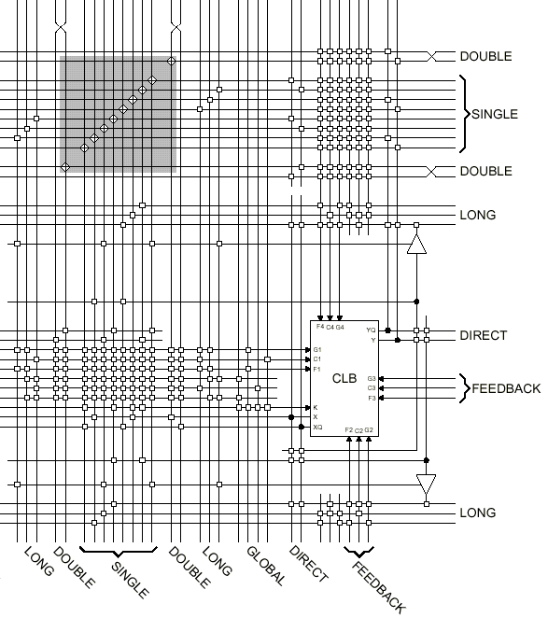
Programmable Interconnect
25

Slide 44
Embedded Functional Units
Fixed, fast multipliers
MAC, Shifters, counters
Hard/soft processor cores
  PowerPC
  Nios
  Microblaze
Memory
  Block RAM
  Various sizes and distributions

Slide 45
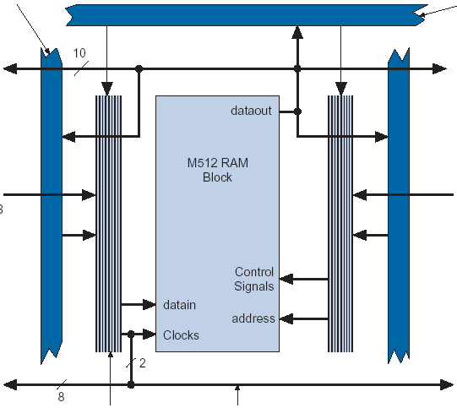
Embedded RAM
Xilinx – Block SelectRAM
  18Kb dual-port RAM arranged in columns
Altera – TriMatrix Dual-Port RAM
  M512 – 512 x 1
  M4K – 4096 x 1
  M-RAM – 64K x 8

Slide 46
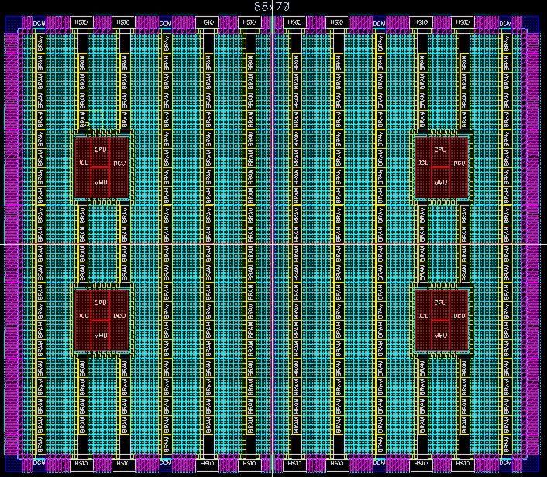
Xilinx Virtex-II Pro
1 to 4 PowerPCs
4 to 16 multi-gigabit transceivers
12 to 216 multipliers
3,000 to 50,000 logic cells
200k to 4M bits RAM
204 to 852 I/Os
Up to 16 serial transceivers
622 Mbps to 3.125 Gbps
PowerPCs
Logic cells

Slide 47
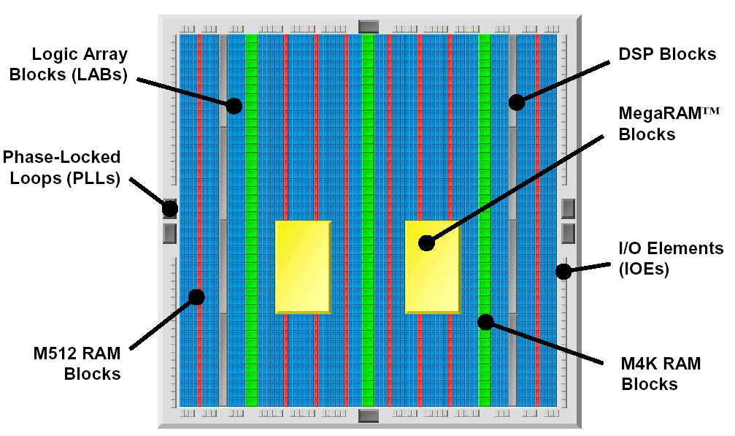
Altera Stratix

Slide 48
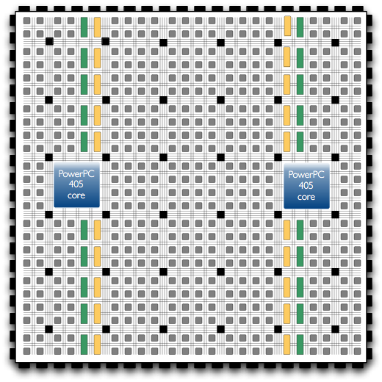
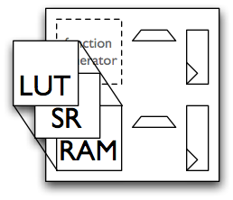
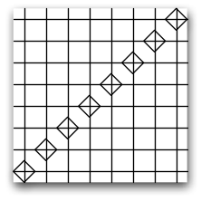
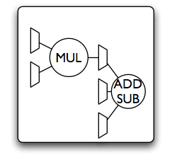
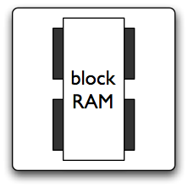
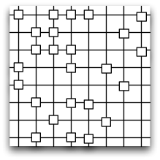
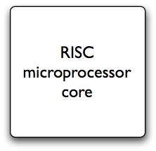
FPGA Architectures
FPGA-based reconfigurable devices
  Configurable logic blocks
    Flexible logic block
    Programmable interconnect
  Dedicated multipliers
  Embedded configurable block RAM
  RISC microprocessor cores
Other architectures
  Reconfigurable multi-core
  processor
  Coarse-grained reconfigurable architectures

Slide 49
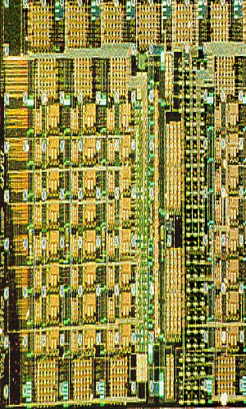
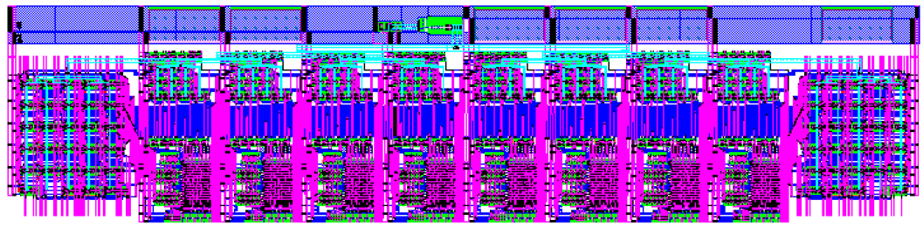
Application Specific Integrated Circuits (ASICs)
Full Custom ASICs
  Every transistor is designed and drawn by hand
  Typically only way to design analog portions of ASICs
  Gives the highest performance but the longest design time
  Full set of masks required for fabrication
Source: Paul D. Franzon

Slide 50
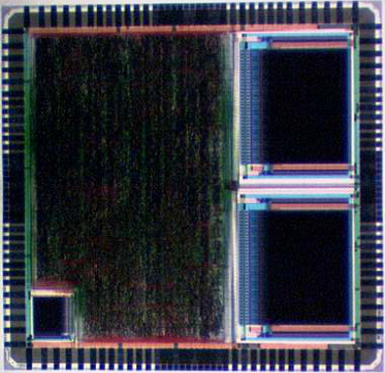
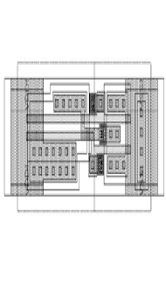
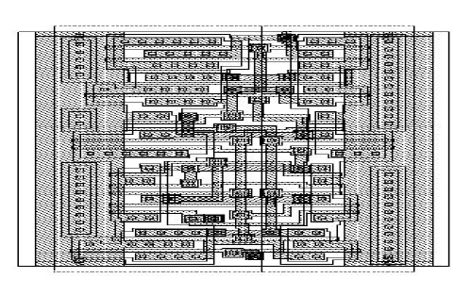
Application Specific Integrated Circuits (ASICs)
Standard-Cell-Based ASICs
  or ‘Cell Based IC’ (CBIC) or ‘semi-custom’
  Standard Cells are custom designed and then inserted into a library
  These cells are then used in the design by being placed in rows and wired together using ‘place and route’ CAD tools
  Some standard cells, such as RAM and ROM cells, and some datapath cells (e.g. a multiplier) are tiled together to create macrocells
D-flip-flop:
NOR gate:
Source: Paul D. Franzon

Slide 51
Standard Cells
N Well
Cell height 12 metal tracks
Metal track is approx. 3λ + 3λ
Pitch =
repetitive distance between objects
Cell height is “12 pitch”
V
DD
Out
2λ
In
Rails ~10λ
GND
Cell boundary
© Digital Integrated Circuits^{2nd}
Notes:
Inverter

Slide 52
Standard Cells
V
2-input NAND gate
DD
A
B
Out
GND
© Digital Integrated Circuits^{2nd}

Slide 53
Standard Cell Layout Methodology – 1980s
Routing
channel
V_{DD}
signals
GND
© Digital Integrated Circuits^{2nd}
Notes:
Contacts and wells not shown.
What does this implement??

Slide 54
Standard Cell Layout Methodology – 1990s
Mirrored Cell
No Routing
channels
V_{DD}
V_{DD}
M2
M3
GND
Mirrored Cell
GND
© Digital Integrated Circuits^{2nd}
Notes:
Contacts and wells not shown.
What does this implement??

Slide 55
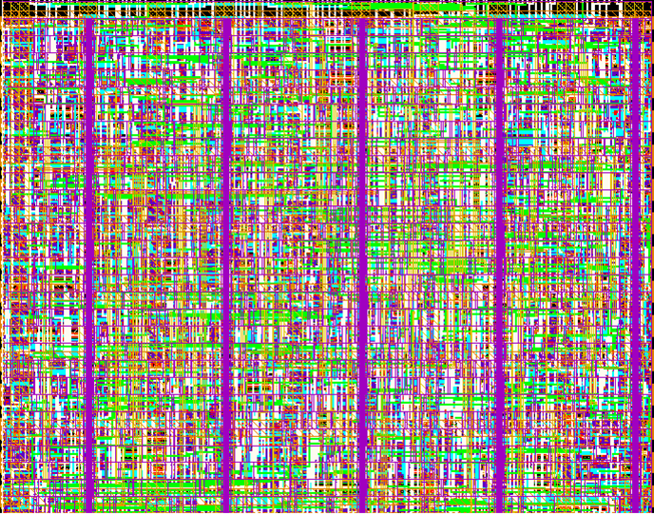
Standard Cell Layouts
Notes:
Old vs New

Slide 56
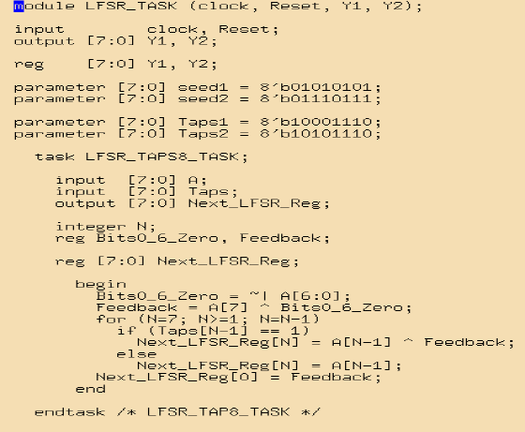
ASIC Design Flow
Most ASICs are designed using a RTL/Synthesis based
methodology
Design details captured in a simulatable description of the hardware
Captured as Register Transfer Language (RTL)‏
Simulations done to verify design
Source: Paul D. Franzon

Slide 57
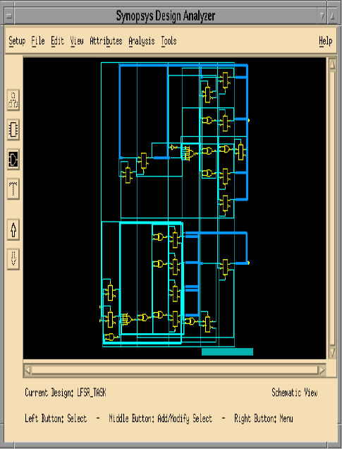
ASIC Design Flow
Automatic synthesis is used to turn the RTL into a gate-level description
ie. AND, OR gates, etc.
Chip-test features are usually inserted at this point
Gate level design verified for correctness
Output of synthesis is a “net-list”
i.e. List of logic gates and their implied connections
NOR2 U36 ( .Y(n107), .A0(n109), .A1(\value[2] ) );
NAND2 U37 ( .Y(n109), .A0(n105), .A1(n103) );
NAND2 U38 ( .Y(n114), .A0(\value[1] ), .A1(\value[0] ) );
NOR2 U39 ( .Y(n115), .A0(\value[3] ), .A1(\value[2] ) );
Source: Paul D. Franzon

Slide 58
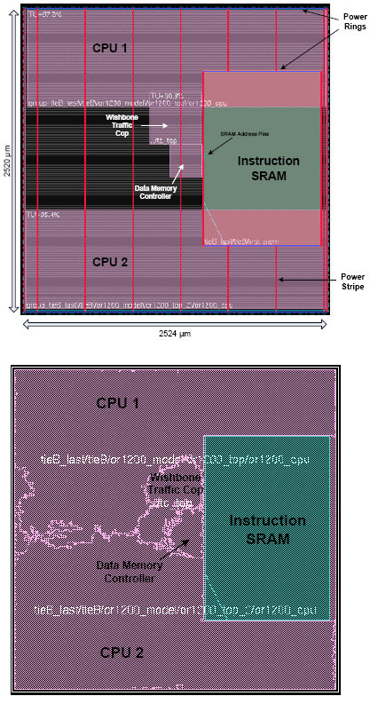
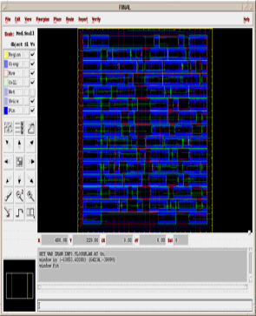
ASIC Design Flow
Physical Design tools used to turn the gate-level design into a set of chip masks (for photolithography) or a configuration file for downloading to an FPGA
Floorplanning
Positioning of major functions
Placement
Gates arranged in rows

Slide 59
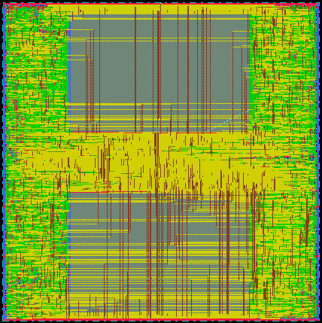
ASIC Design Flow
Clock and buffer Insertion
Distribute clocks to cells and locate buffers for use as amplifiers in long wires
Routing
Logic Cells wired together

Slide 60
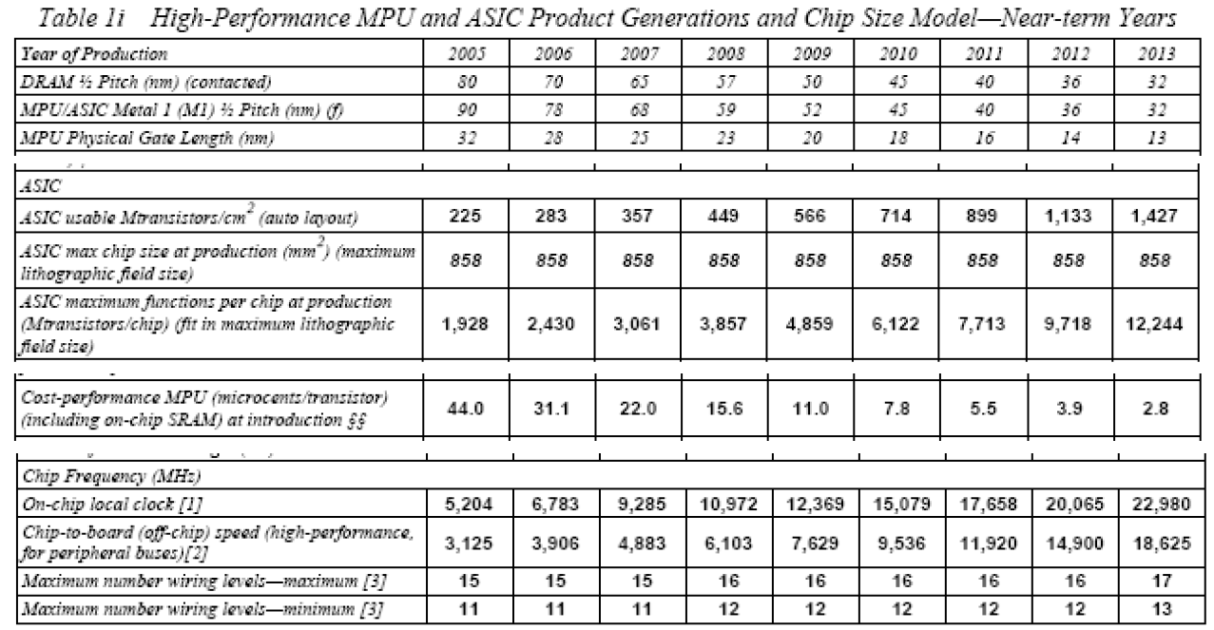
Semiconductor Roadmap
Projections for ‘leading edge’ ASIC: (www.itrs.net)‏

Slide 61
Std Cell ASIC Development Cost Trend
45
Total Development Costs ($M)
40
35
30
25
20
15
10
5
0
0.18 µm
0.15 µm
0.13 µm
90 nm
65 nm
45 nm
Masks & Wafers
Test & Product Engineering
Software
Design/Verification & Layout
Note: Conservative estimate; does not include re-spins.

Slide 62
Result: Declining ASIC Starts
12000
Standard Cell/Gate Arrays
10000
8000
Design Starts
6000
4000
2000
0
1996
1997
1998
1999
2000
2001
2002
2003
2004
2005
2006
2007
Source: Dataquest/Gartner

Slide 63
FPGA vs Standard Cell
Parameter | FPGA | Standard Cell
CAD tool Cost | $2000 | $Millions
Mask Cost | 0 | $1.4M US @ 90 nm
Bug Fix | 1 hour | ~10 weeks
Electrical & Optical Check & Debug | Vendor’s Problem | Your Problem!
Time to Market | Fast | Slow
Die Size | 2X to 20X | 1X
Volume Cost | 1X to 20X | 1X
Speed | 0.3X to 0.6X | 1X
Power | 2X to 5X | 1X
Source: Altera®

Slide 64
Efficiency vs. Development Cost
High
Power & System Cost*
Development Difficulty & Cost
Low
Processor
DSP
FPGA
Struct.
Std. Cell
Full
ASIC
Custom
*For applications with significant parallelism
Source: Altera®

Slide 65
Many Implementation Choices
Speed
Power
Cost
Microprocessors/controllers
ASIP
  DSP
  Graphics
  Network processors
  Crypto
FPGA
ASIC
High Low
Volume

Slide 66
Embedded System Design
CAD tools take care of hardware fairly well
  Although a productivity gap emerging
But, software is a different story…
  HLLs such as C help, but can’t cope with complexity and performance constraints
Holy Grail for Tools People: H/W-like synthesis & verification from a behavior description of the whole system at a high level of abstraction using formal computation models
Source: Mani Srivastava®

Slide 67
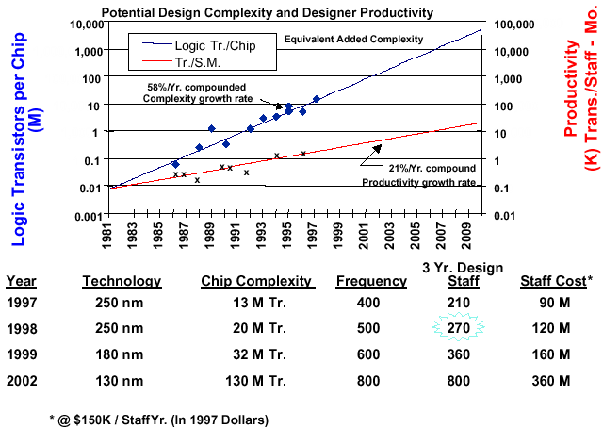
Productivity Gap in Hardware Design
A growing gap between design complexity and design productivity
Source: Alberto Sangiovanni-Vincentelli®

Slide 68
Situation Worse in S/W
DoD Embedded System Costs
Billion $/Year
Source: Mani Srivastava®

Slide 69
Embedded System Design from a Design Technology Perspective
Intertwined subtasks
  Specification/modeling
  H/W & S/W partitioning
  Scheduling & resource allocations
  H/W & S/W implementation
  Verification & debugging
Crucial is the co-design and joint optimization of hardware and software
Source: Mani Srivastava®

Slide 70
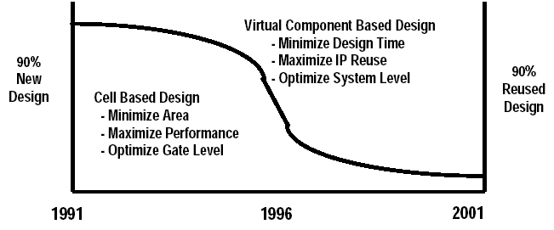
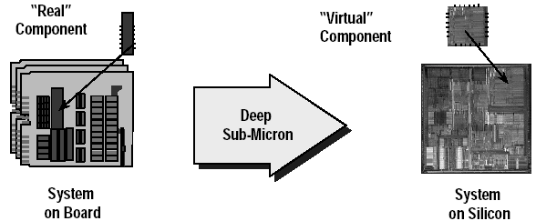
On-going Paradigm Shift in Embedded System Design
Change in business model due to SoCs
  Currently many IC companies have a chance to sell devices for a single board
  In future, a single vendor will create a System-on-Chip
  But, how will it have knowledge of all the domains?
Component-based design
  Components encapsulate the intellectual property
Platforms
  Integrated HW/SW/IP
  Application focus
  Rapid low-cost customization
Source: Mani Srivastava®

Slide 71
Complexity and Heterogeneity
control panel
controller
processes
ASIC
Real-time
OS
μcontroller
UI
processes
DSP
Assembly
Code
Programmable
DSP
Programmable
DSP
DSP
Assembly
Code
Dual-ported
RAM
CODEC
Heterogeneity within H/W & S/W parts as well
  S/W: control oriented, DSP oriented
  H/W: ASICs, COTS ICs
Source: Mani Srivastava®

Slide 72
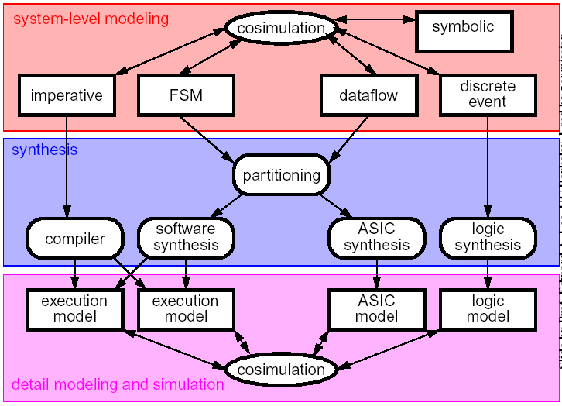
Handling Heterogeneity
Source: Edward Lee®

Slide 73
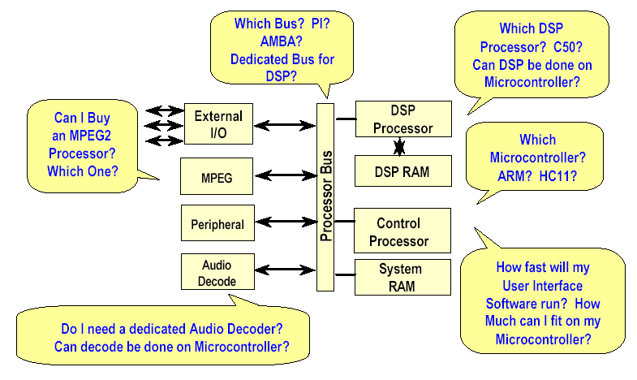
IP-based Design
Source: Mani Srivastava®

Slide 74
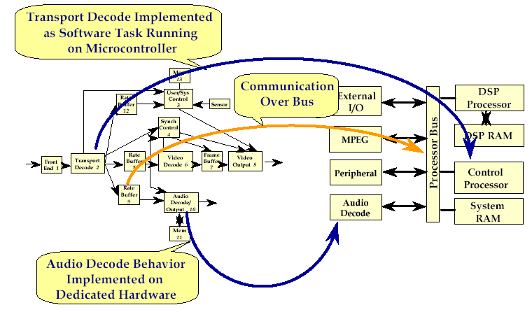
Map from Behavior to Architecture
Source: Mani Srivastava®

Slide 75
Behavior Vs. Architecture
Performance models: Emb. SW, comm. and comp. resources
Models of Computation
1
HW/SW partitioning,
Scheduling
System
Behavior
System
Architecture
2
Behavior
Simulation
Mapping
3
Performance
Simulation
SW estimation
Synthesis
Communication
Refinement
Flow To Implementation
4
Source Alberto Sangiovanni-Vincentelli®

Slide 76
Hardware vs. Software Modules
Hardware = functionality implemented via a custom architecture (e.g. datapath + FSM)
Software = functionality implemented in software on a programmable processor
Key differences:
  Multiplexing
    software modules multiplexed with others on a processor
      e.g. using an OS
    hardware modules are typically mapped individually on dedicated hardware
  Concurrency
    processors usually have one “thread of control”
    dedicated hardware often has concurrent datapaths
Source: Mani Srivastava®

Slide 77
Hardware-Software Architecture
A significant part of the problem is deciding which parts should be in software on programmable processors, and which in specialized hardware
Today:
  Ad hoc approaches based on earlier experience with similar products, & on manual design
  HW-SW partitioning decided at the beginning, and then designs proceed separately
Source: Mani Srivastava®

Slide 78
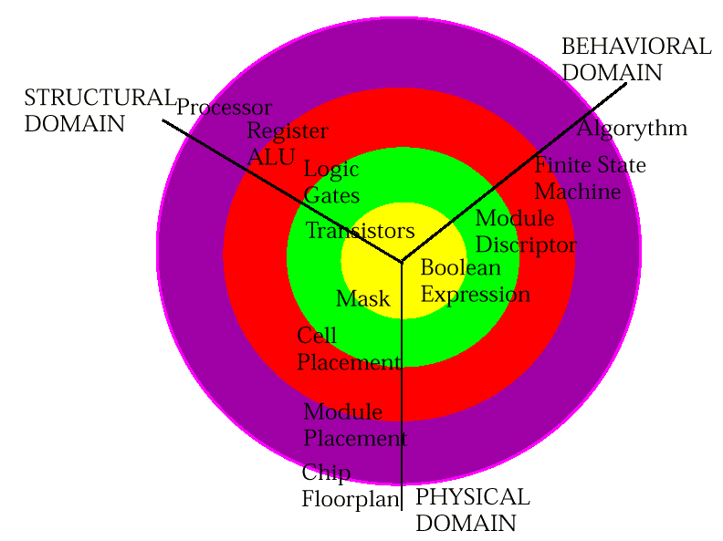

Slide 79
Extra Slides

Slide 80
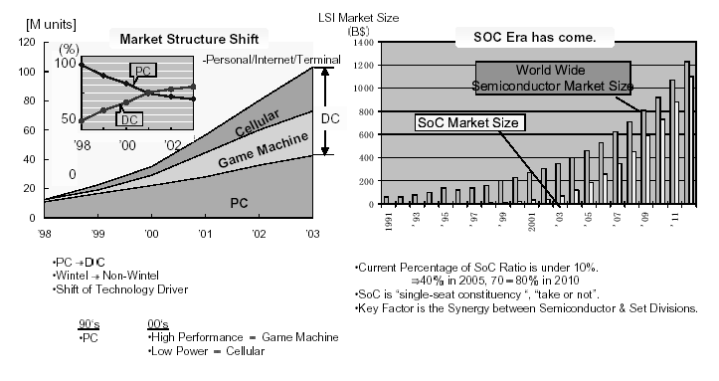
Industrial Structure Shift (from Sony)
Source: Mani Srivastava®

Slide 81
Where are the CPUs?
Estimated 98% of 8 Billion CPUs produced in 2000 used for embedded apps
Where Has CS Focused?
Where Are the Processors?
Direct
2%
Interactive
Computers
Robots
6%
Vehicles
12%
200M
per Year
Servers,
etc.
8.5B Parts
per Year
Embedded Computers
80%
In Vehicles
In Robots
Embedded
Look for the CPUs…the Opportunities Will Follow!
Source: DARPA/Intel (Tennenhouse)

Slide 82
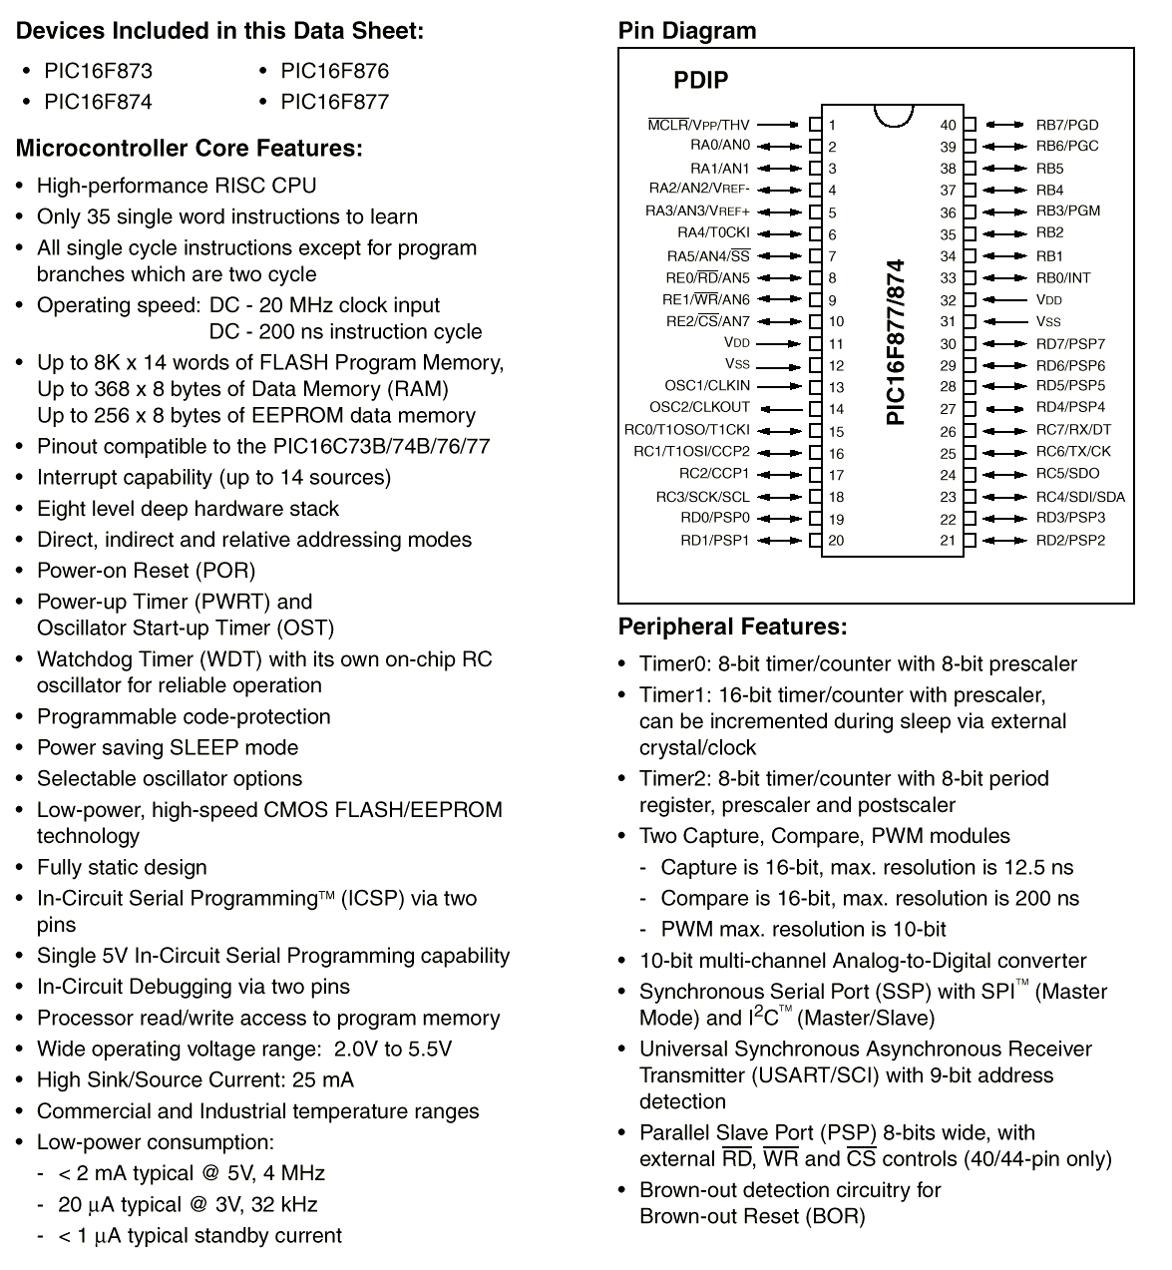
PIC Data Sheet

Slide 83
Example: Video Processor
Philips Nexperia:
MIPSTM
TriMediaTM
SDRAM
General Purpose RISC Processor
50 to 300+ MHz
32-bit or 64-bit
Library of Device Blocks
Image coprocessors
DSPs
UART
1394
USB
…and more
MIPS CPU
MMI
TriMedia CPU
VLIW Media Processor:
100 to 300+ MHz
32-bit or 64-bit
Nexperia
System Busses
PI bus
Memory bus
32-128 bit
D$
PRxxxx
TM-xxxx
D$
I$
I$
DEVICE I/P BLOCK
DEVICE I/P BLOCK
DEVICE I/P BLOCK
DVP MEMORY BUS
DEVICE I/P BLOCK
. . .
. . .
PI BUS
PI BUS
DEVICE I/P BLOCK
DEVICE I/P BLOCK
DVP System Silicon
Flexible architecture for digital video applications

Slide 84


Increasingly on the Same Chip: System on a Chip (SOC)
Source: Mani Srivastava®

Slide 85

Reconfigurable SoC
Other Examples
Atmel’s FPSLIC
(AVR + FPGA)
Altera’s Nios
(configurable RISC on a PLD)
Triscend’s A7 CSoC
Source: Mani Srivastava®

Slide 86
Reconfigurable Hardware
  Main Entry: re-
  Function: prefix
  1 : again : anew <retell>
  2 : back : backward <recall>
Main Entry: con·fig·ure
Pronunciation: k&n-'fi-gy&r
Function: transitive verb
: to set up for operation especially
in a particular way
CLB
Block RAM
IP Core (Multiplier)
KEY ADVANTAGE: Performance of Hardware, Flexibility of Software

