Slide 1
Image Processing
CSE 237D: Spring 2009
Topic #2
Prof. Ryan Kastner

Slide 2
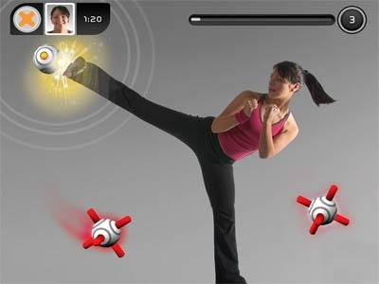
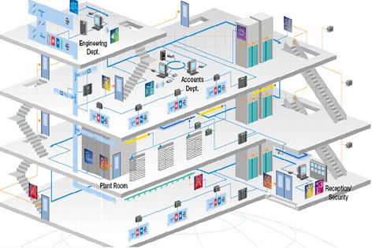
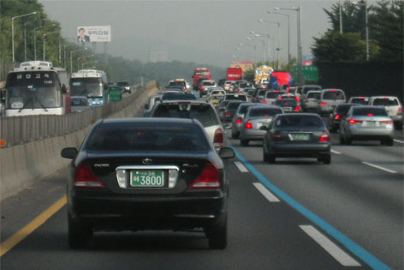
Image Processing Embedded System
Applications
Intelligent robot, monitoring and surveillance, human-computer interface, smart rooms, defense industry, vehicle tracking, biomedical image analysis, video compression, etc.

Slide 3
Dedicated Architecture

Slide 4
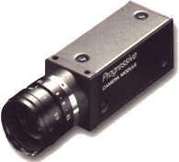
Dedicated Architecture
Important Design Factors
Process the incoming pixel on the fly

Slide 5
Dedicated Architecture
Important Design Factors
Process the incoming pixel on the fly
Minimize the access time to the image memory
Minimize
FPGA
Image
Processor
Image
Buffer
Image
Memory

Slide 6
Dedicated Architecture
Important Design Factors
Process the incoming pixel on the fly
Minimize the access time to the image memory
Adapt the application for parallel processing
START
START
START
PROCESS
PROCESS
PROCESS
DATA
DATA
DATA
IF
IF
IF
END
END
END

Slide 7
Dedicated Architecture
Important Design Factors
Process the incoming pixel on the fly
Minimize the access time to the image memory
Adapt the application for parallel processing
Utilize pipelining: latency vs throughput
Process 1
Process 2
Process 3
Process 4
Process 1
Process 1
Process 2
Process 3
Process 4
Process 1
Process 2
Process 3
Process 1
Process 2

Slide 8

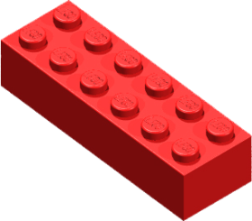
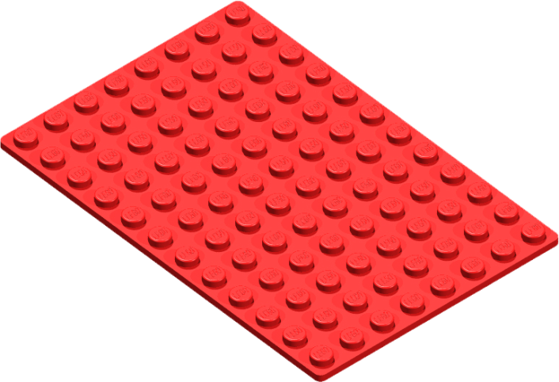










Dedicated Architecture
Important Design Factors
Process the incoming pixel on the fly
Minimize the access time to the image memory
Adapt the application for parallel processing
Utilize pipelining: latency vs throughput
Result: Custom architecture for specific algorithm

Slide 9
II
Histogram Equalization

Slide 10
Histogram Equalization
Important Factors for Vision
Quality algorithms
High quality image data
High performance processing
Vision System Using Image Sequences
Camera sensors – sensitive to lighting conditions
Histogram Equalization with AGC
Flat density distribution of image
Effective and simple
Eliminate darkness and/or brightness

Slide 11
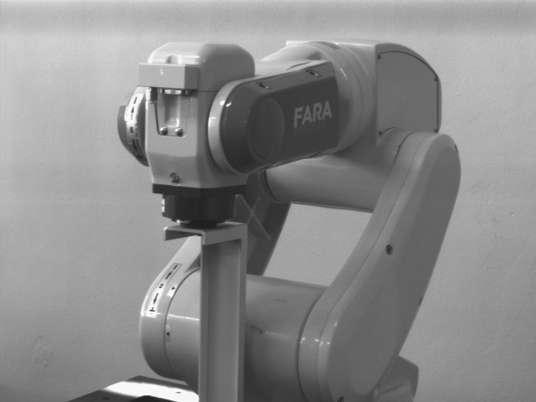
Image Histogram
Notes:
640 x 480 image (VGA) = 307,200 pixels

Slide 12
Histogram Divided into Eight Columns

Slide 13
Generate Histogram
Generate
Histogram

Slide 14

Histogram
Raw Image

Slide 15
Histogram equalization algorithm

Slide 16
Eight Interval Histogram Equalization Algorithm
85

Slide 17
Histogram Equalization
Histogram equalization lookup table
Raw | Equalization
0 | 0
1 | 10
2 | 18
3 | 23
4 | 29
. . . | . . .
253 | 249
254 | 253
255 | 255

Slide 18
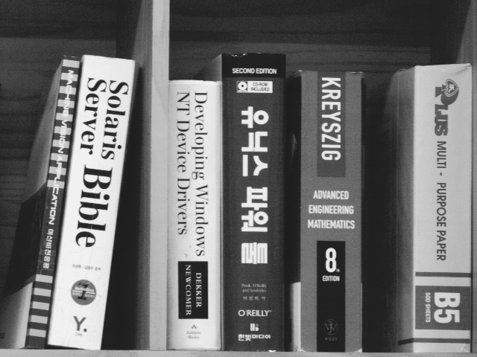
Histogram Equalization
Histogram Equalized Image
Histogram Equalized Image

Slide 19
Histogram Equalization

Slide 20
Histogram Equalization
Camera
Clock
Reset
Controller
Frame
Sync
Automatic Gain Controller
Sync
Separator
A/D
Converter
Comparator I
Camera Controller
Analyzer
Comparator II
Frame
Sync
Raw
Pixel[7:0]
Gain Multiplier
Gain
19-bit Counters
Auto Gain Pixel[7:0]
Histogram Lookup
Table
Frame
Sync
Equalized
Pixel[7:0]
Pixel Converter
Histogram Generator
Cumulative
Histogram
Lookup Table
19-bit Counters
Frame
Sync
Equalizer
Histogram Lookup
Table
Histogram Generator
Notes:
8 19-bit counters. Each covers a range of 32 values [0-31][32-63],…
Comparator I – compares values of last two bins (brightest) from successive frames and then multiplies them by some factor less than 1
Comparator II – compares values of the first two bins (darkest) from successive frames and then multiplies them by some factor greater than 1
Analyzer – Difference between the two largest and two smallest bins and figures out mutliplication factor
Two histogram LUT – one for gain control (on initial image) and one after the auto gain

Slide 21
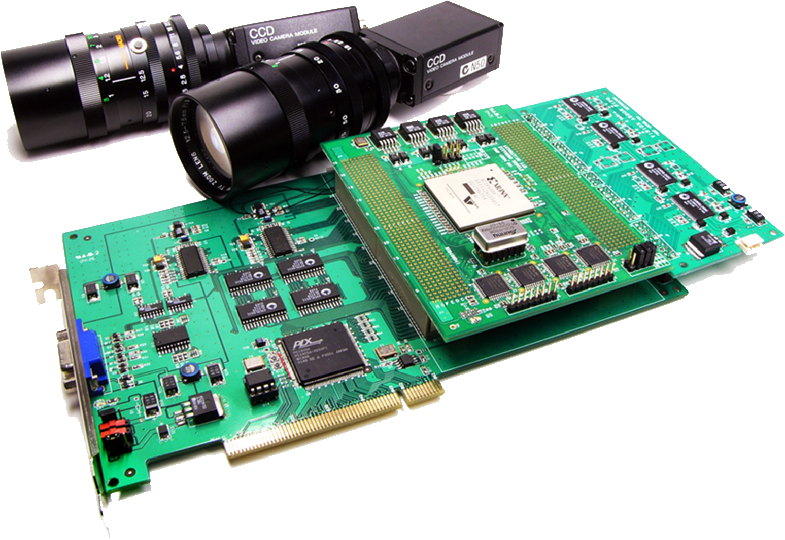
Histogram Equalization
Implement in XILINX XC2V6000 FPGA (about 6M gates, 1,104 I/O pins)
Interface RS-170 CCD Camera (640x480 pixels, 30 fps)
Transfer Raw and Enhanced Images to Host PC via PCI bus
CPU : Pentium4 (2.4)
RAM: 1GB DDR
APP : MS Visual C++
IMG : 640x480 pixels
Equalization | Performance
Proposed circuit for HE w/o AGC | 268.4 fps
Proposed circuit for HE with AGC | 122.3 fps
A S/W program for HE w/o AGC | 149.7 fps
A S/W program for HE with AGC | 10.4 fps
Device Utilization Summary
Number of Slices: Number of Slice Flip Flops: Number of 4 input LUTs: Number of bonded IOBs: Number of MULT18X18s: Number of GCLKs | 984 out of 33,792 2% 999 out of 67,584 1% 1,741 out of 67,584 2% 104 out of 824 12% 18 out of 144 12% 8 out of 16 50%

Slide 22
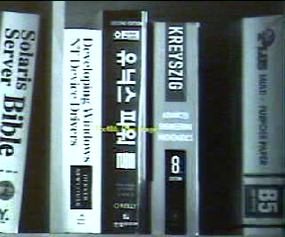
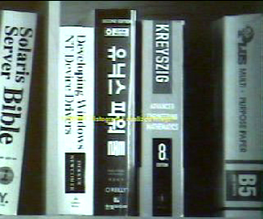
Histogram Equalization
Raw
Histogram Equalization with AGC

Slide 23
IV
Visual Tracking Using Color Histograms

Slide 24
Visual Tracking Using Color Histograms
Reference Model
15x15 model window buffer
Press the button after placing the model at the center of image
Acquire the reference model window and generate corresponding HSV 1D histograms

Slide 25
Visual Tracking Using Color Histograms
Window based Real-time Image Processing
15 line buffers having 640 elements and 15x15 window buffer
Acquire the sample window of adjacent pixels for current pixel and generate corresponding HSV 1D histograms
Notes:
15 add, 15 subtracts from each histogram needed every time (column coming in, column coming out)

Slide 26
Visual Tracking Using Color Histograms
Real-time Window Histogram Matching
Measure the similarity for the histograms of the model window and the histograms of the sample window
Bhattacharyya similarity measure
Model Histograms
Sample
Histograms
Notes:
Bhattacharyya similarity = sqrt((model bin)^2 – (reference bin)^2). Done over all histograms for each value (bin). If small, then it is similar

Slide 27

Visual Tracking Using Color Histograms
Digital Camera Controller
Sync
RGB to HSV Converter
Camera Link
Camera Link Interface
Comparator
RGB
Calculator
Digital Camera
Color Histogram
Based Tracker
HSV
Histogram Generator
Sync_HV
RGB_HSV
Histogram Comparator
Position Counter
Counter
Window
Histogram
Trajectory
Monitor
Model
Histogram
Position
Trajectory Presenter
Comparator
Digital Video Output
Presenter
DVI
Digital Visual Interface
Print
Notes:
position counter discribes the “interesting” regions, the ones that are similar to reference
Trajectory Presentor = just puts out a square to the monitor

Slide 28
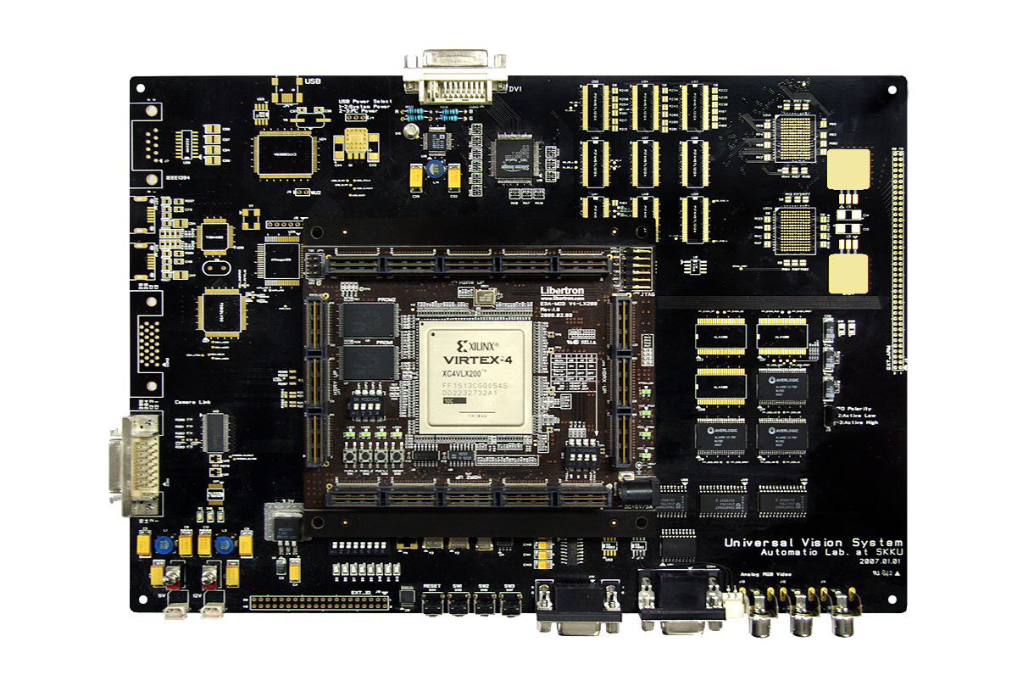
Visual Tracking Using Color Histograms
Implement in XILINX XC4VLX200 FPGA (about 16M gates, 1,513 I/O pins)
Interface Camera Link CCD Camera (640x480 pixels, 60 fps)
Display Raw and Tracking Images and Trajectory Data to LCD Monitor via DVI
CPU : Pentium4 (4.3)
RAM: 1GB DDR
APP : MS Visual C++
IMG : 640x480 pixels
Single Object Tracking
Multiple Objects Tracking
Active Visual Tracking
81 fps @ 640x480 pixels
81 fps @ 640x480 pixels
81 fps @ 640x480 pixels
Equalization | Performance
Proposed visual tracking circuit (640x480 samples) | 81.03 fps
S/W program for visual tracking (1000 samples) | 9.09 fps
S/W program for visual tracking (640x480 samples) | 0.15 fps
Device Utilization Summary
Number of Slices: Number of Slice Flip Flops: Number of 4 input LUTs: Number of bonded IOBs: Number of GCLKs: Number used as RAMB16s: Number of DSP48s: | 35,232 out of 89,088 39% 14,841 out of 178,1176 8% 59,668 out of 178,1176 33% 112 out of 960 12% 1 out of 32 3% 45 out of 336 13% 48 out of 96 50%
Device Utilization Summary
Number of Slices: Number of Slice Flip Flops: Number of 4 input LUTs: Number of bonded IOBs: Number of GCLKs: Number used as RAMB16s: Number of DSP48s: | 20,747 out of 89,088 23% 11,345 out of 178,1176 6% 32,862 out of 178,1176 18% 124 out of 960 12% 2 out of 32 6% 45 out of 336 13% 72 out of 96 75%
Device Utilization Summary
Number of Slices: Number of Slice Flip Flops: Number of 4 input LUTs: Number of bonded IOBs: Number of GCLKs: Number used as RAMB16s: Number of DSP48s: | 35,437 out of 89,088 33% 14,910 out of 178,1176 8% 60,017 out of 178,1176 33% 82 out of 960 8% 3 out of 32 9% 45 out of 336 13% 48 out of 96 50%
Notes:
Multiple object = 3
Active Visual tracking = PTZ camera

Slide 29
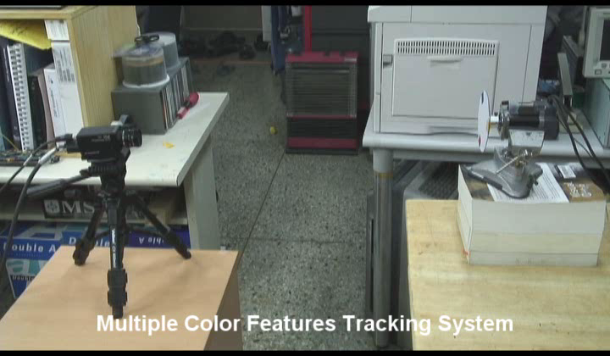
Visual Tracking Using Color Histograms
Multiple Objects Tracking

Slide 30
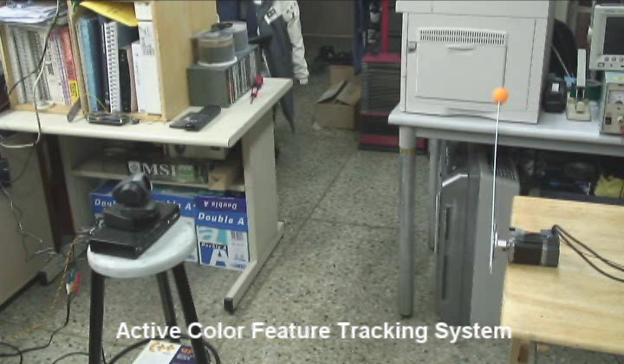
Visual Tracking Using Color Histograms
Active Visual Tracking

Slide 31
V
Motion-Vision Integration Systems

Slide 32
Motion-Vision Integration
Motion
4-axis motion control
Velocity profile generation
Vision
Morphology
Blob analysis
Motion-Vision High Speed Communication
Embedded System OS
Windows CE
Embedded Linux

Slide 33
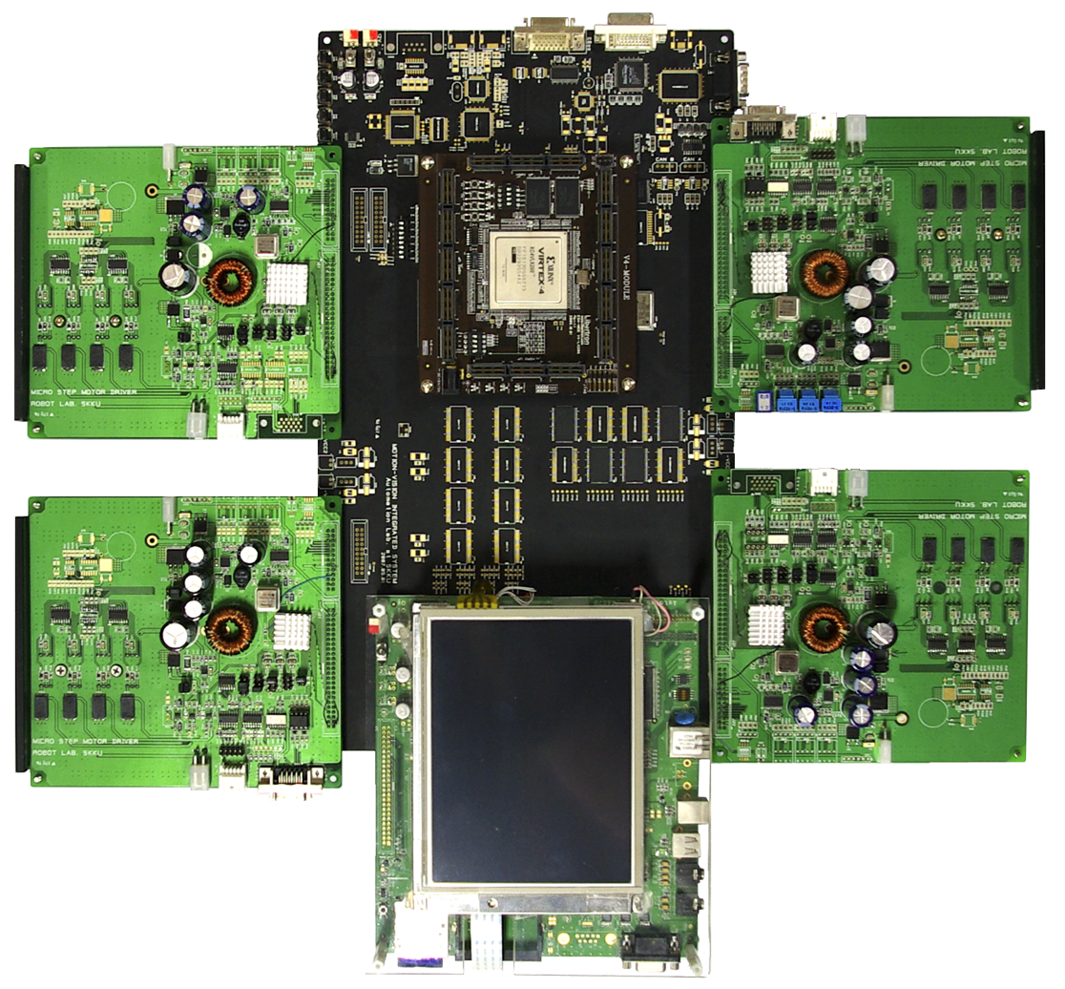
Motion-Vision Integration
Implement in XILINX XC4VLX200 FPGA (about 16M gates, 1,513 I/O pins)
Interface Camera Link CCD Camera (640x480 pixels, 60 fps)
PXA 270 Microprocessor
Interface with ARM based Embedded System
102 fps @ 640x480 pixels
Device Utilization Summary
Number of Slices: Number of Slice Flip Flops: Number of 4 input LUTs: Number of bonded IOBs: Number of GCLKs: Number used as RAMB16s: Number of DSP48s: | 43,361 out of 89,088 48% 42,655 out of 178,1176 23% 63,342 out of 178,1176 35% 470 out of 960 48% 16 out of 32 50% 34 out of 336 10% 84 out of 96 87%
Notes:
4 axis motor controllers on the sides

Slide 34
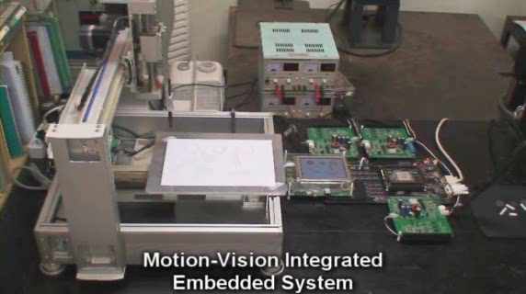
Motion-Vision Integration
Notes:
BLOB = Binary Large Object
converts to white/black (0/1) – background is 0, object is 1
opening – erosion, then dilation
closing – dilation, then erosion

Slide 35
VI
Feature Detection

Slide 36
Feature Extraction
Definition: Methods aimed at computing abstractions of image information by making local decisions in image regions as to the presence of a “feature”
Feature:
No precise definition
An “interesting” part of the image
Often determined by the algorithm
Examples: edges, corners, blobs, ridges, …

Slide 37
Edge Detection
Aims to detecting sharp changes in image brightness.
Discontinuities in image brightness are likely to correspond to:
Discontinuities in depth
Discontinuities in surface orientation
Changes in material properties
Variations in scene illumination.

Slide 38
Edge Detection
Where is the edge here?
How do we mathematically describe the presence of an edge?
What happens if the “edge” is not so pronounced?
20
35
23

Slide 39
Canny Edge Detector
Developed by John F. Canny in 1986
Uses a multi-stage algorithm
Noise reduction
Find intensity gradient
Non-maximum suppression
Tracing edges through the image and hysteresis thresholding
Differential geometric formulation of the Canny edge detector
Still one of the best detectors

Slide 40
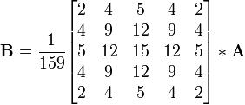
Noise Reduction
Edge detectors often susceptible to noise. Can remove by blurring the image.
Gaussian blurring
For each pixel, consider the window around the pixel (e.g. 5 x 5) .
By performing some sort of “averaging” over the neighborhood pixels, you can remove noise
5 x 5 Gaussian blurring filter

Slide 41
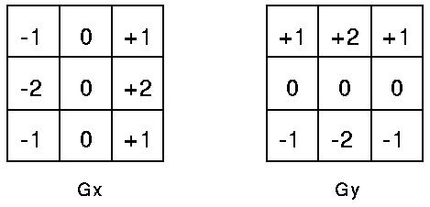


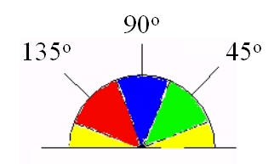
Gradient Intensity
We need to calculate a measure of the gradient. This can be done using Sobel operator (among others)
We sum a constant mask over a window around each pixel
Calculate the “edge strength” of a pixel as:
Calculate the “edge angle” as:
Round edge angle into a discrete angle:

Slide 42
Non-Maximum Suppression
Perform a local search to find the exact location of the edge in the neighborhood i.e. “thin” the edges
if the rounded angle is:
0° the point is on the edge if its intensity is greater than the intensities in the north and south directions,
if the rounded angle is 90°, … west and east
if the rounded angle is 135°, … north east and south west
if the rounded angle is 45°, … north west and south east directions.
This is worked out by passing a 3x3 grid over the intensity map.

Slide 43
Tracing Edges Through Hysteresis Thresholding
Intuition: Pixels with large gradients almost certainly an edge. Edges will form connected lines.
Algorithm Sketch
Define a range [T_{low}, T_{high}]
Any value over T_{high} is certainly an edge
Scan image looking for edge over the T_{high}
Trace that edge until a point is reached that is below T_{low}.
Removes any “unconnected” edges

Slide 44
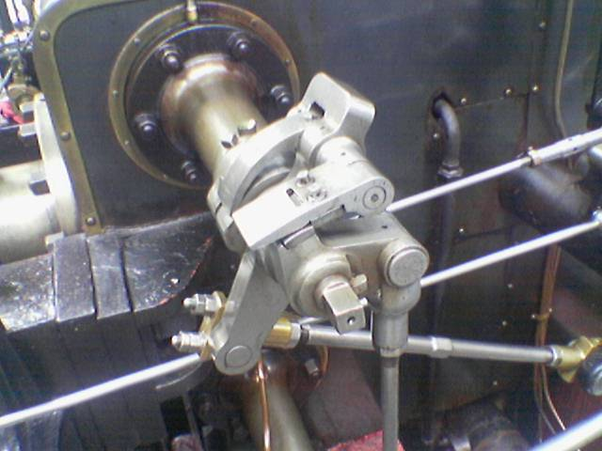
Canny Edge Detection

Slide 45
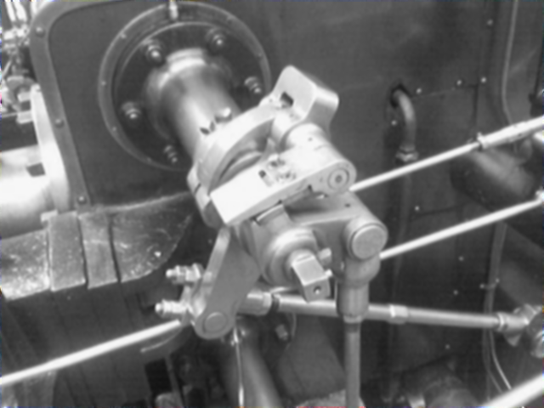
Canny Edge Detection - Blurred
5 x 5 Gaussian filter

Slide 46
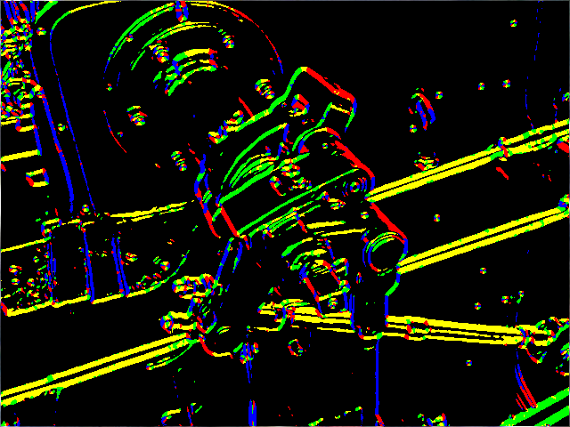
Canny Edge Detection - Sobel
Sobel threshold of 80. The edges are coloured to indicate the edge direction: 0°, 45°, 90°, 135°

Slide 47
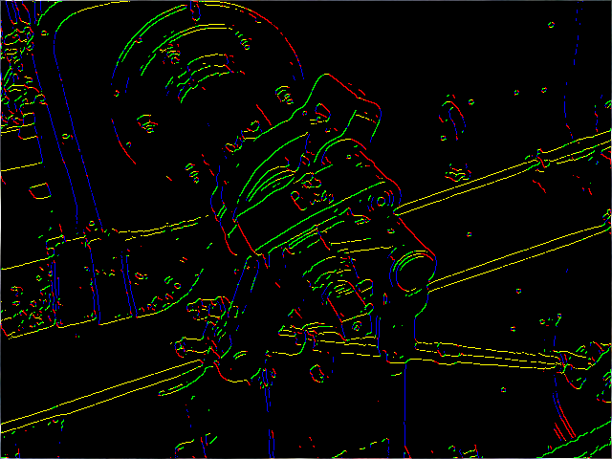
Canny Edge Detection - Suppression

Slide 48
VII
Face Detection Using Haar Classifiers

Slide 49
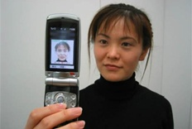
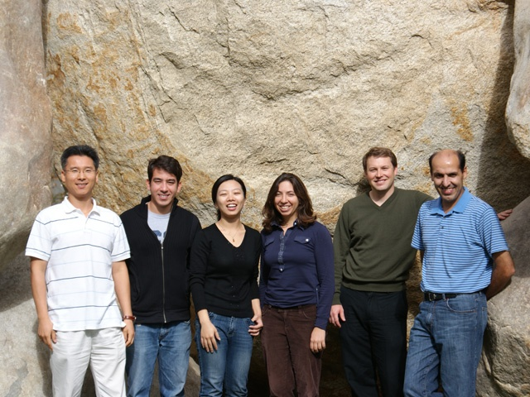
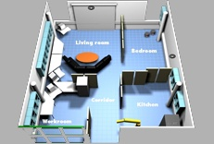
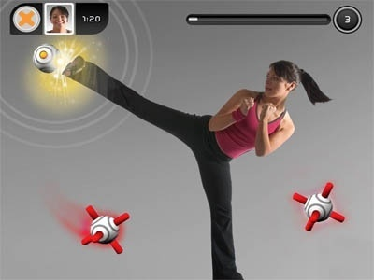
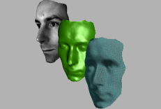
Face Detection using Haar Classifires
Face detection
Monitoring and surveillance, human computer interface, smart rooms, robotics, biomedical image analysis.

Slide 50




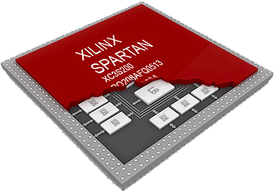
Introduction
Image processing system
Big size, high power consumption, expensive cost
Complex and considerable computation power

Slide 51
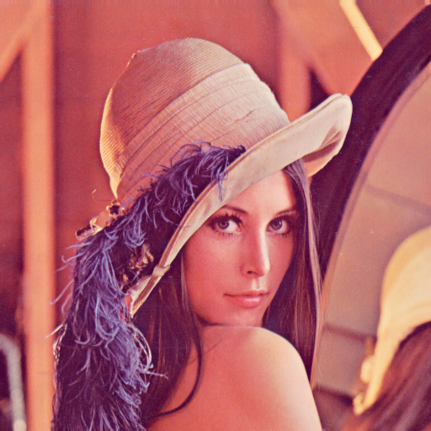
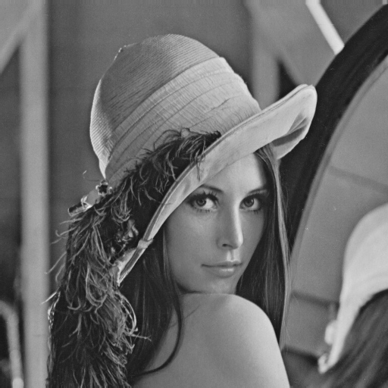
Algorithm
Viola & Jones face detection
Integral image
L1
L2
R =
– L2
– L3
+ L1
L4
R
II(x,y) = ∑I(x',y') when x'≤x, y'≤y
R
L3
L4
II(x,y)
1 | 1 | 1
1 | 1 | 1
1 | 1 | 1
1 | 2 | 3
2 | 4 | 6
3 | 6 | 9
Image
Integral
Image

Slide 52
Algorithm
Haar feature
Classifier
(3,7)
14
-1
(3,9)
4
2
1
2
14
( x y width height weight )
( 3 7 14 4 -1 )
( 3 9 14 2 2 )
( threshold left right )
( 4.01419 0.03379 0.83781 )
Area = R₁ × weight₁ + R₂ × weight₂
if Area < threshold then Result = left else Result = right

Slide 53
Algorithm
Cascade
Stage # | # of Classifier | Stage # | # of Classifier | Stage # | # of Classifier
0 | 3 | 8 | 56 | 16 | 140
1 | 16 | 9 | 71 | 17 | 160
2 | 21 | 10 | 80 | 18 | 177
3 | 39 | 11 | 103 | 19 | 182
4 | 33 | 12 | 111 | 20 | 211
5 | 44 | 13 | 102 | 21 | 213
6 | 50 | 14 | 135 | Total | 2135
7 | 51 | 15 | 137
…
…
…
2135
( 21th StageThreshold = 105.67110)
( 2nd StageThreshold = 6.95660)
( 1st StageThreshold = 0.82268)
if Sum(Results) ≥ StageThreshold then Pass else Fail
Stage 0
Stage 1
Stage 21
Pass
Pass
…
Face
3 features
16 features
21 features
39 features
33 features
44 features
…
213 features
Fail
Fail
Fail
Candidate

Slide 54
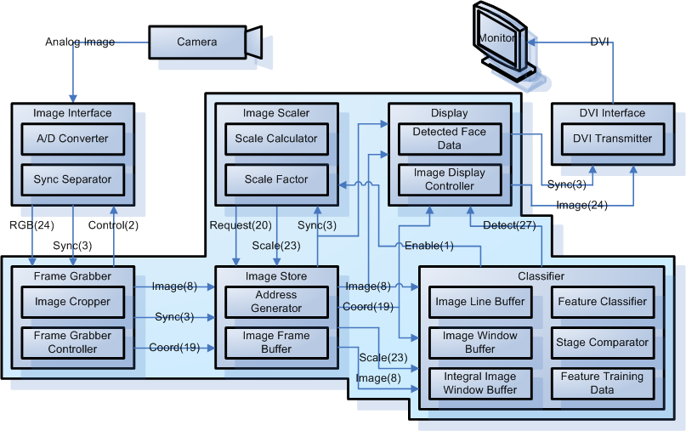
Architecture
Face detection system

Slide 55
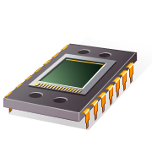
Architecture
Scaling window mask with fixed images
Down-sampling image with fixed window mask

Slide 56
Architecture
Integral image calculation of whole image
Integral image calculation of window mask
∑
∑
∑
∑
∑
∑
∑

Slide 57

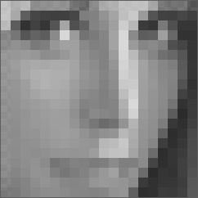

Architecture
Integral image calculation
Down-sampling image
Magnification
Window mask

Slide 58









Architecture
Integral image calculation
width
n-1
Image Line Buffer
n
2n
n
n
Integral Image Window Buffer
Image Window Buffer

Slide 59






Architecture
Integral image calculation
width
n-1
n
Image Line Buffer
2n
+- | +- | +- | +- | +-
+- | +- | +- | +- | +-
+- | +- | +- | +- | +-
+- | +- | +- | +- | +-
+- | +- | +- | +- | +-
+
n
n
+
+
+
Integral Image Window Buffer
Image Window Buffer

Slide 60
Architecture
Classifier
II_{a}¹
II_{d}¹
II_{b}¹
II_{c}¹
w¹
II_{a}²
II_{d}²
II_{b}²
II_{c}²
w²
II_{a}³
II_{d}³
II_{b}³
II_{c}³
w³
+
+
+
+
+
+
a
width
b
(x,y)
weight
height
-
-
-
c
d
x
x
x
x
width
y
height
weight
+
+
+
stage
threshold
a_{x}
b_{x}
a_{y}
c_{y}
w
+
b_{y} = a_{y}, c_{x} = a_{x}, d_{x} = b_{x}, d_{y} = c_{y}
threshold
>
>
fail
left
MUX
pass
∑
right

Slide 61
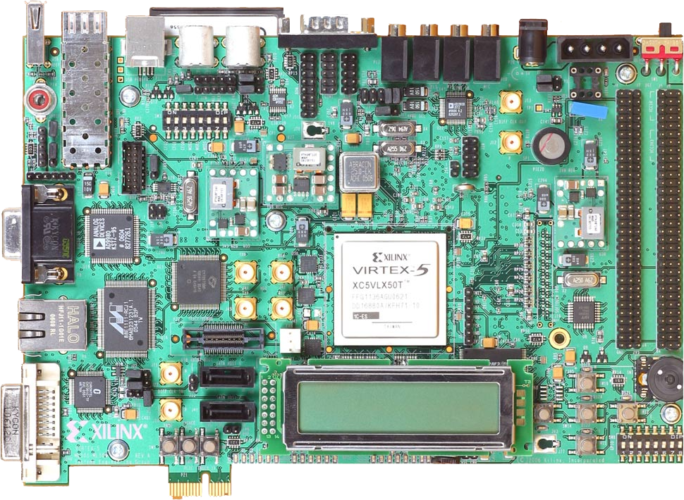
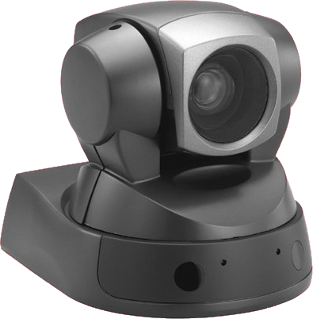
Result
FPGA implementation
Core 2 Extreme CPU (2.8 GHz), 2.98 GB DDR2 SDRAM (800 MHz),
Windows XP Professional, Visual C++
Type of Classifier |  | Slice Registers | Slice LUTs | BRAMs | DSP48Es
QVGA | Single Classifier | 19,066 | 64,143 | 41 | 7
 | Triple Classifier | 21,163 | 79,537 | 41 | 7
VGA | Single Classifier | 19,556 | 66,851 | 97 | 7
 | Triple Classifier | 21,902 | 84,232 | 97 | 7

Slide 62
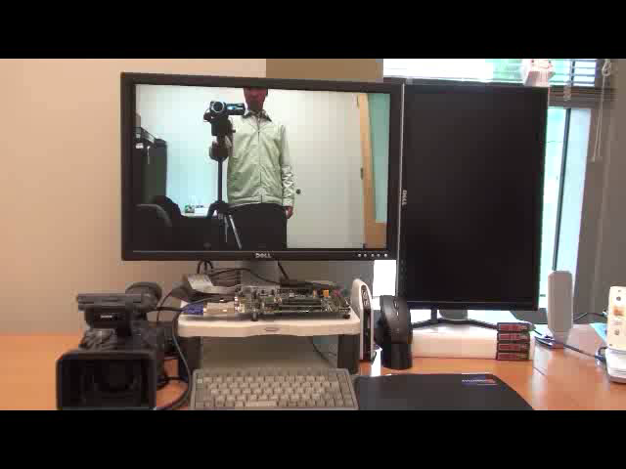
Demo
Face detection demo

Slide 63
III
Human Detection

Slide 64
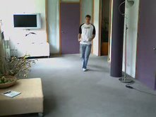
Human Detection
Problem: Determine the existence of people in an image
How many soldiers? Where?
What are they doing? E.g. posture, running, walking, etc.

Slide 65
Human Detection
Parts-based human detection algorithm:
Scale image to a fixed size
Down-sampling or Up-sampling

Slide 66
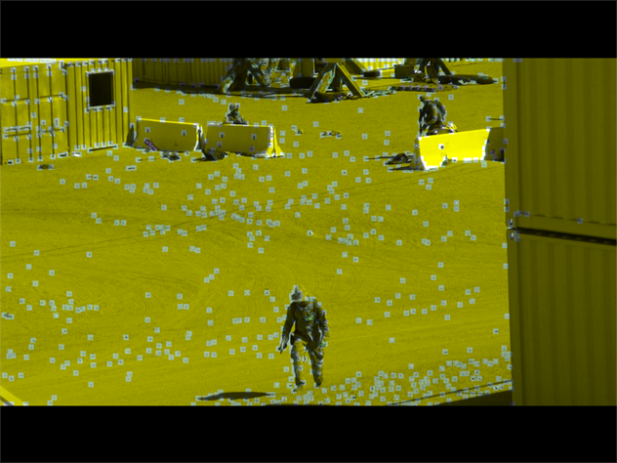
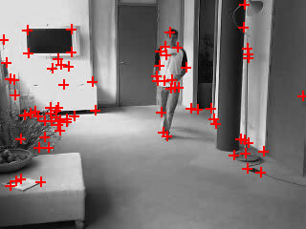
Human Detection
Parts-based human detection algorithm:
Scale image to a fixed size
Perform Harris corner detection
Find interest points by corner detector

Slide 67
Harris Corner Detection Overview
Basic idea: Find points where two edges meet - High gradient in two directions
Look at the gradient behavior over a small window
Categories image windows based on gradient statistics
Flat: Little or no brightness change
Edge: Strong brightness change in single direction
Corner: Strong brightness changes in orthogonal directions

Slide 68
Categories
“flat” region: no change in all directions
“edge”: no change along the edge direction
“corner”: significant change in all directions

Slide 69
Harris Corner Detection
“Edge”
“Corner”
R is large for a corner
R is negative with large magnitude for an edge
|R| is small for a flat region
R < 0
R > 0
“Flat”
“Edge”
|R| small
R < 0
λ₁

Slide 70
Harris Corner Detection
Compute x and y derivatives of image

Slide 71
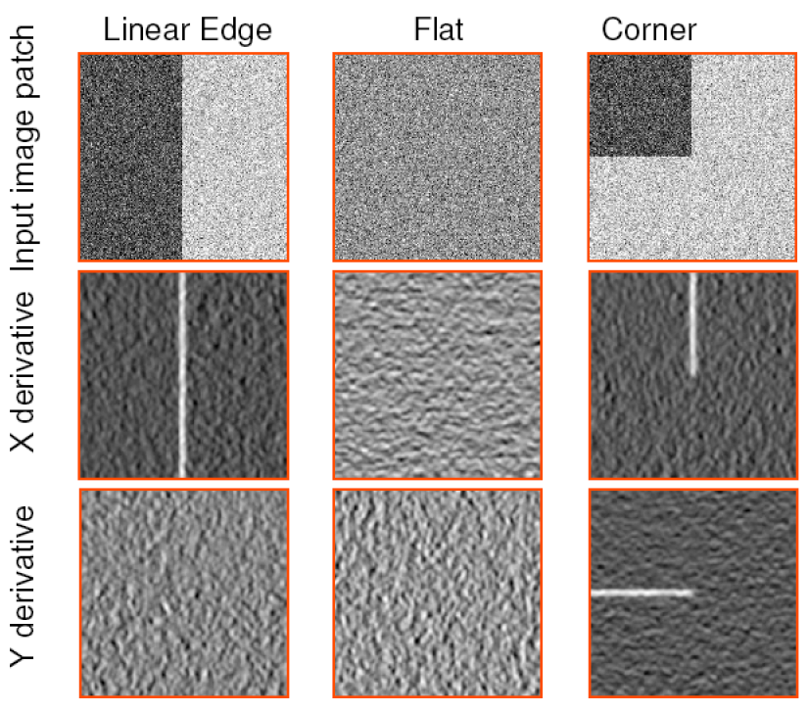
Harris Corner Detection

Slide 72
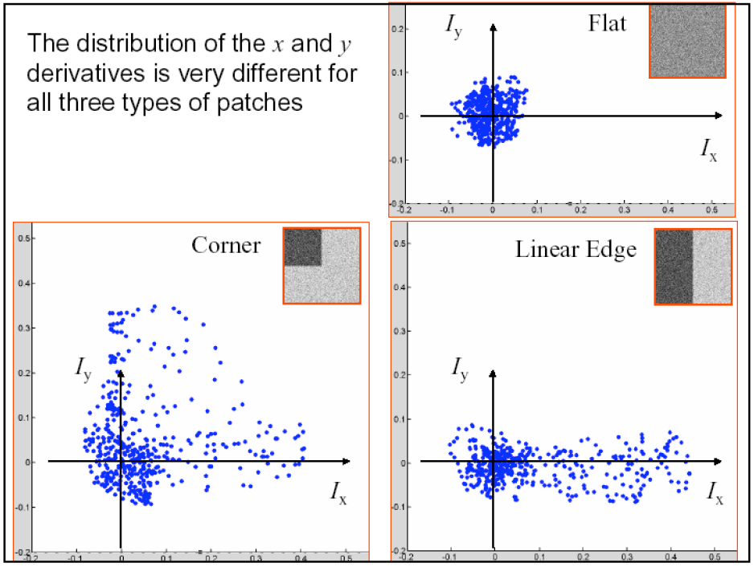
Harris Corner Detection

Slide 73
Harris Corner Detection
Compute x and y derivatives of image
Compute products of derivatives at every pixel

Slide 74
Harris Corner Detection
Compute x and y derivatives of image
Compute products of derivatives at every pixel
Compute the sums of the products of derivatives at every pixel

Slide 75
Harris Corner Detection
Compute x and y derivatives of image
Compute products of derivatives at every pixel
Compute the sums of the products of derivatives at every pixel
Compute the response of the detector at each pixel
Notes:
what does this mean? What are typical values for k? 0.004 – 0.016

Slide 76
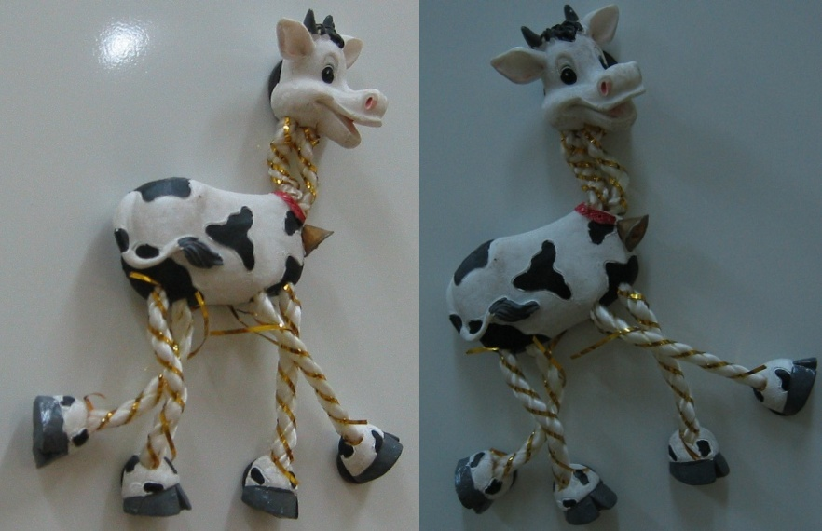
Source Images

Slide 77
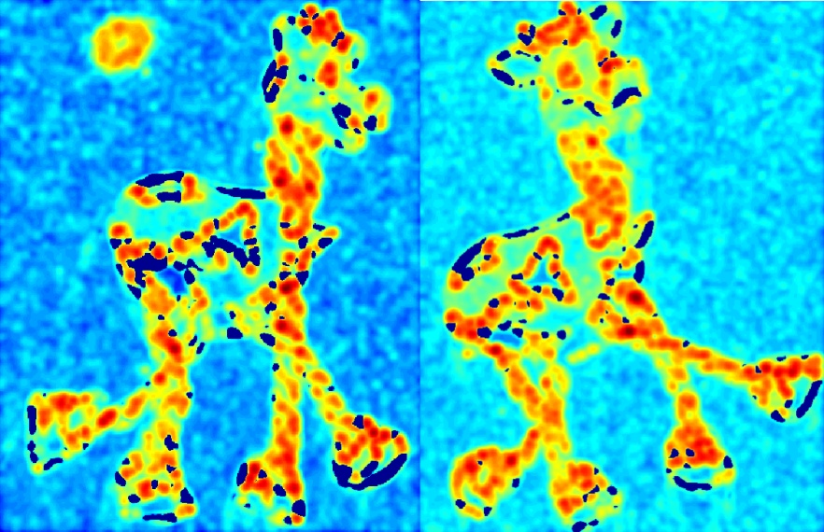
Corner Response Function

Slide 78
Harris Corner Detection
Compute x and y derivatives of image
Compute products of derivatives at every pixel
Compute the sums of the products of derivatives at every pixel
Compute the response of the detector at each pixel
Threshold on value of CRF, set the pixel as corner or non-corner
Notes:
Threshold 400-10,000

Slide 79
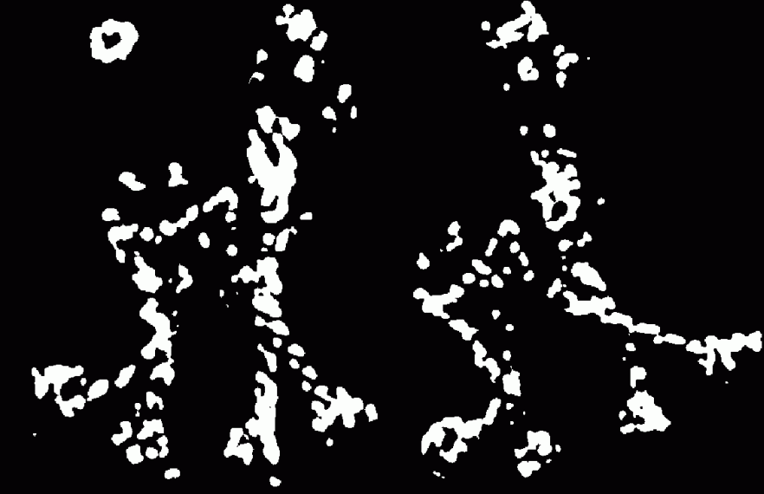
Threshold on CRF

Slide 80
Harris Corner Detection
Compute x and y derivatives of image
Compute products of derivatives at every pixel
Compute the sums of the products of derivatives at every pixel
Compute the response of the detector at each pixel
Threshold on value of CRF, set the pixel as corner or non-corner
Find local maximum on value of CRF

Slide 81
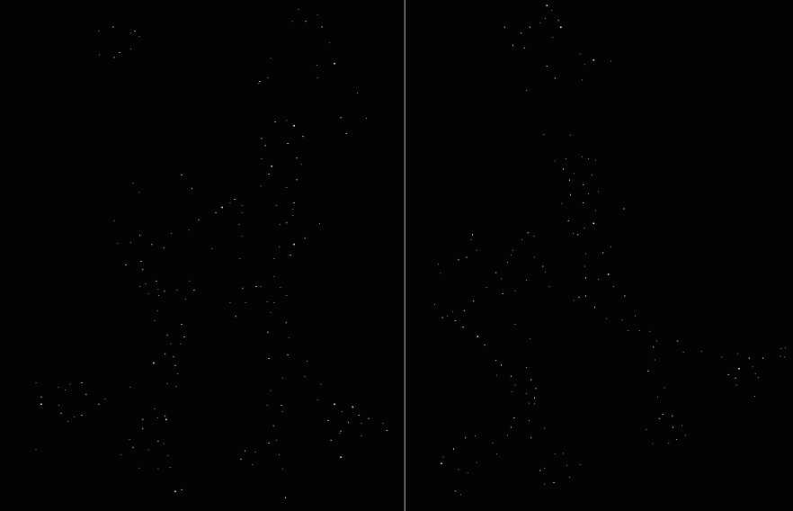
Local Maximum on CRF

Slide 82

Harris Corner Detection Results

Slide 83
System Block Diagram

Slide 84
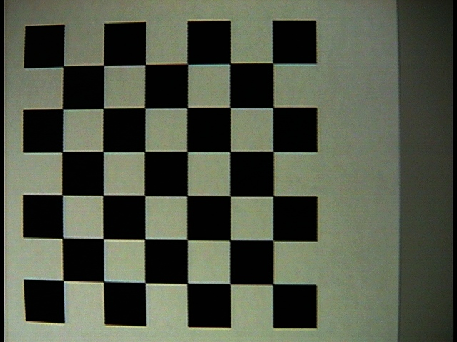
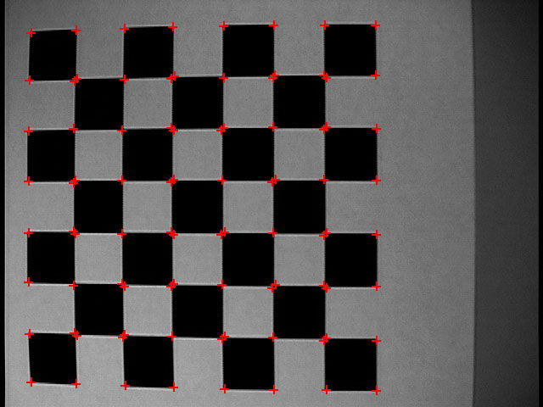
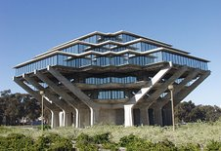
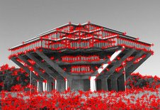
Experimental Results

Slide 85


Experimental Results

Slide 86

Human Detection
Parts-based human detection algorithm:
Scale image to a fixed size
Perform Harris corner detection
Extract a patch around each corner point

Slide 87
Human Detection
Scale image to a fixed size
Perform Harris corner detection
Extract a patch around each corner point
Perform NGCC(Normalized Grayscale Cross-Correlation) with patch and codeword

Slide 88
Example Code Words

Slide 89
Human Detection
Scale image to a fixed size
Perform Harris corner detection
Extract a patch around each corner point
Perform NGCC(Normalized Grayscale Cross-Correlation) with patch and codeword
If NGCC>threshold, obtain vote offsets of codeword, accumulate votes into voting space

Slide 90

Human Detection

Slide 91
Human Detection

Slide 92
Human Detection
Scale image to a fixed size
Perform Harris corner detection
Extract a patch around each corner point
Perform NGCC(Normalized Grayscale Cross-Correlation) with patch and codeword
If NGCC>threshold, obtain vote offsets of codeword, accumulate votes into voting space
Obtain most votes for the object center of marines

Slide 93


Voting Space

Slide 94
Human Detection

Slide 95
Architecture

Slide 96
III
Object Tracking Using Particle Filters

Slide 97
Object Tracking Using Particle Filter
Object Tracking
Robotics, monitoring and surveillance, perceptual user interfaces, smart rooms, vehicle tracking, biomedical image analysis, human-computer interface, video compression, etc.
Numerous Approaches
Lucas-Kanade tracker
Mean shift
Kalman filter, extended Kalman filter
Gaussian sum filter
Sequential Monte Carlo, particle filter, bootstrap filter, condensation, interacting particle filter approximation, survival of the fittest

Slide 98
Object Tracking Using Particle Filter
Object Tracking - Particle Filter
Posterior density is approximated a set of particles with associated weights
Expensive computation
Multiple Objects Tracking – Priority-based Probabilistic Data Association
Problems of single object tracking + multiple objects tracking
Multiple hypotheses tracking + probabilistic data association
Object Tracking with Active Camera – Background Compensation
Motions of moving object + active camera
Motion decomposition to extract motion of active camera from mixed motions

Slide 99
Object Tracking Using Particle Filter
Particle Filter
Particle Resampling
Diffusion
Output
Drift
Particle Resampling
Sampling
Output
Particle Resampling
Observed
Feature Z_{t}
Moving
Diffusion
Particle Resampling
Drift
Output
Observed
Feature Z_{t-1}
Sampling
Particle Resampling
Particle Filter with Point Cloud
(Size N=5)

Slide 100
Object Tracking Using Particle Filter
Initialization
Draw a set particles uniformly
Sampling
Sample the positions of the particle from the proposal distribution
Find the feature of the moving object (Inter-Frame Difference)
Update the weight of the particles
Normalize the weight of the particles
Output
Output the mean position of the particles that can be used to approximate the posterior distribution
Resampling
Resample the particles with probability to obtain independent and identically distributed random particles
Initialize Particles
Sampling
1
2
N-1
N
Moving Object?
N
Search Again
N
Y
Y
1
2
N-1
N
Update Weights
Normalize Weights
Output Estimates
Resampling

Slide 101
Object Tracking Using Particle Filter
Particle Initiator (Initialization)
Particle Filter
Initialization
Lookup Table
Particle Selector (Resampling)
Random Distribution
Lookup Table
Cumulative
Lookup Table
Particle Sampler (Sampling)
Particle Coordinates
Lookup Table
Distributor
Data Output (Output)
Particle Printer
Gaussian Distribution
Lookup Table
Arithmetic Operator
Tracker Printer
Coordinates Calculator
Coordinates Comparator (Update Weights)
Particle Coordinates
Lookup Table
Particle Coordinates
Lookup Table
Particle Weight
Lookup Table
Coordinates Comparator 1
Particle Normalizer (Normalize Weights)
Coordinates Comparator 2
Particle Weight
Lookup Table
Cumulative
Lookup Table
Coordinates Comparator 8
Accumulator

Slide 102
Multiple Object Tracking Using Particle Filter
Particle Filter
Priority-Based Probabilistic Data Association
Particle Set #1
Particle Set #3
Potential Field 1
Particle Set #2
Potential Field 3
Potential Field 2
Priority PS#1>PS#2>PS#3

Slide 103
Object Tracking Using Particle Filter
Particle Filter
Priority-Based Probabilistic Data Association
Background Compensation
D(dx,dy)
Displacement:
dx>0, dy<0

Slide 104
Object Tracking Using Particle Filter
Projection Profile Initiator / Transferor
Displacement Calculator
Background
Compensation
Horizontal
Histogram
Initiator
Vertical
Histogram
Initiator
Coordinates Calculator
Horizontal Displacement
Calculator
Vertical
Displacement
Calculator
Horizontal
Histogram
Transferor
Vertical
Histogram
Transferor
Horizontal Optimal Displacement
Vertical Optimal Displacement
Horizontal Projection Profile
Lookup Table
Vertical
Projection Profile
Lookup Table
Pre-horizontal Projection Profile
Lookup Table
Pre-vertical
Projection Profile
Lookup Table
Projection Profile Comparator
Comparator 1
Comparator 2
Accumulator 1
Accumulator 2
Projection Profile Generator
Coordinates Calculator
Subtractor 1
Subtractor 2
Horizontal
Histogram
Generator
Vertical
Histogram
Generator
Horizontal
Translator
Vertical
Translator
Horizontal
Histogram
Accumulator
Vertical
Histogram
Accumulator
Horizontal Projection Profile
Lookup Table
Vertical
Projection Profile
Lookup Table
Horizontal Projection Profile
Lookup Table
Vertical
Projection Profile
Lookup Table
Pre-horizontal Projection Profile
Lookup Table
Pre-vertical
Projection Profile
Lookup Table

Slide 105
Object Tracking Using Particle Filter
Single Object Tracking
Camera
Particle Filter
Output
Tracking Image
Comparator
Controller
Calculator
Trajectory Data
A/D Converter
Lookup Table
Sync
Separator
Camera Controller
Noiseless IFD
Clock
Tracking Image
Raw Pixels
Sync
Reset
Comparator
Frame Store t
IFD
Frame Store t-∆
Subtractor
Image Store Memory
Stored Pixels
Image Subtractor

Slide 106
Object Tracking Using Particle Filter
Camera
Multiple Objects Tracking
Tracking Image
Trajectory Data
Clock
Reset
Observation Associater
Particle Set Position
Controller
Multiple Output
Particle Filter
Particle Filter
Particle Filter
A/D
Converter
Output
Output
Output
Priority
Distributor
Sync
Separator
Resampler
Resampler
Resampler
Position Analyzer
Camera Controller
Sync
Comparator
Comparator
Comparator
Raw Pixels
Priority
Particle Set Position
Calculator
Calculator
Calculator
Frame Store t
Noise Reduction
Filter
Stored Pixels
Generator
Generator
Generator
Frame Store t-∆
Priority-based
Subtractor
Image Store Memory
Image Subtractor
IFD

Slide 107
Object Tracking Using Particle Filter
Clock Reset
Tracking Image
Active Visual Tracking
Camera
Motion Command
Camera Motion
Controller
Analog Image
Background Compensator
Serial
Communication
Projection Profile
Generator
Raw Pixel
Motion Controller
A/D
Converter
Projection Profile
Comparator
Trajectory
Sync
Separator
Particle Filter
Displacement
Calculator
Camera Image
Controller
Output
Raw Pixel
Sync
Displacement
Resampler
Frame Store t
Noise Reduction
Filter
Comparator
Frame Store t-∆
Subtractor
IFD
Calculator
Frame Store t-2∆
Stored Pixel
Image Translator
Generator
Image Store Memory
Image Subtractor

Slide 108

Object Tracking Using Particle Filter
Implement in XILINX XC2V8000 FPGA (about 8M gates, 1,104 I/O pins)
Interface RS-170 CCD Camera (640x480 pixels, 60 fps)
Display Raw and Tracking Images and Trajectory Data to LCD Monitor
Single Object Tracking
Multiple Objects Tracking
Active Visual Tracking
56.52 fps @ 640x480 pixels
56.38 fps @ 640x480 pixels
39.77 fps @ 640x480 pixels
Device Utilization Summary
Number of Slices: Number of Slice Flip Flops: Number of 4 input LUTs: Number of bonded IOBs: Number of MULT18X18s: Number of GCLKs | 7,611 out of 33,792 22% 6,278 out of 67,584 9% 8,798 out of 67,584 13% 121 out of 824 14% 1 out of 144 1% 4 out of 16 25%
Device Utilization Summary
Number of Slices: Number of Slice Flip Flops: Number of 4 input LUTs: Number of bonded IOBs: Number of MULT18X18s: Number of GCLKs | 22,497 out of 33,792 66% 18,691 out of 67,584 27% 25,640 out of 67,584 37% 121 out of 824 14% 3 out of 144 2% 4 out of 16 25%
Device Utilization Summary
Number of Slices: Number of Slice Flip Flops: Number of 4 input LUTs: Number of bonded IOBs: Number of MULT18X18s: Number of GCLKs | 34,468 out of 46,592 73% 25,182 out of 93,184 27% 40,401 out of 93,184 43% 140 out of 824 16% 1 out of 168 1% 6 out of 16 37%

Slide 109

Object Tracking Using Particle Filter
Multiple Object Tracking

Slide 110

Object Tracking Using Particle Filter
Active Visual Tracking

Slide 111
Conclusion
Conclusion
Real-time face detection system on FPGA
Architecture for face detection using Haar classifiers
Down-sampling image with fixed window mask
Integral image window buffer
Single classifier and triple parallel classifier
35 times increase of system performance over equivalent software implementation
Feature works
More multiple parallel classifier
Various object detection – fish, pedestrian, letter

