Slide 1
Overview of Embedded Computing Systems
CSE 237D: Spring 2009
Topic #1
Prof. Ryan Kastner

Slide 2
What is an Embedded Computing System?
What is an embedded system?
What are some examples of embedded systems?

Slide 3
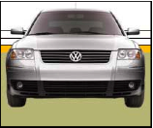
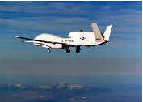

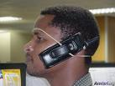
Characteristics of Embedded Systems
Computational – but not first-and-foremost a computer
Integral with physical processes – sensors, actuators
Reactive – at the speed of the environment
Heterogeneous – hardware/software, mixed architectures architectures
Networked – shared adaptive
Source: Edward Lee®

Slide 4
More Characteristics of Embedded Systems
Part of a larger system
not a “computer with keyboard, display, etc.”
HW & SW do application-specific function – not general purpose
Application is known a priori
but definition and development concurrent
Some degree of re-programmability is essential
flexibility in upgrading, bug fixing, product differentiation, product customization
Interact (sense, manipulate, communicate) with the external world
Never terminate (ideally) – fundamentally different from TM
Operation is time constrained: latency, throughput
Other constraints: power, size, weight, heat, reliability etc.
Increasingly high-performance (DSP) & networked
Source: Mani Srivastava®

Slide 5
Key Recent Trends
Increasing computation demands
e.g. multimedia processing in set-top boxes, HDTV
Increasingly networked
to eliminate host, and remotely monitor/debug
embedded Web servers
e.g. IQEye camera
e.g. Mercedes car with web server
embedded Java virtual machines
e.g. Java ring, smart cards, printers
cameras, disks etc. that sit directly on networks
Increasing need for flexibility
time-to-market under ever changing standards!
Need careful co-design of h/w & s/w!
Source: Mani Srivastava®

Slide 6
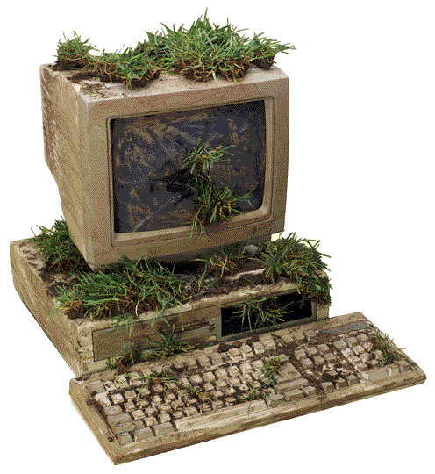
Embedded Everywhere
2001 National Research Council Report
“Information technology (IT) is on the verge of another revolution. Driven by the increasing capabilities and ever declining costs of computing and communications devices, IT is being embedded into a growing range of physical devices linked together through networks and will become ever more pervasive as the component technologies become smaller, faster, and cheaper... These networked systems of embedded computers ... have the potential to change radically the way people interact with their environment by linking together a range of devices and sensors that will allow information to be collected, shared, and processed in unprecedented ways. ...
The use of [these embedded computers] throughout society could well dwarf previous milestones in the information revolution.”

Slide 7
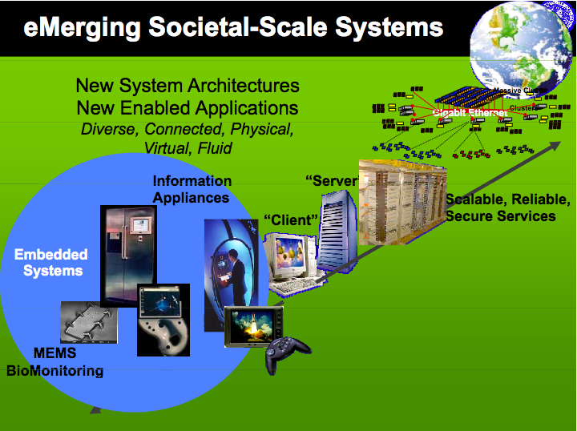
State of Computing
Computers are cheap, embedded everywhere
Transition from how to we build computers to how to we use computers

Slide 8
State of Computing
Computers are cheap, embedded everywhere
Transition from how to we build computers to how to we use computers
Source: Alberto Sangiovanni-Vincentelli®

Slide 9
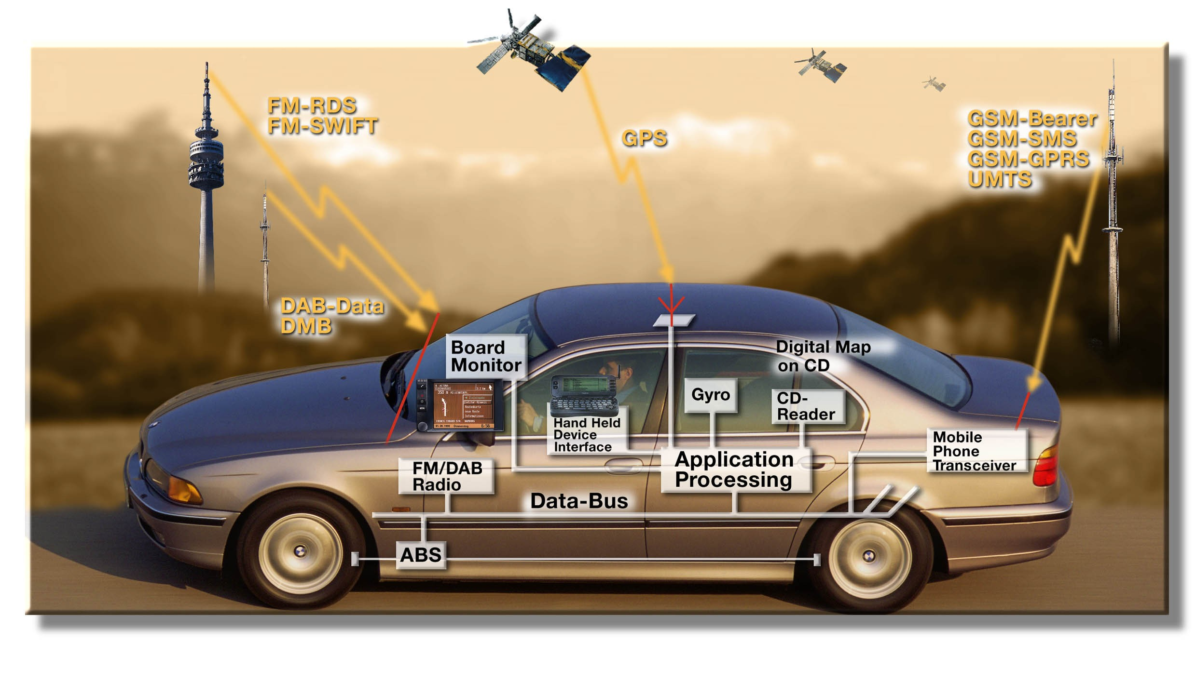
Electronics and the Car
More than 30% of the cost of a car is now in Electronics
90% of all innovations will be based on electronic systems
Source: Alberto Sangiovanni-Vincentelli®

Slide 10
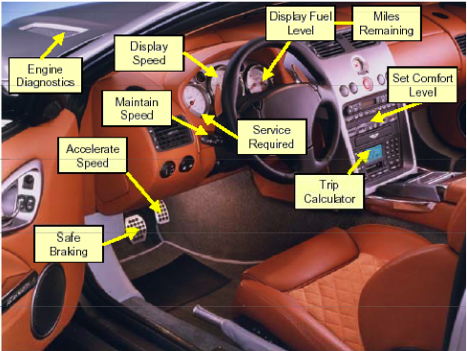
Typical Car Controls
Configure
Sense
Actuate
Regulate
Display
Trend
Diagnose
Predict
Archive
Source: Alberto Sangiovanni-Vincentelli®

Slide 11
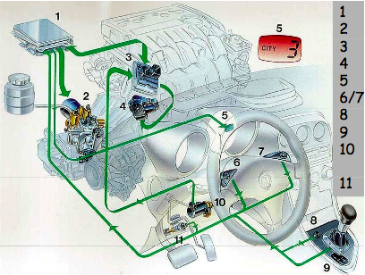
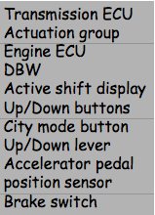
Engine Controls
Modern cars: up to ~100 processors running complex software
engine & emissions control, stability & traction control, diagnostics, gearless automatic transmission
http://www.howstuffworks.com/car-computer.htm
Source: Alberto Sangiovanni-Vincentelli®

Slide 12
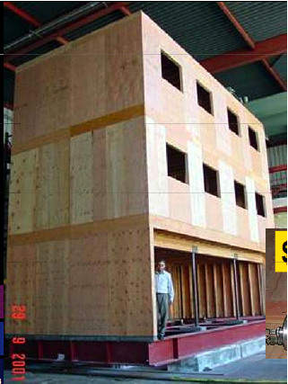
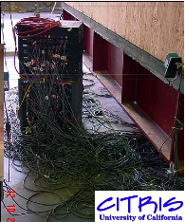
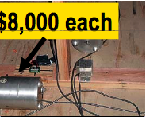
Seismic Building Monitoring
Before

Slide 13
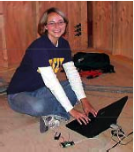
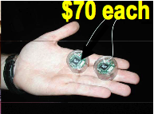
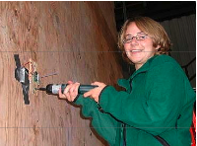
Seismic Building Monitoring
After

Slide 14
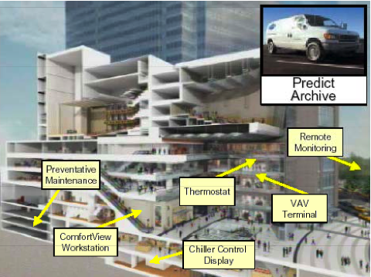
HVAC Building Monitoring
Source: Alberto Sangiovanni-Vincentelli®

Slide 15
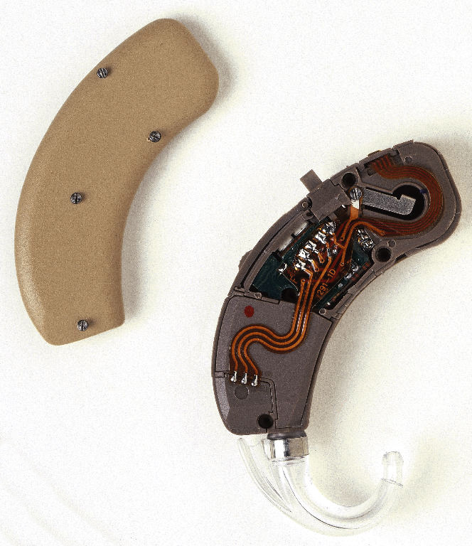
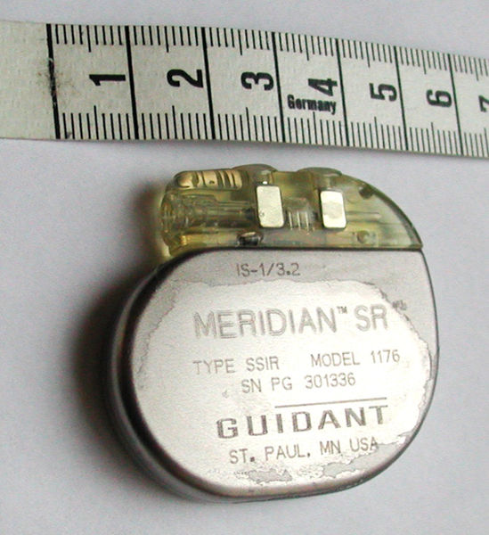
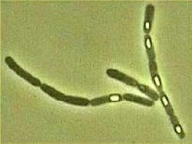
Biotechnology
Hearing Aids
Pacemakers
Systems Biology
Source: Alberto Sangiovanni-Vincentelli®

Slide 16
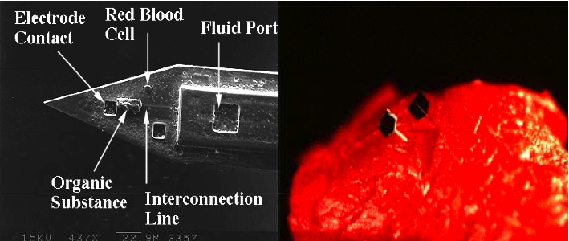
Biotechnology
Silicon-Processed Micro-needles
Source: Alberto Sangiovanni-Vincentelli®

Slide 17
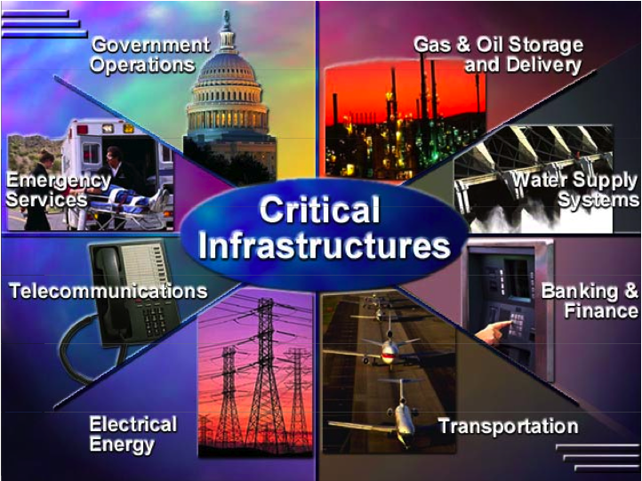
International Infrastructures

Slide 18
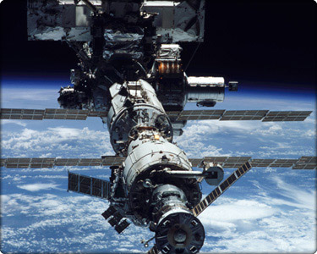
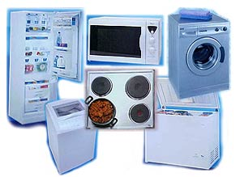
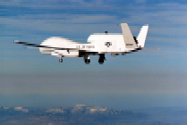
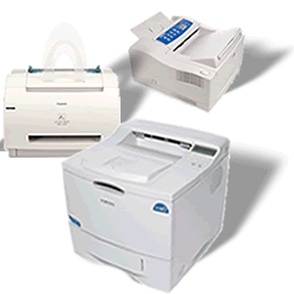

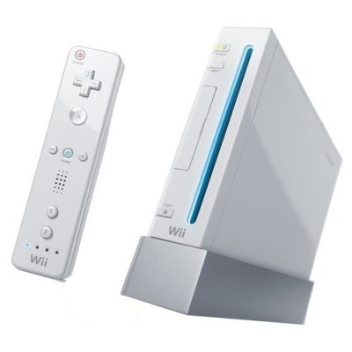
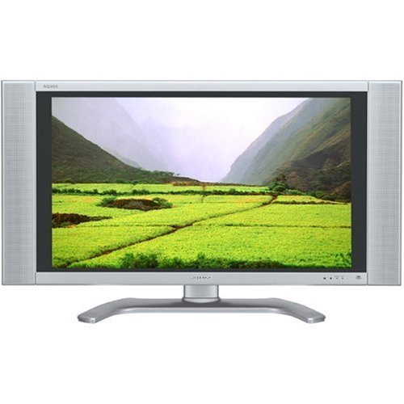
More Examples…
Avionics
Household Appliances
Home Entertainment
Office Equipment

Slide 19
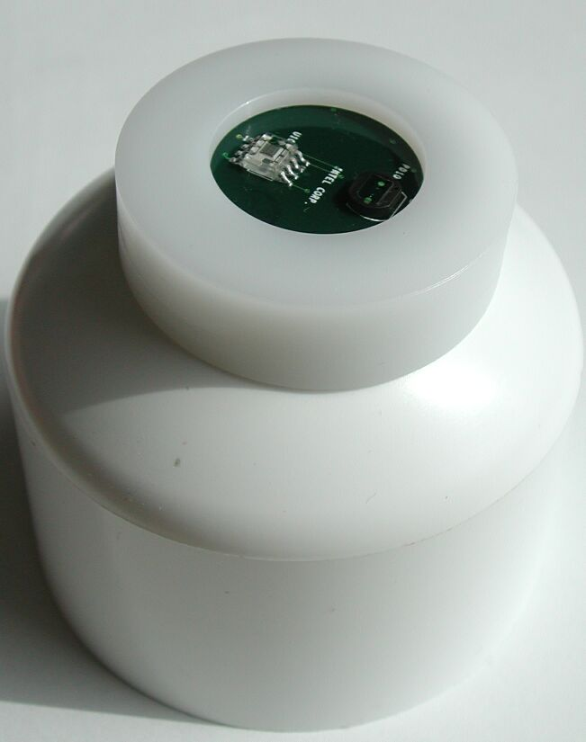
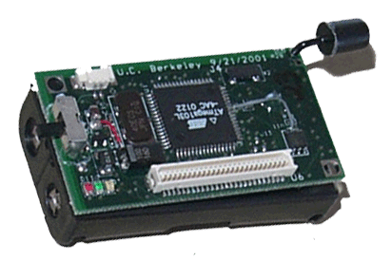
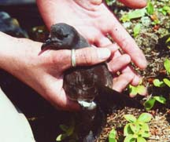
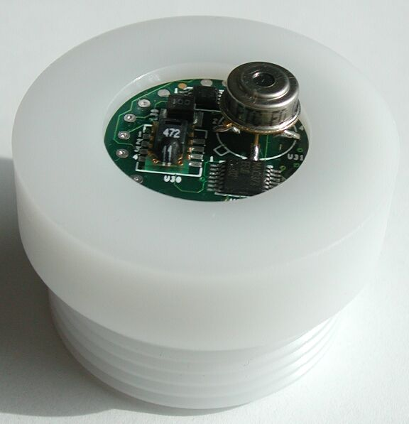
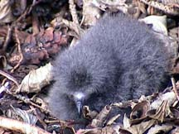
Ecological Monitoring
Great Duck Island
Petrol Monitoring:
Breeding Habits
Miniature Weather Station: Humidity, temperature, pressure solar radiation sensors
Wireless Monitoring Network
Sensor Nodes
Patch
Network
Gateway
Basestation
Internet
Burrow Occupancy Sensor: Humidity, temperation and IR sensors
Client Data Browsing
and Processing
Data Service

Slide 20
Duck Island Petrol Monitoring
Sensor Node
Patch
Network
Sensor Patch
Gateway
Transit Network
Client Data Browsing
and Processing
Basestation
Base-Remote Link
Internet
Data Service

Slide 21
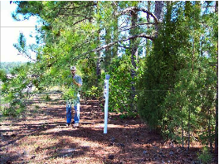
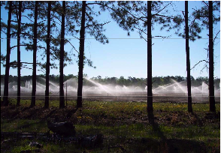
Crop Monitoring and Control
Old Method
Trust nature
Monitor local atmospheric conditions
New ways
Monitor soil temperature and moisture at various location
Adjust irrigation schedule accordingly

Slide 22
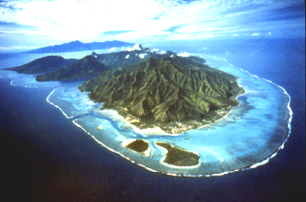
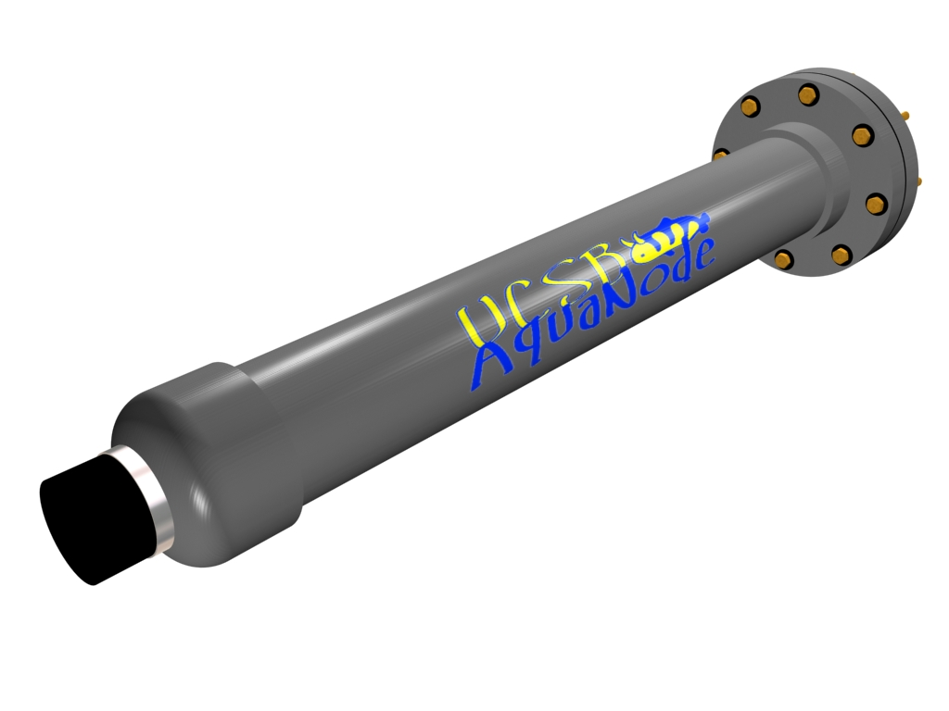
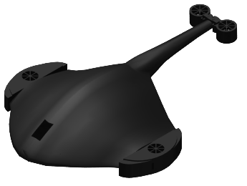
Computers Underwater

Slide 23
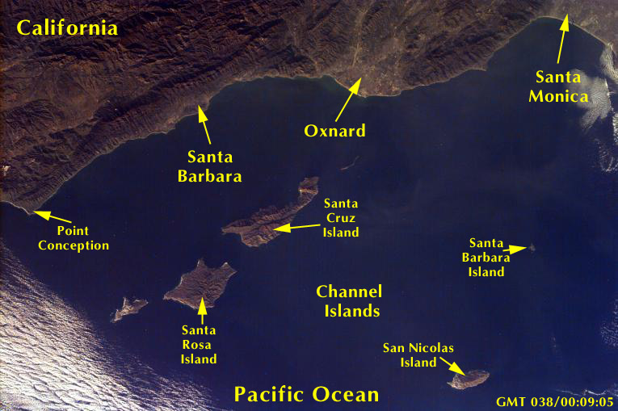
Underwater Ecological Research
Santa Barbara Channel Long Term Ecological Research (SBC LTER) Program
Moorea Long Term Ecological
Research (Moorea LTER) Program
Goals
Focuses on understanding the nearshore ecosystems of the west coast
Time/space variation of individual organisms, populations, and ecological communities
Goals
Understanding processing in coral reef, lagoons and forereef
Nature of animal and plant community structure and diversity
Responses to environmental change induced either by human activities or natural cycles

Slide 24
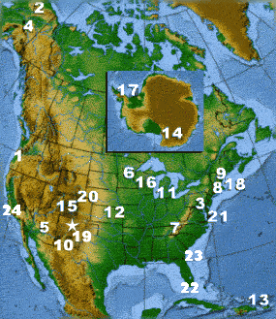
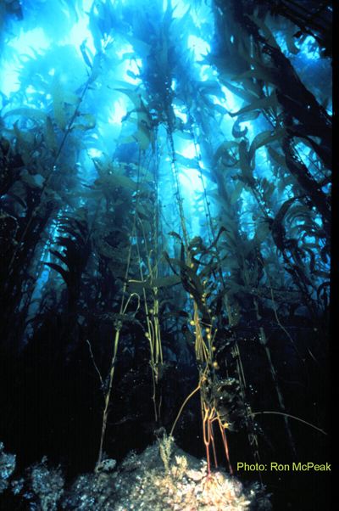
Monitoring Realities
Repetitive data collection is expensive and requires massive numbers of person hours
1/3 Santa Barbara Coastal LTER budget allocated to collection and management of monitoring data
Estimated 10,000 “Scientist” hours to conduct large scale monitoring program of tropical forest
Need for autonomous, adaptive underwater networks for eco-surveillance and adaptive sampling

Slide 25
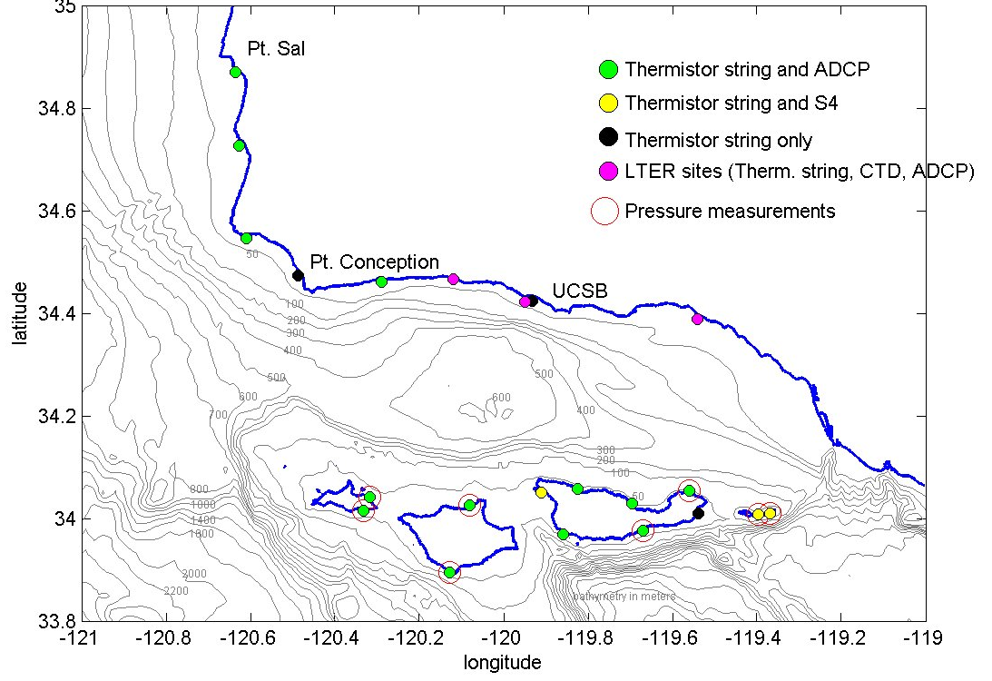
Monitoring in the Santa Barbara Channel (SBC)
Stearns Wharf

Slide 26
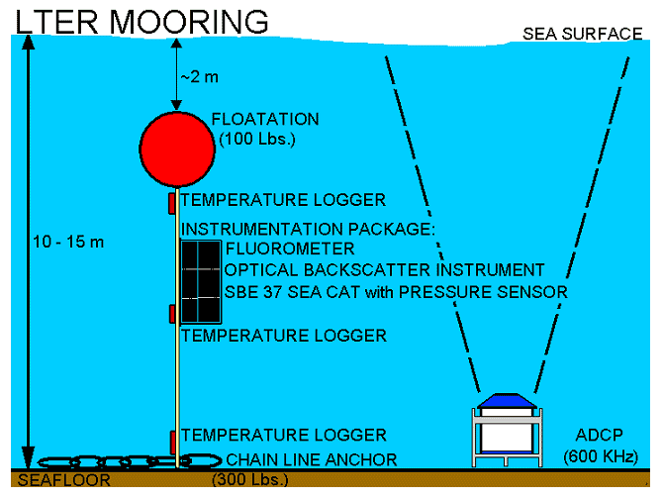
Typical Instrumentation: SBC mooring
Stearns Wharf
Notes:
The range of instrumentation deployed on the CHARM, SCCOOS, SBC-LTER and PISCO moorings will allow development of modem-instrument interface configurations for the broad range of sensors used in modern marine and aquatic ecological research. The CHARM mooring carries the most sophisticated instrument suite including spectral radiometers, a high vertical resolution thermistor string, and interdisciplinary packages with conductivity-temperature-depth (CTD), chemical and bio-optical sensors. SBC-LTER moorings carry CTD and bio-optical sensors and thermistor strings. PISCO moorings carry thermistor strings and various settlement substrates for measuring marine recruitment. Moorings in all programs have bottom-mounted, upward-looking acoustic Doppler current profilers (ADCPs) nearby. Moorings of the MCR-LTER and ARC-LTER will be similar to the SBC-LTER and PISCO moorings

Slide 27
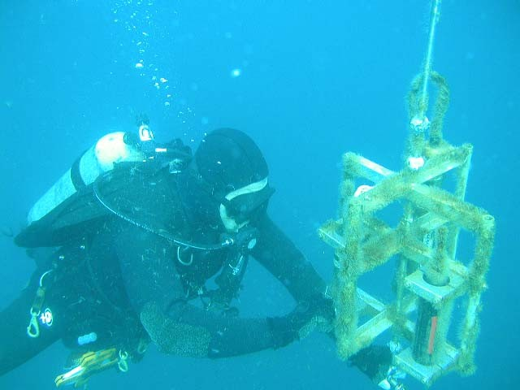
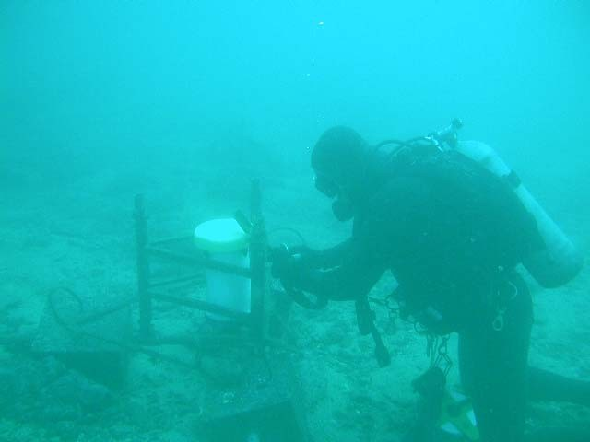
Existing SBC Moorings
Stearns Wharf

Slide 28
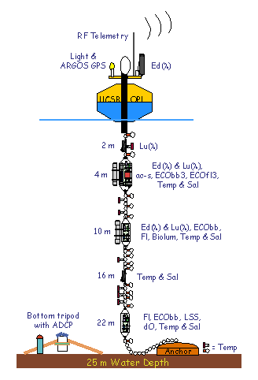
Santa Barbara Channel Moorings
CHARM
Santa Barbara CHAnnel Relocatable Mooring
Science Goals
Investigate particulate dynamics through optics
Optical and chemical detection and characterization of harmful algal blooms
Understand effects of physical processes on chemical and bio-optical properties.
Engineering Goals
Testbed for new optical and chemical sensors
Real time data telemetry to enable adaptive sampling
Notes:
Santa Barbara CHAnnel Relocatable Mooring Depth and Sensor or Sensor PackageApprox. Data Amount (per day)1 m SBE 39 Temperature Sensor40 kB2 m Hyperspectral Lu Sensor130 kB4 m Sensor Package450 kB7 m SBE 39 Temperature Sensor40 kB10 m Sensor Package325 kB19 m SBE 39 Temperature Sensor40 kB22 m Sensor Package65 kB24 m ADCP100 kB or 1 MB w/ waves (CHARM)
Schematic diagram of the CHARM. Abbreviations: GPS = global positioning system, RF = radio frequency, Ed(λ) and Lu(λ) = downwelling irradiance and upwelling radiance, ac-s = absorption-attenuation meter, ECObb(3) = backscattering sensor, ECOfl3 = spectral fluorometer; Fl = chlorophyll fluorometer; Biolum = bioluminescence sensor, Temp = temperature sensor, Sal = conductivity sensor, dO = dissolved oxygen sensor, ADCP = acoustic Doppler current profiler, DH-4 = data handler

Slide 29
CHARM
Depth and Sensor or Sensor Package | Approx. Data Amount (per day)
1 m SBE 39 Temperature Sensor | 40 kB
2 m Hyperspectral L_{u} Sensor | 130 kB
4 m Sensor Package | 450 kB
7 m SBE 39 Temperature Sensor | 40 kB
10 m Sensor Package | 325 kB
19 m SBE 39 Temperature Sensor | 40 kB
22 m Sensor Package | 65 kB
24 m ADCP | 100 kB or 1 MB w/ waves
CHARM
Buoy mounted communication system (satellite, cellular, 802.1x)
Highly variable
sampling rates
Bundled packages of chemical/optical sensors
Several Temperature sensors
Notes:
Santa Barbara CHAnnel Relocatable Mooring Depth and Sensor or Sensor PackageApprox. Data Amount (per day)1 m SBE 39 Temperature Sensor40 kB2 m Hyperspectral Lu Sensor130 kB4 m Sensor Package450 kB7 m SBE 39 Temperature Sensor40 kB10 m Sensor Package325 kB19 m SBE 39 Temperature Sensor40 kB22 m Sensor Package65 kB24 m ADCP100 kB or 1 MB w/ waves (CHARM)
Schematic diagram of the CHARM. Abbreviations: GPS = global positioning system, RF = radio frequency, Ed(λ) and Lu(λ) = downwelling irradiance and upwelling radiance, ac-s = absorption-attenuation meter, ECObb(3) = backscattering sensor, ECOfl3 = spectral fluorometer; Fl = chlorophyll fluorometer; Biolum = bioluminescence sensor, Temp = temperature sensor, Sal = conductivity sensor, dO = dissolved oxygen sensor, ADCP = acoustic Doppler current profiler, DH-4 = data handler

Slide 30
Adaptive Sampling for Moored Systems
Benefits:
Event Based Sampling – when X occurs change sampling stategy
Determine sensor status – battery power, errors, …
Moored Communications Options for Adaptive Sampling
Inductive
Low data rates (1200-9600 baud)
Cost: $10K+: Depends on number of sensors
Prone to mechanical failure
Wired
“Infinite”, data rate
Cost: $5K-100K: Depends on depth of mooring
Prone to mechanical failure
Acoustic
Wireless: no mechanical failures
Cost, energy, data rates?

Slide 31
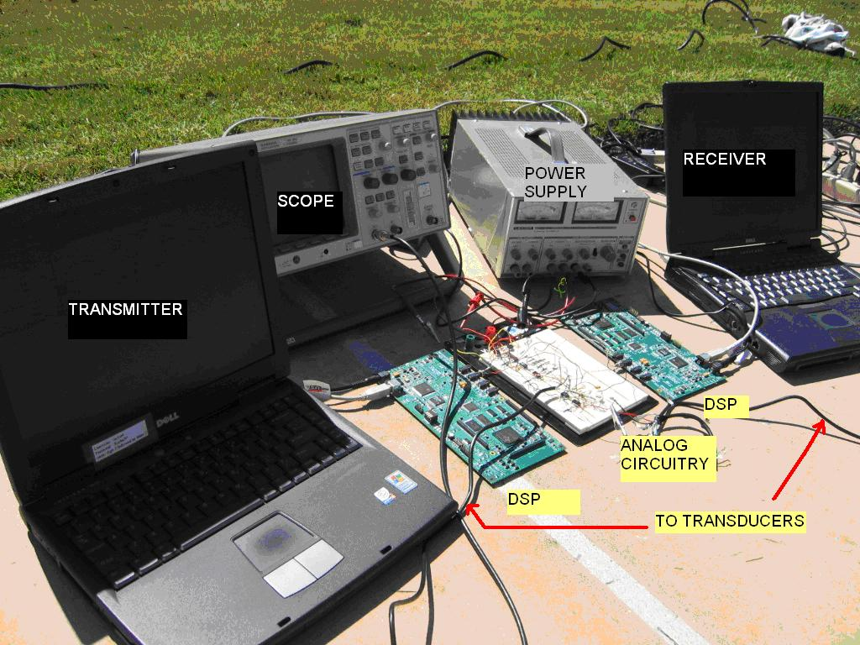
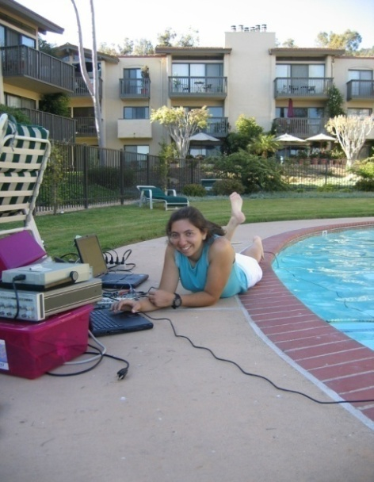
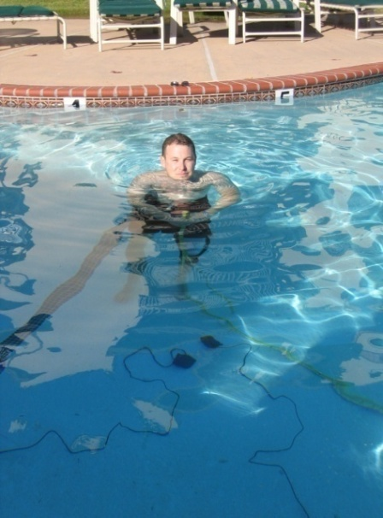
Mooring Modem Specifications
Requirements: low energy, low data rates, inexpensive, short distances
Modulation: Frequency Shift Keying
Data Rate: 80 bps
Carrier Frequency: 50 kHz
Frequency Separation: 320 Hz
Sampling Frequency: 8 kHz
Garmin Fish Finder Transducer
Cheap ~$50
Beam Width: 20°
Power Requirements
Transmission: 2 uW @ 1m, 200 uW @10 m, 24 mW @ 100 m
Signal processing: TI DSP ~ 1W, microcontroller ~1 mW
B. Benson et al. “Design of a Low-cost Acoustic Modem for Moored Oceanographic Applications”, ACM International Workshop on UnderWater Networks (WUWNet)

Slide 32
Energy Efficient Mooring Transmission
Maximize Network Lifetime
Minimize Total Energy Consumption
f_{ij}: fraction of time spent transmitting packets from node i to node j
t: network lifetime (seconds)
e_{i}: battery energy of node i (Joules)
g_{i}: packet generation rate for each node i (packets/second)
tt: packet transmission time (seconds)
p_{tx,ij}: energy spent for transmission of a packet from node i to node j (Joules)
p_{rx}: energy spent for reception of a packet (assumed constant)

Slide 33
CHARM Optimizations
Total Energy
Lifetime
Depth (m)
Data (kB/day)
1
1
Configurations are the same for both modems in both cases
0
0
1
2
2
40
Node | # of D-Cells Aqua Modem | # of D-cells Hypothetical Modem
2 | 51 | 0.0041
3 | 165 | 0.0134
4 | 51 | 0.0041
5 | 412 | 0.0334
6 | 51 | 0.0041
7 | 83 | 0.0067
2
3
3
130
7
4
4
40
10
5
5
325
19
6
6
40
Lifetime (2 D-cell/node):
Moorea: .87 days
Mooring: ~29.5 years
22
7
7
65

Slide 34
Ecological Research Programs
Santa Barbara Channel Long Term Ecological Research (SBC LTER) Program
Moorea Long Term Ecological
Research (Moorea LTER) Program
Goals
Focuses on understanding the nearshore ecosystems of the west coast
Time/space variation of individual organisms, populations, and ecological communities
Goals
Understanding processing in coral reef, lagoons and forereef
Nature of animal and plant community structure and diversity
Responses to environmental change induced either by human activities or natural cycles

Slide 35
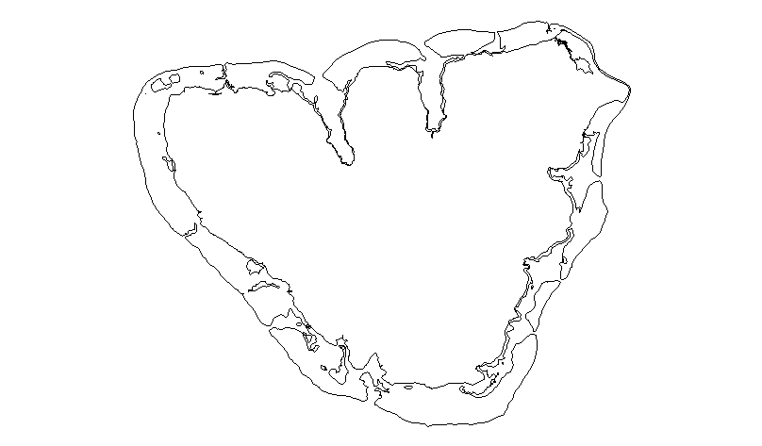
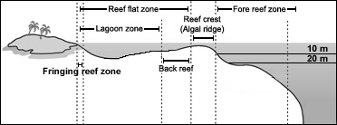
Monitoring in Moorea
Establish monitoring sites in lagoons and on fore reefs surrounding Moorea
Response variables measured:
Weather
Tides, Currents and Flows
Ocean Temperature & Color
Salinity, Turbidity & pH
Nutrients
Recruitment & Settlement
Size & Age Structure
Species Abundance
Community Diversity
Lagoon
Fore reef

Slide 36
Vision for Underwater Monitoring in Moorea
Viapahu Lagoon
UC Gump Research Station
Legend
L
Drogues
Stingray
Local Area Underwater Network
Acoustic Link
ReefPole
AquaNode

Slide 37

Drogues
Autonomous Underwater Explorers: Self organizing drifters
Dynamic, spatiotemporal 3D sampling
Track water motions or mimic migration behavior of organisms
Buoyancy control can follow ocean surface
Acoustic modem for 3D localization amongst drifters
25 cm diameter
Under development by Curt Schurgers (ECE), Jules Jaffe (SIO), Raymond de Callafon (MAE)

Slide 38
Vision for Underwater Networking in Moorea
Reef Pole
Viapahu Lagoon
Internet point of presence on the reef
Highly instrumented gathering system
Powered through solar panels
High bandwidth RF (802.1x) communication b/w Reef Poles and Gump Research station
UC Gump Research Station
Legend
L
Drogues
ReefBot
Local Area Underwater Network
Acoustic Link
ReefPole
AquaNode

Slide 39


AquaNode
Deploy ad hoc wireless underwater networks around island
Transmit data to/from underwater sensors
Aquanode requirements:
Low cost, low power wireless modems
Associated networking functionality
Plug and play interface with variety of sensors
Near real-time data and adaptive sampling
Software Defined
Acoustic Modem
Battery
Transparent View
Transducer

Slide 40

AquaNode Hardware Platform
Ideal: One piece of hardware for any sensor and scenario
Hardware is wirelessly updatable: no need to retrieve equipment to update hardware for changing communication protocols, sampling, sensing strategies
A/D
.
μController
.
Transducer or
Hydrophone
inputs
.
FPGA
Matching Network
and Power Amp
Daughtercard
A/D
D/A
.
RS232
.
.
D/A
CTD Sensor

Slide 41
Hardware Platform Interfaces
Sensor Interface:
Must develop common interface with different sensors (CTD, chemical, optical, etc.) and communication elements (transducer)
Wide (constantly changing) variety of sensors, sampling strategies
Communication Interface:
Amplifiers, Transducers
Signal modulation
Hardware:
Software Defined Acoustic Modem (SDAM)
Reconfigurable hardware known to provide, flexible, high performance implementations for DSP applications
A/D
.
μController
.
.
FPGA
Matching Network
and Power Amp
Daughtercard
A/D
D/A
.
RS232
.
.
D/A
CTD Sensor

Slide 42
Design Considerations for Moorea Modem
Acoustic Propagation
Multipath Spread – Range of 1 to 10 milliseconds for shallow water at up to 1 km range
Doppler Spreads up to 1 Hz
Transducers
Size/weight/cost proportional to wavelength
Acceptable propagation losses at 100 meter ranges
Sonatech 24 kHz provided enough bandwidth (6 kHz) and avoided higher frequency absorption
Physical layer communication
Frequency Shift Keying (FSK)
Narrowband thus sensitive to frequency-selective fading.
Use more tones – increasing sensitivity to Doppler spread.
Direct-sequence spread spectrum (DSSS)
Provides frequency diversity due to wide bandwidth
Can be detected noncoherently
Notes:
Resistent to doppler spreads up to 1 Hz

Slide 43



Moorea Modem Specifications
Signal and Data Parameters Data rate: 133 bps Chip duration T_{c} = .2 msec. Symbol duration T_{sym} = 11.2 msec. Time guard interval T_{c} = 11.2 msec. M-sequence length L_{pn} = 7 chips. Walsh sequence length N_{w} = 8 Bandwidth = 5 kHz Carrier Frequency f_{c} = 25 kHz Nominal range 100 – 300 m.
Power Consumption Overview Load Tx State Rx State Sleep State CPU 440 mW 440 mW .30 mW CPU I/O 420 mW 420 mW .15 mW Flash Memory 165 mW 165 mW .10 mW Power Amp. 7.2 W .05 mW .05 mW Battery Total 9.3 W 2.1 W 10 mW
Battery Life (Based on 20 amp-hours) Tx Duty Cycle Rx Duty Cycle Days .1% .2 % 624 .5% 1 % 189 1% 2% 101
Pelican case
Power Amplifier
Sonatech Transducer
24 KHz center freq.
TI 6713 DSP
Successfully tested at Westlake Village lake at 70m range
R. Iltis et. al. “An Underwater Acoustic Telemetry Modem for Eco-Sensing”, MTS/IEEE OCEANS 2005

Slide 44














Moorea Modem Receiver Specification
Generalized multiple hypothesis test (GMHT)
Matching
Pursuit
Core
Matching
Pursuit
Core
arg min
i
Matching
Pursuit
Core
Note: 112 samples/symbol + 112 samples for channel clearing.
Matching
Pursuit
Core
Notes:
Generalized multiple hypothesis test (GMHT)

Slide 45






Walsh/m-Sequence Waveforms
Chip rate – 5 kcps, approx. 5 kHz bandwidth. Uses 25 kHz carrier.
Use 7 chip m-sequence c per Walsh symbol, 8 bits per Walsh symbol b_{i}. Composite symbol duration is thus T = 11.2 msec. (Longer than maximum multipath spread.)
Symbol rate is 266 bps, or 133 bps using 11.2 msec. time guard band for channel clearing.
11 msec.

Slide 46











Transmitted Signal
1
1
-1
1
-1
-1
-1
-1
-1
1
-1
1
1
1
1
1
-1
1
-1
-1
-1

Slide 47

Walsh/m-sequence Signal Parameters
1
1
-1
1
-1
-1
-1
-1
-1
1
-1
1
1
1
1
1
-1
1
-1
-1
-1

Slide 48

8 Walsh Symbols

Slide 49





Evolution of AquaNode
Air, …
to pool, … to lake, … to Moorea

Slide 50

Unanchored Transducers: Cook’s Bay Test
Transducers hanging from side of boat.
Water ~ 30 m deep (boats not anchored).
High “estimated” Doppler spread mostly due to transducer movement, and boat movement.

Slide 51






Unanchored Transducers: Cook’s Bay Test

Slide 52

Anchored Transducers: Viapahu Lagoon Test
After Cook’s Bay testing, moved to shallower Viapahu Lagoon
Hardware setup essentially the same, except boats now anchored.
Two successful tests in this new environment

Slide 53






Anchored Testing - Viapahu Lagoon Test (125m)

Slide 54







Viapahu Lagoon Test (280 m)
Tx Boat
Tx Boat
Rx Boat

Slide 55








Viapahu Lagoon Test (330 m, 440 m)
Tx Boat
Tx Boat
Rx Boat

Slide 56






Viapahu Lagoon Test (50 m, Bommies)

Slide 57

Results summary
Doppler spread (averaged, median-filtered):
High (averaging > 1 Hz) when boats and transducers are unanchored.
Generally averaging on the order of 0.01 Hz with anchored transducers in Viapahu Lagoon.
Modem Performance:
DSSS modem: average SER < 1%
Distances up to 500 km

Slide 58

Vision for Underwater Monitoring in Moorea
Stingray AUV
Agile propellers for navigation
High powered LEDs
Viapahu Lagoon
Acoustic modems to retrieve sensor data
UC Gump Research Station
Camera for object detection and avoidance
Legend
L
Drogues
Stingray
Local Area Underwater Network
Acoustic Link
ReefPole
AquaNode

Slide 59

The Stingray
San Diego iBotics’ AUVSI AUV Competition entry

Slide 60
Hull
Biomimetic
Streamlined
Light weight
Flooded

Slide 61
Waterproofing
Machined aluminum housing for electronics
Pelican box for batteries
Wet-matable connectors

Slide 62


Propulsion
Voith-Schneider Propellers
Two position underneath hull
Two controls 3 degrees of freedom in the lateral plane
Scorpion Motors
One on each wing, two on tail
Controls depth, pitch and roll

Slide 63

Devices & Instruments
Cameras
Hydrophones
Lights
Dropper
Pressure Sensor

Slide 64

Electronic Housing
All on-board electronics are housed within a water-tight aluminum enclosure
A machined aluminum enclosure chosen for superior heat dissipation and to fill all electronics compactly

Slide 65


Electronics
PC/104 form factor
Dual-core 1.5 GHz processor, 2 GB RAM
Dual-channel frame-grabber PCI card
DAQ attached to PC/104
Measures voltages from the battery, pressure sensor, and internal moisture sensor
Controls LED intensity

Slide 66



2008 Hardware and Sensors
Kontron ETX-CD with Intel Core Duo ULV 2500, 1.2 GHz
PC/104 form factor using stacked modules
Pololu Serial Servo Controller (USB)
RTD VFG7330ER Dual-Channel Video Frame Grabber (NTSC)
LabJack U3-HV (USB) for digital and analog I/O
MicroStrain Inertial Measurement Unit 3DM-GX1 (Serial)

Slide 67

Motor Control
The two Voith Schneider propeller motors are driven by two ESC to maintain constant speed and four more ESC are for the wing and tail motors

Slide 68


Onboard Instrumentation
MicroStrain 3DM-GX1 IMU
Provides orientation measurements
Connects to the main computer via a standard RS-232 serial connection.
Analogue pressure transducer voltage is filtered and measured by the DAQ card

Slide 69

Power Systems and Motor Control
Stingray powered by two 11.1V 8Ah lithium polymer batteries
Operate on two independent circuits, with one battery powering the motors and the other the electronics

Slide 70

Lighting
Cree XR-E Q5 LEDs together with Cree 8-degree Total Internal Reflection optics used to for lighting in less than idea vision conditions
Finished light assemblies placed on the wing-tips to reduce backscattering and retro-reflection by debris in the water

Slide 71

Cameras
Inuktun FireflEYE – downward looking camera
Remote Ocean Systems BP-L3C-HR-D6-N – forward looking camera
Cameras connect directly to the video-capture card

Slide 72
Vision for Underwater Monitoring in Moorea
Stingray AUV
Underwater
Cameras
Agile propellers for navigation
High powered LEDs
Viapahu Lagoon
Acoustic modems to retrieve sensor data
UC Gump Research Station
Camera for object detection and avoidance
Legend
L
Drogues
Stingray
Local Area Underwater Network
Acoustic Link
ReefPole
AquaNode

Slide 73

Automatic Fish Detection
Much time and resources spent to count and identify fish
Boats, divers = $$$
1/3 of budget in ecological research sites used for data gathering
Research questions:
Can we do it automatically?
What features to train?
Types of fish to track?
Number of fish per frame?
Requires fast processing

Slide 74
Image Processing Applications
Computation of a large number of repetitive operations
Complex and expensive computation

Slide 75

Image Processing Applications
Start
Low-Level Processing
High-Level Processing
Large amounts of low-level processing on massive amount of data
Image Data
Display Image
Bottleneck of
real-time operation

Slide 76

Image Processing
Important Design Factors
Process the incoming pixel on the fly

Slide 77

Filtering and Edge Detection

Slide 78


Histogram Equalization
Raw
Histogram Equalization with AGC

Slide 79





Histogram Equalization

Slide 80




Histogram Equalization

Slide 81

Object Detection
Working Example: Face Detection using Haar Features

Slide 82
Conclusions
Embedded Systems are starting revolutions in variety of multidisciplinary fields
Vision, communications, autonomous vehicles, bioengineering, …
Much work done here at UCSD
Scripps, CalIT2, CSE, ECE, MAE, etc.
Get involved!
For more information
Talk to me email (kastner@ucsd.edu) or in person (2112)
Stingray: www.sdibotics.org

Slide 83
Extra Slides

Slide 84


More Embedded Systems
Camera-on-chip (Bell Labs)
Solar-power Wireless Sensor (Berkeley)
Source: Mani Srivastava®

Slide 85

Advanced Car Controls
Source: Alberto Sangiovanni-Vincentelli®

Slide 86

Transmission Power: FSK vs DSSS

