Slide 1
Robot Vision and Image Processing
Week #9
Prof. Ryan Kastner

Slide 2
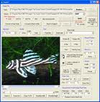
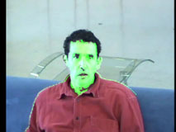
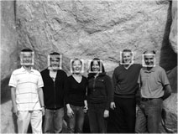
Robot Vision
The Scribbler has a small digital camera
Pictures taken by the camera is called image
We can perform computation on images
e.g. Face Detection

Slide 3
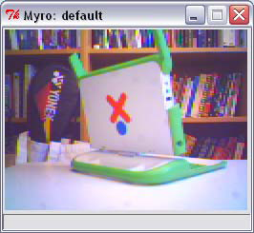
Robot Vision
The image taken by a camera can serve as the eye of the Robot
pic = takePicture()
show(pic)
In a color image, each pixel contains color information which is made up of the amount of red, green, and blue (also called, RGB) values
Values can be in the range [0..255]

Slide 4
Image
A grayscale image contains only the level of gray in a pixel
Takes a single byte between 0 (white) and 255 (black)
How many bits in a byte?
Image is just a 2-dimensional array of pixels
Images obtained from the Scribbler have 256×192 (WxH)
49,152 pixels
Each pixel is 3 bytes. So, scribbler images are 147,456 bytes in size

Slide 5
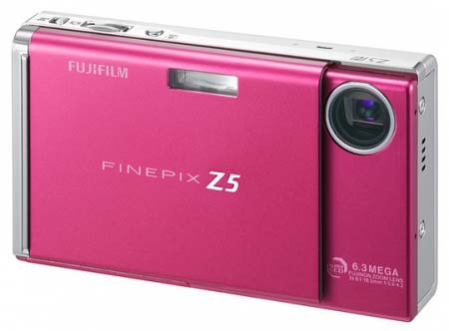
Pixels
All digital cameras are sold by specifying the number of megapixels
A camera is referred by the size of the largest image it can take
The Scribbler camera, has an image size of 147,456 bytes
It is only about 0.14 megapixels

Slide 6
Saving Images
Electronic storage and transfer can be made by compressing the data in the image
Compressed Formats: JPEG, GIF, PNG etc.
Scribbler supports JPEG and GIF
Image Functions: Try this
picWidth = getWidth(pic)
picHeight = getHeight(pic)
print "Image WxH is", picWidth, "x", picHeight, “pixels.”

Slide 7
Saving Images
savePicture(pic, "OfficeScene.jpg")
savePicture(pic, "OfficeScene.gif")
Loading from disk:
mySavedPicture = makePicture("OfficeScene.jpg")
show(mySavedPicture)
Try this:
mySavedPicture = makePicture(pickAFile())
show(mySavedPicture)
Gives a navigational dialog box
Click on the picture, what do you get?

Slide 8
Robot Explorer
Taking gray-scale picture is faster than taking a color picture
You can update the images faster and also use as a camera
Try this:
joyStick()
for i in range(25):
pic = takePicture("gray")
show(pic)

Slide 9
Movies
The savePicture() function allows make animated GIF which in a browser shows several images one after the other
pic1 = takePicture()
turnLeft(0.5,0.25)
pic2 = takePicture()
turnLeft(0.5,0.25)
pic3 = takePicture()
turnLeft(0.5,0.25)
pic4 = takePicture()
listOfPictures = [pic1, pic2, pic3, pic4]
savePicture(listOfPictures, "turningMovie.gif")
Can you write this program
using a for loop?
Notes:
pictureList = []
for i in range (15):
pic = takePicture()
pictureList = pictureList + [pic] #append the new picture
turnLeft(0.5, 0.1)
savePicture(pictureList, “rotatingMovie.gif”)

Slide 10
Making Pictures
You can also make your own pictures
Try this:
W = H = 100
newPic = makePicture(W, H, black)
show(newPic)
Try this:
for x in range(W)
for y in range(H):
pixel = getPixel(newPic, x, y)
setColor(pixel, white)
repaint(newPic)

Slide 11
Selecting Colors
You can
Set a color: setColor(pixel, white)
Create a new color if you know the RGB values of the color: myRed = makeColor(255, 0, 0)
Visually select a color: myColor = pickAColor()
The repaint command refreshes the displayed image: for x in range(W)
for y in range(H):
pixel = getPixel(newPic, x, y)
setColor(pixel, white)
repaint(newPic)
Do you see any problems?
Notes:
Takes too much time

Slide 12
Image Processing
Way of taking existing images and transforming them in interesting ways
You access an individual pixel and its color value, and transform it in any way you like
Examples: Shrinking & Enlarging, Blurring & Sharpening, Negative & Embossing and Object Detection

Slide 13
Shrinking & Enlarging
Write a program that will take an input image and shrink it by a factor, say F
For example: if the original image is 3000×3000 pixels and we shrink it by a factor of 10, we would end up with an image of 300×300 pixels
New pixel at x, y is a copy of the old pixel x*F, y*F

Slide 14
Shrinking & Enlarging
def main():
# read an image and display it
oldPic = makePicture(pickAFile())
show(myPic, "Before")
X = getWidth(oldPic)
Y = getHeight(oldPic)
# Input the shrink factor and computer size of new image
F = int(ask("Enter the shrink factor."))
newx = X/F
newy = Y/F
# create the new image
newPic = makePicture(newx, newy)
for x in range(newx):
for y in range(newy):
setPixel(newPic, x, y, getPixel(myPic, x*F, y*F))
show(newPic, "After")

Slide 15
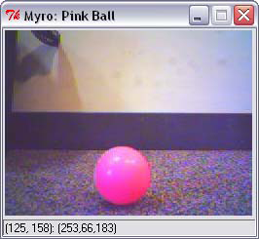
Image Processing
How does Scribbler recognize a ball?
Once it recognizes it, can it follow the ball wherever it goes?

Slide 16
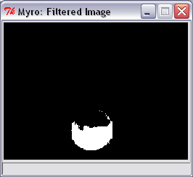
Image Processing
To identify an object on an image, click on the image to get the RGB values
Set the remaining pixels to 0
Thus the robot can identify the object as in the image shown below
Change the threshold values to get more refined identification

Slide 17
Image Processing
for pixel in getPixels(p):
r, g, b = getRGB(pixel)
if r > 200 and g < 100:
setRGB(pixel, (255, 255, 255))
else
setRGB(pixel, (0, 0, 0))

Slide 18
Image Processing
Once you have identified the white image in the processes image, you can find the position of the object by taking the average of the x- locations
What is the purpose of this function:
def ?(picture)
tot_x = 0
count = 0
for pixel in getPixels(p):
r, g, b = getRGB(pixel)
if r > 200 and g < 100:
tot_x = tot_x + getX(pixel)
count = count + 1
return tot_x/count

Slide 19
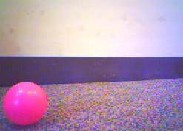
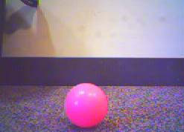
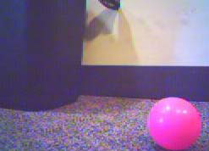
Image Processing
You can use the count value and make the robot follow the movement of the ball
while timeTemaining(T):
# take picture and locate the ball
pic = takePicture()
ballLocation = locateBall(pic)
if ballLocation <= 85:
turnLeft(cruiseSpeed)
elif ballLocation <= 170:
forward(cruiseSpeed)
else:
turnRight(cruiseSpeed)
Here ballLocation contains count value

