Slide 1
Sights & Sounds
Week #8
Prof. Ryan Kastner

Slide 2
More than Numerical Calculations?
Notion of computation extends far beyond simple numerical calculations
Using basic computational techniques you have learned so far, you can do computations on shapes and sounds

Slide 3
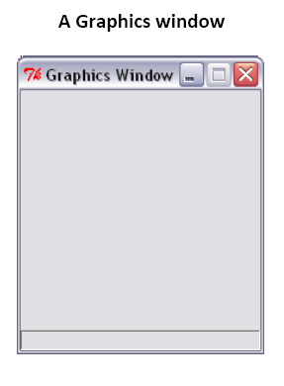
Sights: Drawing
Have you ever used drawing applications on your computer?
To draw something using Python, you first need a place to draw it
        myCanvas = GraphWin()

Slide 4
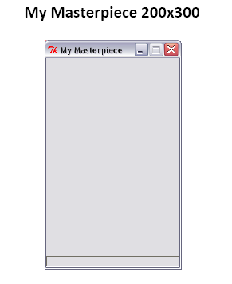
Sights: Drawing
To make the window go away, type
      myCanvas.close()
To create a graphics window of any size and a name that you specify, type
myCanvas = GraphWin(“My Masterpiece”, 200, 300)

Slide 5
Sights: Drawing
To change the background color
          myCanvas.setBackground(“white”)
You can even try “red”, “blue”, “yellow” or more exotic colors ranging from “AntiqueWhite” to “LavenderBlush” to “WhiteSmoke”

Slide 6
Sights: Drawing
You know how to create a canvas, and now it is time to draw in it ☺
You can create and draw all kinds of geometrical objects: points, lines, circles, rectangel, even text and images
To draw things:
      You should first create it and then draw it
      You should also know the coordinate system of the window

Slide 7
Coordinates
Graphics window with width, W, and height, H, has
W × H pixels
  The pixel (0,0) is at the top left corner
  The pixel (199, 299) is at the bottom right corner

Slide 8
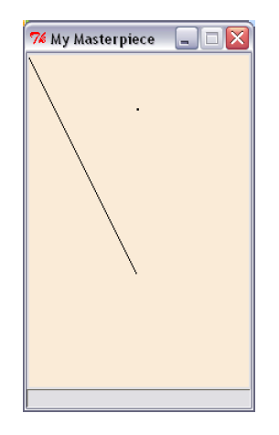
Then Create and Draw it
The simplest object is a point
      p = Point(100, 50) → CREATE WITH COORDINATES
      p.draw(myCanvas) → DRAW IT
The general form of commands issued on objects
  <object>.<function>(<parameters>)
A line requires the two end points specified
      L = Line(Point(0, 0), Point(100,200)) → CREATE WITH COORDINATES
      L.draw(myCanvas) → DRAW IT

Slide 9
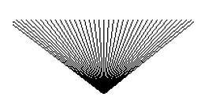
Sights: Drawing
Can you draw this?
for n in range(0, 200, 5):
L=Line(Point(n,25),Point(100,100))
L.draw(myCanvas)
Notes:
Not including 200

Slide 10
Sights: Drawing
Try these
for n in range(0, 200, 5):
L = Line(Point(n, 25), Point(100, 100))
L.draw(myCanvas)
wait(0.3)
L.undraw()
C = Circle(centerPoint, radius)
C.draw(myCanvas)
C = Circle(Point(100, 150), 30)
C.draw(myCanvas)

Slide 11
Sights: Drawing
Also try these
You can get the center point of a circle:
centerPoint = C.getCenter()
You can specify color for objects:
C = Circle(Point(100, 150), 30)
C.draw(myCanvas)
C.setOutline(“red”)
C.setFill(“yellow”)

Slide 12
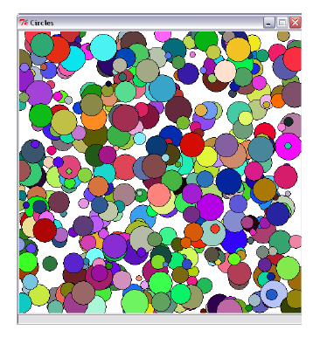
Exercise
Can you draw this?

Slide 13
Exercise
# Program to draw a bunch of # random colored circles
from myro import *
from random import *
def makeCircle(x, y, r):
# creates a Circle centered at point (x, y) of radius r
return Circle(Point(x, y), r)
def makeColor():
# creates a new color using random RGB values
red = randrange(0, 256)
green = randrange(0, 256)
blue = randrange(0, 256)
return color_rgb(red, green,blue)
def main():
# Create and display a
# graphics window
width = 500
height = 500
myCanvas =
GraphWin(‘Circles’,width,height)
myCanvas.setBackground("white")
# draw a bunch of random
# circles with random
# colors.
N = 500
for i in range(N):
# pick random center
# point and radius
# in the window
x = randrange(0,width)
y = randrange(0,height)
r = randrange(5, 25)
c = makeCircle(x, y, r)
# select a random color
c.setFill(makeColor())
c.draw(myCanvas)
main()
Notes:
Look at the scopes of the variables and discuss them

Slide 14
Drawing Text and Images
To place text in a graphics window
  myText = Text (<anchor point>, <string>)
  To place an image in a graphics window
    myPhoto = Image(<center point>, <filename>)

Slide 15
Sound
Try
beep(1, 440)
This command instructs the robot to play a tone at 440Hz for 1 second
The letters Hz are an abbreviation for Hertz
We use Hertz as a unit for specifying frequencies
            1 Hertz = 1 cycle/second

Slide 16
Sound
The most common use of frequencies is in specifying the clock speeds of computer CPU’s
        1 GigaHertz = 10⁹ cycles/second
        The human ear is capable of distinguishing sounds that differ only by a few Hertz, as little as 1 Hz. Try these, can you feel the difference?
                beep(1, 440)
                beep(1, 450)

Slide 17
Musical Scales
In western music, a scale is divided into 12 notes (from 7 major notes: ABCDEFG). Further there are octaves.
An octave in C comprises of the 12 notes:
C C#/Db D D#/Eb E F F#/Gb G G#/Ab A A#/Bb B
Frequencies corresponding to a specific note, say C, are multiplier (or divided) by 2 to achieve the same note in a higher (or lower) octave

Slide 18
Musical Scales
What is the relationship between these two tones?
          beep(1, 440)
          beep(1, 880)
          The second tone is exactly one octave the first. To raise a tone by an octave, you simply multiply the frequency by 2.
          To make a tone an octave lower, you divide by 2

Slide 19
Musical Scales
In common tuning the 12 notes are equidistant. Thus if the frequency doubles every octave, each successive note is 2^{1/2} apart
If C4 is 261.63 Hz, what will be C# (or Db)?
  C#4/Db4 = 261.63 Hz × 2^{1/2} = 277.18 Hz

Slide 20
Making Music
Making songs by frequency is a lot of work
Luckily, Myro contains a set of functions
A Myro song is a set of characters composed like so:
        NOTE1 [NOTE2] WHOLEPART
NOTE1 is either a frequency or a NOTENAME,
NOTE2 is the same, and optional. Use for Chords.
WHOLEPART is a number representing how much of a whole note to play.

Slide 21
Making Music
NOTENAMES are case-insensitive strings.
Here is an entire scale of NOTENAMES:
C C#/Db D D#/Eb E F F#/Gb G G#/Ab A A#/Bb B C
5th octave version can be written as
C5 C#5/Db5 D5 D#5/Eb5 E5 F5 F#5/Gb5 G5 G#5/Ab5 A5 A#5/Bb5 B5 C6

Slide 22
Making Music
Try this:
c 1
c .5
c .5
c 1
c .5
c .5
e 1
c .5
c .5
c 2
e 1
e .5
e .5
e 1
e .5
e .5
g 1
e .5
e .5
e 2

Slide 23
Using a Song
You need to initialize the robot in a different way
      Robot = scribbler ()
      If your song is in a file, you can read it
              s = readSong(filename)
              The you can play it on the robot
                robot.playSong(s)
                Or on the computer
                computer.playSong(s)
                You can also makesong(text) to make a song
                s = makeSong("c 1; d 1; e 1; f 1; g 1; a 1; b 1; c7 1;")

