Slide 1
Behavior Based Control
Week #7
Prof. Ryan Kastner

Slide 2
Oh Behave!
A program is all about exercising control
Python programs control the computer which communicates with the Myro
When writing robot control programs, the structure you use to organize the program itself is a control strategy
Programming a robot is specifying automated control
Sensing and control together form Reactive Control

Slide 3
Structuring Robot Programs
Structuring robot programs makes designing behaviors easy
Sensor Fusion: Just another buzz name for Reactive Control or Direct Control
In behavior-based control you get away from sensors and focus the design of your robot programs based on the number and kinds of behaviors your robot has to carry out

Slide 4
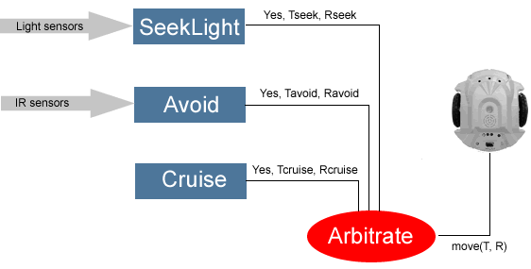
Behavior in a Maze
The robot in a Maze has three behaviors:
Cruise (If there is no obstacle)
Avoid Obstacles (If present)
Seek Light (If present)
Define each behavior as an individual decision unit

Slide 5
Design Each Behavior
cruiseSpeed = 0.8
turnSpeed = 0.8
lightThresh = 80
def cruise():
# is always ON, just move forward
return [True, cruiseSpeed, 0]
def avoid():
# see if there are any obstacles
L, R = getIR()
L = 1 - L
R = 1 - R
if L:
return [True, 0, -turnSpeed]
elif R:
return [True, 0, turnSpeed]
else:
return [False, 0, 0]
def seekLight():
L, C, R = getLight()
if L < lightThresh:
return [True, cruiseSpeed/2.0, turnSpeed]
elif R < lightThresh:
return [True, cruiseSpeed/2.0, -turnSpeed]
else:
return [False, 0, 0]

Slide 6
Arbitration Schemes
To control the Robot, one has to decide which recommendation to chose
Priority Assignment: Also called subsumption architecture
Higher the module in the figure, higher the priority
By arranging control:
Design of each behavior is easy
Testing becomes easy
More behaviors can be added

Slide 7
Names and Return Values
In Python a name can represent anything as its value: a number, a picture, a function, etc.
E.g. : behaviors = [seekLight, avoid, cruise]
List named behaviors is a list of function names each of which denote the actual function as its value
for behavior in behaviors:
output, T, R = behavior()
In each iteration of the loop, the variable behavior takes on successive values from this list: seekLight, avoid, and cruise

Slide 8
Design Main and Arbitrate
# list of behaviors, ordered by priority (left is highest)
behaviors = [seekLight, avoid, cruise]
def main():
while True:
T, R = arbitrate()
move(T, R)
main()
# Decide which behavior, in order of priority
# has a recommendation for the robot
def arbitrate():
for behavior in behaviors:
output, T, R = behavior()
if output:
return [T, R]

Slide 9
Math in Python
Python provides a set of libraries so you don’t have to write them ☺
math library: from math import *
ceil(x) Returns the ceiling of x as a float, the smallest integer value greater than or equal to x
floor(x) Returns the floor of x as a float, the largest integer value less than or equal to x
exp(x) Returns e^{x}

Slide 10
Functions in Math
log(x[, base]) Returns the logarithm of x to the given base. If the base is not specified, return the natural logarithm of x (i.e., log _{e} x)
log10(x) Returns the base-10 logarithm of x (i.e. log ₁₀ x )
pow(x, y) Returns x^{y}
sqrt(x) Returns the square root of x (√x)
import math
>>> math.ceil(5.34)
6.0

Slide 11
Summary
Behavior based Control
Mathematical Functions

