Slide 1
Designing Robot Behaviors
Week #6
Prof. Ryan Kastner

Slide 2
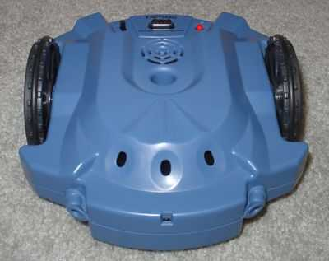
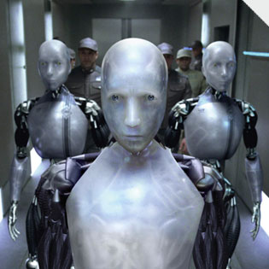
Designing Robot Behaviors
Be Creative
Recognize the Strengths and Limitations of the Robot
Know the environment the robot will be working in
Know available paradigms for programming robots behaviors

Slide 3
Braitenberg Vehicles
Valentino Braitenberg wrote a book titled: Vehicles: Experiments in Synthetic Psychology (MIT Press)
Describes several thought experiments that are centered around the creation of simple vehicles with very simple control mechanisms that exhibit seemingly complex behavior
Illustrates insights into animal (human) brain
Shows that vehicles are capable of complex behavior like Fear, Love, Logic etc.

Slide 4
Law of Uphill Analysis and Downhill Invention
One central theme underlying Braitenberg's experiments
Trying to postulate the internal structure purely by observing certain behavior is an uphill (harder) task
Trying to create an entity that exhibits a certain behavior is a downhill (easier) task
A Scribbler can do most of what the robots Braitenberg described can do

Slide 5
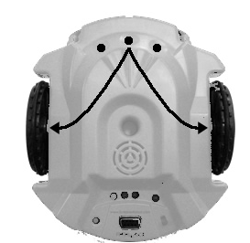
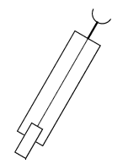
Vehicle 1
Alive
One Sensor – One Motor
Scribbler
One Sensor – Two motors
You can use the center light sensor and connect what it reports directly to both motors of the robot
Try this:
motors(c,c) where ‘c’ is the value from light sensor

Slide 6

Movement Using Light Sensors
Light sensors report values in range of 0 – 5000 while motors take values from -1 to 1
Normalizing (mapping light sensor values to the range of motor values)
def normalize(v): # normalizes v to range 0.0 to 1.0
def main():
while True:
L = getLight("center")
forward(normalize(L))

Slide 7
Normalizing Sensor Values
Normalizing is transforming a value proportional to a required range (here 0.0 to 1.0, 1.0 being brighter light)
Light Sensor is actually a Darkness sensor
Small values for bright light e.g. 50
Larger values for dark light e.g. 3000
def normalize(v):
# Normalize v (in the range 0..5000) to 0..1.0, inversely
return 1.0 - v/5000.0
For brightness v = 35 what is the normalized value

Slide 8
Light Sensing
You can set the ambient light value as the darkest condition so that you can identify a brighter light, say, a Flash Light
How:
def normalize(v):
if v > Ambient:
v = Ambient
return 1.0 - v/Ambient
Either you can set this value or let the Robot sense it
You can also find the values sensed by left and right sensors and take an average

Slide 9
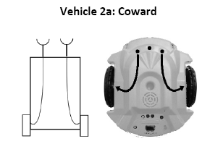
Coward and Aggressive
Speed of individual motor depends on the sensor on one side
Coward mode:
Left sensor controls Left motor
Right sensor controls Right motor
Ambient = sum(getLight())/3.0 # values from 3 sensors/3
def normalize(v):
if v > Ambient:
v = Ambient
return 1.0 - v/Ambient

Slide 10
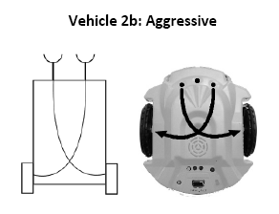
Coward and Aggressive
L = getLight("left")
R = getLight("right")
motors(normalize(L), normalize(R))
Aggressive
Left sensor controls Right motor
Right sensor controls Left motor
Repeat as you did before now
L = getLight(“right")
R = getLight(“left")
motors(normalize(L), normalize(R))
Try flashing the light on either side of the robot

Slide 11
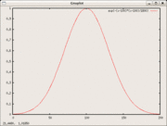
Mathematical Functions
Braitenberg suggests using non-monotonic mathematical functions
Monotonic: More light, faster motor speed; or more light, slower motor speed
Non-monotonic: the relationship is increasing in proportion to sensory input but only up to a certain point and after that it decreases
You can use exp() for e^{x}
f(x) = e^{-x2}
Bell Curve or
Gaussian Curve

Slide 12
Bell Curve Behavior
def normalize(v):
mean = Ambient/2.0
stddev = Ambient/6.0
if v >= Ambient:
v = Ambient
return exp(-(v - mean)**2 / 2*(stddev**2))
Other mathematical functions using math library (from math import *):
Step
Threshold

Slide 13
Multiple Sensing
Adding more sensors makes the robot behavior more interesting
Scribbler in addition to light sensors has
Stall Sensors (detect if the robot has stopped)
IR sensors and more
Digital Sensors: Give either On or Off (e.g Stall)
Try this:
Replace the light sensors with obstacle sensors and try moving the robot

Slide 14
Exercise
How would you design paranoid, shadow fearing, behavior?
Paranoid should be capable of turning.
This can be accomplished by moving the right motor forward and moving the left motor in reverse direction at the same time.
Notes:
It has a single threshold light sensor. When the sensor detects light, it moves forward. When the sensor enters a shadow, it reverses the direction of its left motor, thus turning right. Soon the sensor will swing around, out of the shadow. When that happens, it resumes its forward motion.

Slide 15
If - else
if <condition>:
<this>
else:
<that>
Else if : elif
if <condition-1>:
<this>
elif <condition-2>:
<that>
...
else:
<other>
How do you use the if, else and elif
while timeRemaining(30):
if #left light is brighter that right light:
turnLeft(1.0)
else:
turnRight(1.0)
Try this:
If the left side is brighter go right, vice versa

Slide 16
Light Follower
# Light follower
from myro import *
initialize(ask("What port?"))
# program settings...
thresh = 50
fwdSpeed = 0.8
cruiseSpeed = 0.5
turnSpeed = 0.7 # left turn, -0.7 will be right turn
def main():
while True:
# get light sensor values for left, center, and right
L, C, R = getLight()
# decide how to act based on sensor values
if C < thresh:
# bright light from straight ahead, go forward
move(fwdSpeed, 0)
elif L < thresh:
# bright light at left, turn left
move(cruiseSpeed, turnSpeed)
elif R < thresh:
# bright light on right side, turn right
move(cruiseSpeed, -turnSpeed)
else:
# no bright light, move forward slowly (or stop?)
move(cruiseSpeed/2, 0)
main()

Slide 17
Avoiding Obstacles
# Avoiding Obstacles
from myro import *
initialize(ask("What port?"))
# program settings...
cruiseSpeed = 0.6
turnSpeed = 0.5 # this is a left turn, -0.5 will be right
turn
def main():
while True:
# get sensor values for left and right IR sensors
L, R = getIR()
L = 1 - L
R = 1 - R
# decide how to act based on sensors values
if L and R:
# obstacle straight ahead, turn (randomly)
move(0, turnSpeed)
elif L:
# obstacle on left, turn right
move(cruiseSpeed, -turnSpeed)
elif R:
# obstacle on right, turn left
move(cruiseSpeed, turnSpeed)
else:
# no obstacles
move(cruiseSpeed, 0)
main()

Slide 18
Summary
You now have an idea of Psychology
Programming internal structures in a robot thus building brains for robot
if – else ; elseif (elif) statements

