Slide 1
Sensing the World and
Making Decisions
Week #5
Prof. Ryan Kastner

Slide 2
Scribbler’s Internal Sensors
Previous lecture you learned Scribbler’s internal sensors
1) Stall
Why: It could be stuck against a wall!!
2) Time
Why: Knowing the time is important to have more complex robot behaviors!!
3) Battery Level
Why: So you can detect when to change the batteries!!

Slide 3
Scribbler’s External Sensors
Scribbler also come equipped with a suite of external sensors (exteroceptors) that can sense various things in the environment
These various things can be seen as inputs and Scribbler perform different tasks depending on them

Slide 4
Scribbler’s External Sensors
1) Camera
Why: It can take a still picture of whatever the robot is seeing
2) Light Sensors
Why: Scribbler detect variations in the ambience light in a room
3) Proximity Sensors
Why: So Scribbler can detect objects on the front and on its sides

Slide 5
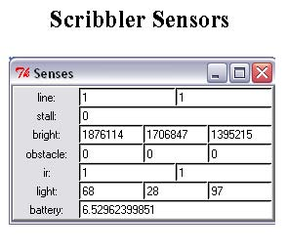
Getting to Know Sensors
It is important to know
  How to access the information reported by them;
  What this information looks like.
Try
    senses()

Slide 6
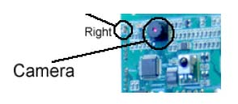
Camera
Camera is located on the Fluke dongle
To take pictures, use
      takePicture()
      takePicture(“color”)
      takePicture(“gray”)
To show pictures, use
      p = takePicture()
      show (p)

Slide 7
Camera
Alternatively you can use
      show(takePicture())
You can do many different things with these pictures, but you might want to save them first:
      savePicture(p, “NAME.jpg”)
Exercise: Assume that Scribbler got lost, write a program so Scribbler turns around, takes pictures and shows them so you can locate it

Slide 8
Camera
      while timeRemaining(30):
      show(takePicture())
      turnLeft(0.5, 0.2)
Do you know how many pictures it took?
      N = 0
      while timeRemaining(30):
      show(takePicture())
      turnLeft(0.5, 0.2)
      N = N +1
      print N
Notes:
See it might be slow, then you need to use gray!

Slide 9
Camera
Can you create an animated GIF using these images?
      Pics = []
      while timeRemaining(30):
      pic = takePicture()
      show(pic)
      Pics.append(pic)
      turnLeft(0.5, 0.2)
      savePicture (Pics, “NAME.gif”)
This code uses Lists which we will learn at the end of this lecture.
Notes:
See it might be slow, then you need to use gray!

Slide 10
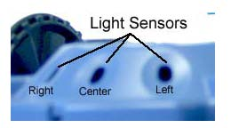
Light Sensors on Scribbler
To obtain values of light sensors, use
      getLight()
      getLight(<POSITION>)
      getLight(‘left’) OR getLight(0)
The values being reported can be in the range of [0…5000]
Low values imply bright light

Slide 11
Light Sensors on Scribbler
Move your robot around, and see it values with
senses() command
Also try:
        L, C, R = getLight()
        print L

Slide 12
Light Sensors on Fluke
Camera on the fluke has a brightness sensor
        getBright()
        getBright(<POSITION>)
The values being reported by these sensors can vary depending on the view of the camera
Higher values imply bright segments while lower values imply darkness

Slide 13
Light Sensors on Fluke
Important Note:
  getLight reports the amount of ambient light being sensed by the robot (including the light above the robot
  getBright is an average of the brightness obtained from the image seen from the camera
These can be used in many different ways!

Slide 14
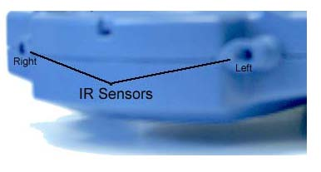
Proximity Sensor on Scribbler
Scribbler has two infrared (IR) sensors on the front of the robot
To obtain values of the front IR sensors, use
      getIR()
      getIR(<POSITION>)
IR sensors return either a 1 or a 0.
  1 implies that there is nothing in close proximity of the front of that sensor

Slide 15
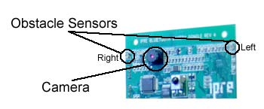
Proximity Sensor on Fluke
Fluke has three additional IR obstacle sensors
To obtain values of the obstacle IR sensors, use
      getObstacle()
      getObstacle(<POSITION>)
The values reported by these sensors range from 0 to 7000.
  A 0 implies there is nothing in front of the sensor

Slide 16
Lists in Python
List is a sequence of objects
These objects could be anything: numbers, letters, strings, images etc.
Lists are very useful way of collecting a bunch of information
Python provides many useful operations and functions that enable manipulation of lists

Slide 17
Lists in Python
Try these:
    #Empty List
    []
    N = [7, 14, 17, 20, 27]
    Cities = [“New York”, “Moscow”]

Slide 18
Lists in Python
Try these:
>>> N = [7, 14, 17, 20, 27]
>>> Cities = [“New York”, “Dar es Salaam”, “Moscow”]
>>> FamousNumbers = [3.1415, 2.718, 42]
>>> SwankyZips = [90210, 33139, 60611, 10036]
>>> MyCar = [“Toyota Prius”, 2006, “Purple”]
>>> len(N)
>>>len(L)
>>> N + FamousNumbers
>>> SwankyZips[0]
>>> SwankyZips[1:3]
>>> 33139 in SwankyZips
True
>>> 19010 in SwankyZips
False

Slide 19
Lists in Python
Try these:
>>> SwankyZips
[90210, 33139, 60611, 10036]
>>> SwankyZips.sort()
>>> SwankyZips
[10036, 33139, 60611, 90210]
>>> SwankyZips.reverse()
>>> SwankyZips
[90210, 60611, 33139, 10036]
>>> SwankyZips.append(19010)
>>> SwankyZips
[90210, 60611, 33139, 10036, 19010]

Slide 20
Inputs in Python
Using the input function, you can input some values into your Python programs:
>>> N = input("Enter a number: ")
Enter a number: 42
>>> print N
42

Slide 21
Remembering Python Functions
Basic syntax for defining new commands/functions:
def <FUNCTION NAME>(<PARAMETERS>):
<SOMETHING>
...
<SOMETHING>
Writing functions that return values:
def triple(x):
# Returns x*3
return x * 3

