Slide 1
Building Robot Brains
Week #3
Prof. Ryan Kastner

Slide 2
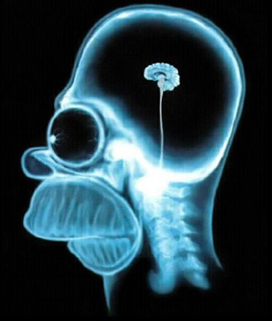
Robot Brains
When you write a program, you are actually building a brain for your Robot
In the computing world, this brain is replaceable
  Firefox as a Browser
  iTunes as a Media Player
  VLC as a Movie Player
By learning to write Robot programs you are also learning to write computer programs

Slide 3
Structure of a Robot Brain
The basic structure of a Program (Brain) is:
def main():
  <do something>
  <do something>
  ...
Every Robot program will begin with
  from myro import *
  init()
Then you import other files/modules or you ask the robot to do something using the modules

Slide 4
Robot Dance
Make the Robot do some random movements using function moves()
# The main dance program
def main():
  print "Running the dance routine..."
  yoyo(0.5, 0.5)
  wiggle(0.5, 0.5)
  yoyo(1, 1)
  wiggle(1, 1)
  print "...Done"
main()
The function ‘print’ will print out what you have entered in the double quotes “ ”
When the main() function is called, the functions in main() are called in order so you get the output:
Running the dance routine…
…Done

Slide 5
Pythonese
Try this:
speak("Dude! Pardon me, would you have any Grey Poupon?")
Python comes with several other useful libraries or modules
Libraries are made up of sets of functions
You can import the commands provided in a library
Every programming language has a set of predefined functions and a mechanism for defining additional functions

Slide 6
Pythonese - Rules
A name in Python must begin with either an alphabetic letter (a-z or A-Z) or the underscore (i.e. _) and can be followed by any sequence of letters, digits, or underscore letters
  jitterBug2
  my_2_cents
By giving functions a name you have a way of defining new functions

Slide 7
Pythonese - Rules
Functions can take parameters that help customize what they do. In the above example, you can issue the following two commands:
>>> yoyo(0.8, 2.5)
>>> yoyo(0.3, 1.5)
It is better you choose names which makes sense
For example:
A function turnRight() should turn the robot right and NOT make it go in circles or dance
PS: This is not mandatory though! ☺

Slide 8
Pythonese - Rules
Values
  Designating values by names is an important feature of Programming
  We can create names for speed, temperature etc.
  Designating Values
    aveHighTemp = 37
    DowIndex = 12548.30
    myFavoriteRobot = "C3PO"
Syntax: <variable name> = <expression>
    Strings are given within double quotes

Slide 9
Pythonese – Rules
What you type at the Python prompt >>> is an Expression
>>> 5
5
>>> 5 + 3
8
>>> 3 * 4
12
>>> 3.2 + 4.7
7.9
>>> 10 / 2
5
Addition (+), subtraction (-), multiplication (*), and division (/) can be used on numbers to form expressions that involve numbers
Whole numbers are called integers and those with decimal points in them are called floating point numbers
Python handles both (try 10.0/3.0)

Slide 10
Pythonese - Rules
Strings
Python requires that strings be written enclosed in quotes: which could be single ('I am a string'), double ("Me too!"), or even triple quotes ('''I'm string as well!''')
Python also provides some operations on strings using which you can write some useful string expressions
>>> mySchool = "Bryn Mawr College"
>>> yourSchool = "Georgia Institute of Technology“
>>> yourSchool+mySchool
'Georgia Institute of TechnologyBryn Mawr College'

Slide 11
Pythonese - Computation
Estimate the world population growth in a year and also per day. Given that on January 1, 2008 the world's population was estimated at 6,650,000,000 and the estimated growth is at the rate of +1.14%

Slide 12
Pythonese - Computation
In a large program if you want to change some value, you can search for the value line by line and modify your program to reflect the new value
Instead you can use the input facility of Python
Python has a simple input command
  Syntax: <variable name> = input(<some prompt string>)
  Population = input("Enter current world population: ")

Slide 13
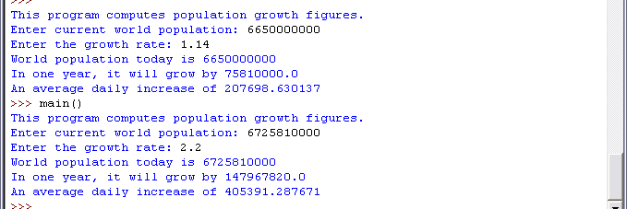
Pythonese - Computation
This is how your GUI will look when you use the input function

Slide 14
Pythonese - Repetitions
If you want the dance behavior 10 times
for i in range(10):
dance()
Syntax for repetition:
for <variable> in <sequence>:
  <do something>
  <do something>
  ...
range() function is used to specify a sequence
  range(10)
  [0, 1, 2, 3, 4, 5, 6, 7, 8, 9]

Slide 15
Pythonese - Repetition
What if you want to make the robot dance forever??
How do you stop it?
In addition to repeating by counting, you can also specify repetition using time
  while timeRemaining(10):
    <do something>
    <do something>
    ...

Slide 16
Summary
Values in Python can be numbers (integers or floating point numbers) or strings
Operations can be performed on Values
<variable name> = <expression>
This is how Python assigns values to variables
range(10)
Generates a sequence of numbers from 0..9
range(n1, n2)
  Generates a list of numbers starting from n1…(n2-1)
range(5, 10) will generate the list of numbers [5, 6, 7, 8, 9]
range(n1, n2, step)
  Generates a list of numbers from n1…(n2-1) in steps of step
range(5, 10, 2) will generate the list of numbers [5, 7, 9]

Slide 17
Summary
Repetition
for <variable> in <sequence>:
  <do something>
  <do something>
...
while timeRemaining(<seconds>):
  <do something>
  <do something>
  ...
while True:
<do something>
<do something>
...

