Slide 1
Getting Started with Python and Myro
Week #2
Prof. Ryan Kastner

Slide 2
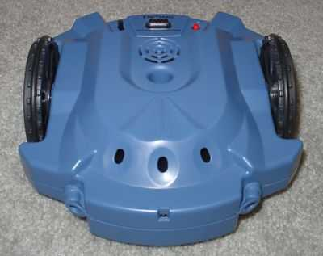
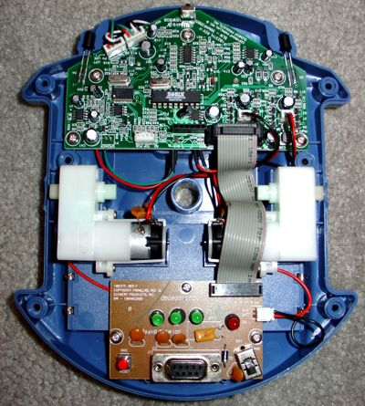
Scribbler
Three Wheels – Big ones on either side are powered by motors
Scribbler’s movements are performed through the two motor-driven wheels
motors(LEFT, RIGHT)
motors(0.0, 1.0) – only right motor works
Which way does the robot move?

Slide 3
Speed of Myro
forward(SPEED)
backward(SPEED)
turnLeft(SPEED)
turnRight(SPEED)
stop()
forward(SPEED, SECONDS)
backward(SPEED, SECONDS)
turnLeft(SPEED, SECONDS)
turnRight(SPEED, SECONDS)
Make your robot traverse in a rectangular path
Try making the robot traverse along the shorter two paths in the same time as the longer two paths (sides) of the rectangle
turnLeft(1, .3)
forward(1, 1)
T seconds
T seconds
T seconds
T seconds

Slide 4
New Commands
Making a robot carry out more complex behaviors requires several series of commands
Packaging a series of commands into a brand new command called a function
Yoyo()
>>>def yoyo():
forward(1)
backward(1)
stop()
>>> yoyo()
Issuing the new function like this one in Python is called, invocation

Slide 5
New functions() - parameters
The Robot will move forward for 1 second before applying the command that follows the wait
def yoyo():
forward(1)
wait(1)
backward(1)
wait(1)
stop()
>>>def yoyo1(speed):
forward(speed, 1)
backward(speed, 1)
>>>yoyo1(0.5)
The Robot moves at
half the speed
Try passing other parameters like waitTime
Pass multiple parameters: yoyo3(0.5, 1.5)

Slide 6
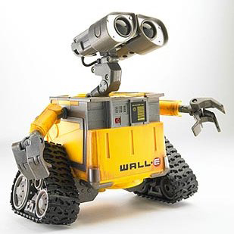
Saving Commands in Modules
When you work with different functions of the Robot you may end up with large collection of new functions
Wouldn’t it be better to store them in files on your computer so that you can call them when you need?
Typical robot programs have huge number of functions and it is easy to store them in a file and call them when needed

Slide 7
Writing and Saving to a File
from myro import *
init()
# Define the new functions
def yoyo(speed, waitTime):
forward(speed)
wait(waitTime)
backward(speed)
wait(waitTime)
stop()
Click file on IDLE GUI and open a new window
# is used to enter comments (so that you remember what you did when you come back to your program)
Enter your program as you would do in your Python IDLE GUI

Slide 8
Writing and Saving to a File
A good programmer always comments his program well
Once you are done writing your program click File > Save As and enter the file name you like say ‘moves’ with an extension ‘.py’ (All Python modules end with the filename extension .py)
Make sure they are always saved in the same folder as the Start Python.pyw file

Slide 9
Accessing the Files
You can use the file in two ways
>>> from moves import *
# Try the commands we used before
>>> yoyo(0.5,0.5)
Accessing the commands defined in a module is similar to accessing the capabilities of the myro module
from <MODULE NAME> import <SOMETHING>
When you replace <SOMETHING> with * you import everything

Slide 10
Functions as Building Blocks
The basic syntax for defining a Python function takes the form:
def <FUNCTION NAME>(<PARAMETERS>):
<SOMETHING>
...
<SOMETHING>
To define a new function,
Start by using the word def followed by the name of the function (<FUNCTION NAME>) followed by <PARAMETERS> enclosed in parenthesis followed by a colon (:).
This line is followed by the commands that make up the function definition (<SOMETHING>...<SOMETHING>).

Slide 11
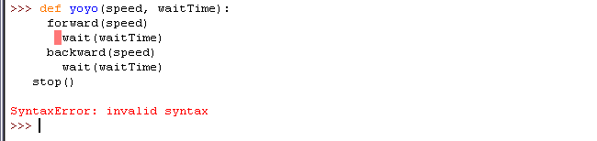
Syntax
Each command is to be placed on a separate line, and all lines that make up the definition should be indented (aligned) the same amount
The number of spaces in the indentation should be same
def yoyo(speed, waitTime):
forward(speed); wait(waitTime)
backward(speed); wait(waitTime)
stop()
Commands on the same line can be entered separated
by a semi-colon (;)

Slide 12
Syntax – Readability in Python
The indentation helps better readability of your code (program)
Python also has a color highlighting feature
Defining new functions using existing functions is very effective and is used by all computer programmers
By defining the function yoyo as a new function using the existing functions (forward, backward, wait, stop)) you have abstracted a new behavior for your robot
For example, the word def in a function definition appears in red, the name of your function, yoyo appears in blue

Slide 13
Sample Function using Functions
Try this:
>>> def dance():
yoyo(0.5, 0.5)
yoyo(0.5, 0.5)
wiggle(0.5, 1)
wiggle(0.5, 1)
>>> dance()

Slide 14
Summary
Commands to make a Robot move in different ways
Define new commands by defining new Python Functions
Saving Functions in a File
Importing from a File or Module

Slide 15
Try These
Compare the robot's movements in the commands turnLeft(1), turnRight(1) and rotate(1), rotate(-1).
Closely observe the robot's behavior and then also try the motor commands:
>>> motors(-0.5, 0.5)
>>> motors(0.5, -0.5)
>>> motors(0, 0.5)
>>> motors(0.5, 0)

