Slide 1
Reconfigurable Hardware
Professor Ryan Kastner
Dept. of Computer Science and Engineering
University of California, San Diego

Slide 2

Reconfigurable Hardware

Slide 3
Reconfigurable Hardware
Main Entry: re-
Function: prefix
1 : again : anew <retell>
2 : back : backward <recall>
Main Entry: con·fig·ure
Pronunciation: k&n-'fi-gy&r
Function: transitive verb
: to set up for operation especially
in a particular way
CLB
Block RAM
IP Core (Multiplier)
KEY ADVANTAGE: Performance of Hardware, Flexibility of Software

Slide 4
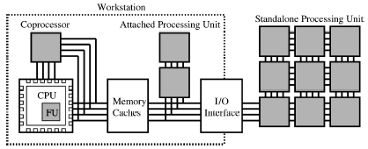
Origins of Reconfigurable Computing
Fixed-Plus-Variable (F+V) Structure Computer
Standard processor augmented with inventory of reconfigurable building blocks
“… to permit computations which are beyond the capabilities of present systems by providing an inventory of high speed substructures and rules for interconnecting them such that the entire system may be temporarily distorted into a problem oriented special purpose computer.” - G. Estrin

Slide 5
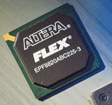
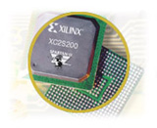
History of Reconfigurable Computing
PLA
Early Years – PLA, PAL
One time programmable
Programmed by blowing fuses
Complex Logic Devices
FPGA, CPLD
Reprogrammable (SRAM)
Initially used for glue logic, ASIC prototyping
“Moore” transistors = more complex devices

Slide 6
Modern Reconfigurable Devices
Reconfigurable devices are extremely complicated, multiprocessing computing systems
Mix of hardware and software components
Microprocessors – RISC, DSP, network, …
Logic level (FPGA) Reconfigurable logic
Specs for high end Xilinx Virtex 7
1 GHz ARM Dual Core Cortex A9
96 transceivers @ 28.05 Gb/s peak
3600 DSP Slices @ 5,335 GMAC/s
1,955K logic cells
68 Mb BRAM
1,200 I/Os
Can implement complex applications

Slide 7
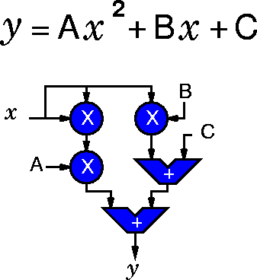
Traditional Choice: Hardware vs. Software
Properties of Hardware
Fast: High performance
Spatial execution
Adaptable parallelism
Compact: Silicon area efficient
Operations tailored to application
Simple control
Direct wire connections between operations
Source: DeHon/Wawrzynek
Hardware Inflexible: Fixed at Fabrication

Slide 8
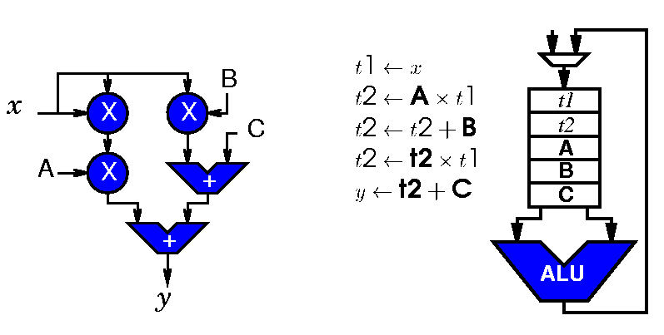
Traditional Choice: Hardware vs. Software
Properties of Software
Slow:
Sequential execution
Overhead of interpreting instructions
Area inefficient:
Fixed width, general operators
Area overhead
Instruction cache
Control circuitry
Souce: DeHon/Wawrzynek
Software Flexible: Fixed at Runtime

Slide 9
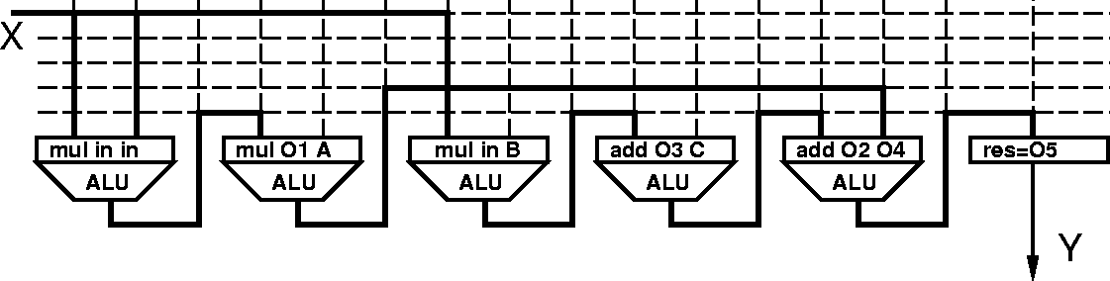
Reconfigurable Hardware
Fast:
Spatial parallelism (like hardware)
Application specific operators, control circuitry
Flexible:
Operators and interconnect programmable (like software)
Source: DeHon/Wawrzynek

Slide 10
Reconfigurable Hardware
Fast and flexible, but…
Area overhead – switches, configuration bits
Delay overhead – switches, logic
Compilation
Difficult - architecture “too” flexible
Slow - based on hardware synthesis techniques
Source: DeHon/Wawrzynek

Slide 11
Performance Benefits
Up to 100x performance increase compared to processors (microprocessor, DSP)
~10x performance density advantage over processors
Applications like:
Pattern matching
Data encryption
Data compression
Digital communications
Video and image processing
Boolean satisfiability
Networking
Cryptography

Slide 12
Programmability Abstractions
Control
Control
ADD
Register
FU
FU
Memory
MUL
Register
Register
Bank
Logic Level
Instruction Level
Function Level
Programming Unit
Bit
Byte
Operands
Basic Unit of Computation
Boolean Operation
(and, or, xor)
Arithmetic Operation
Functional Operation
Communication
Wires, Flip Flops
Bundles of Wires, Registers
Bus, Memory
Example Devices
FPGA, CPLD
PRISC, Chimaera, Garp
NAPA, RAW, RaPiD
Flexibility
Performance
Power/Energy Consumption
Design Complexity

Slide 13
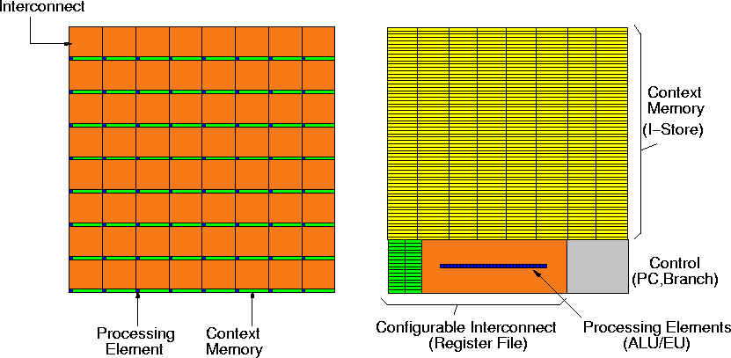
Processor vs FPGA
Souce: DeHon

Slide 14
FPGA
CLB
Switchbox
Routing
Channel
IOB
Routing
Channel
Configuration
Bit

Slide 15
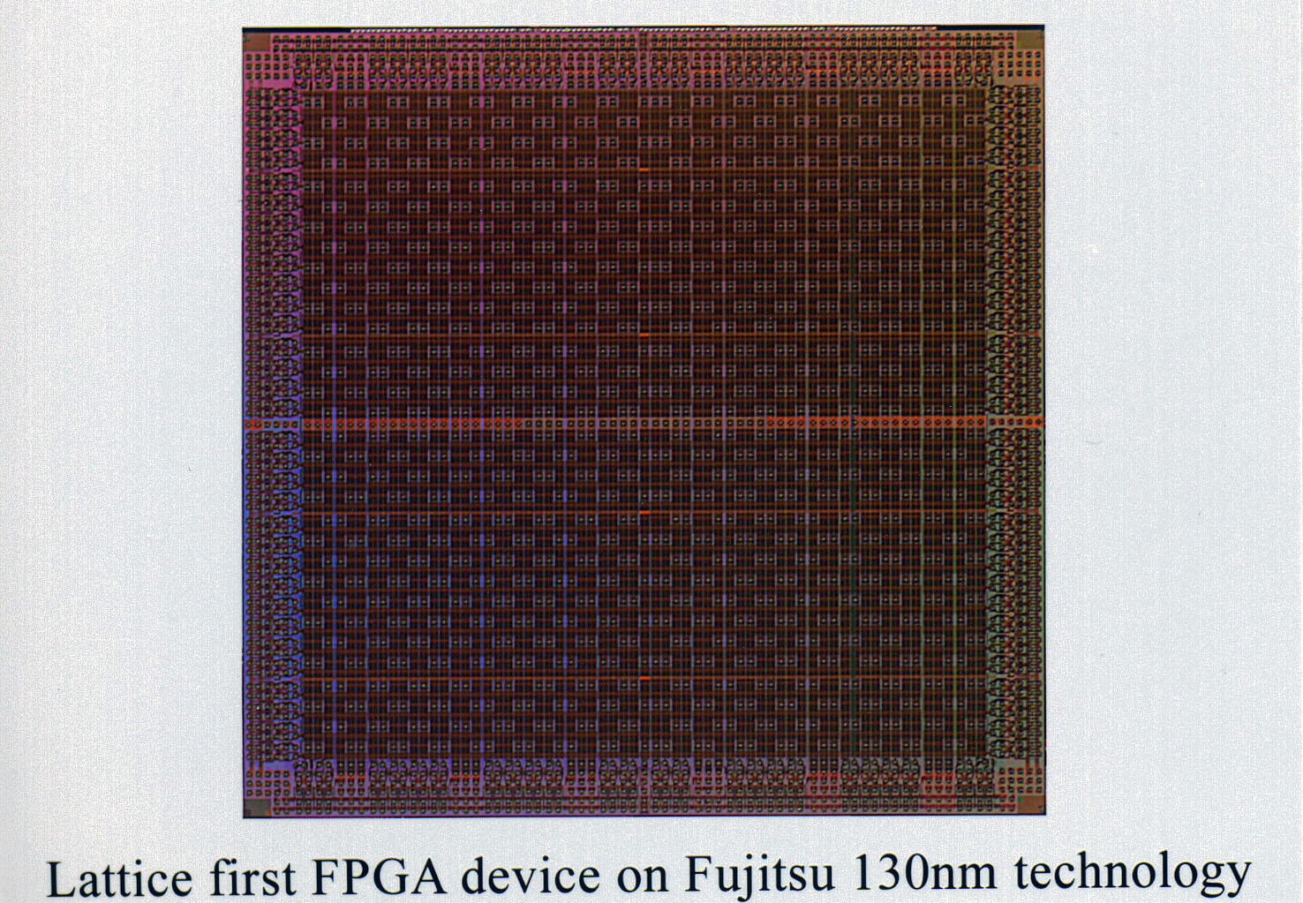
FPGA

Slide 16
Programmable Logic
Logic Element
Tracks
LE
LE
LE
LE
LE
LE
LE
LE
LE
LE
LE
LE
Each logic element outputs one data bit
Interconnect programmable between elements
Interconnect tracks grouped into channels

Slide 17
Lookup Table (LUT)
Program configuration bits for required functionality
Computes “any” 2-input function
2-LUT
In Out
00 0
01 0
10 0
11 1
A
C=A ⋅ B
B
Configuration Bit 0
Configuration Bit 1
C
Configuration Bit 2
Configuration Bit 3
A
B

Slide 18
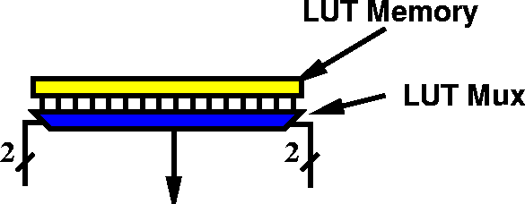
Lookup Table (LUT)
K-LUT -- K input lookup table
Any function of K inputs by programming table
Load bits into table
2^{N} bits to describe functions
=> different functions

Slide 19
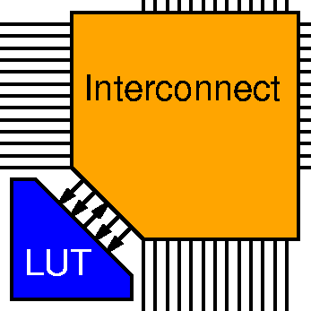
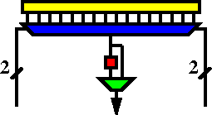
Lookup Table (LUT)
K-LUT (typical k=4)
w/ optional
output Flip-Flop

Slide 20
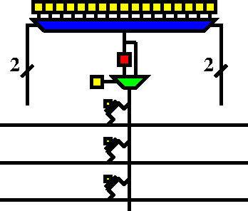
Lookup Table (LUT)
Single configuration bit for each:
LUT bit
Interconnect point/option
Flip-flop select

Slide 21
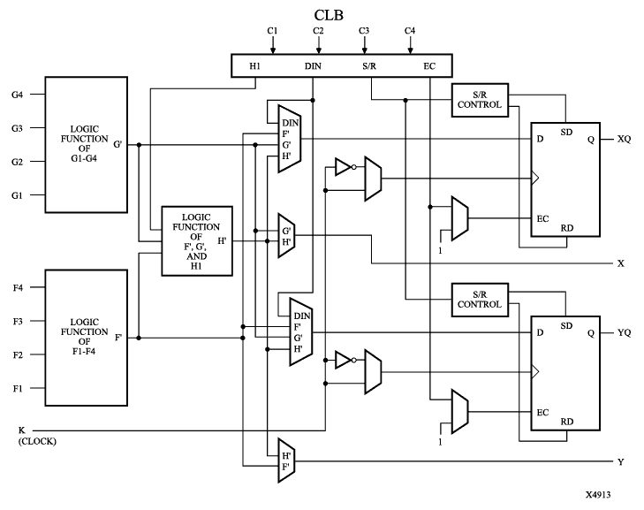
Configurable Logic Block (CLB)

Slide 22
Programmable Interconnect
Interconnect architecture
Fast local interconnect
Horizontal and vertical lines of various lengths
C L
B
C L
B
C L
B
Switch
Matrix
Switch Matrix
C L
B
C L
B
C L
B

Slide 23
Switchbox Operation
Before Programming
After Programming
6 pass transistors per switchbox interconnect point
Pass transistors act as programmable switches
Pass transistor gates are driven by configuration memory cells

Slide 24
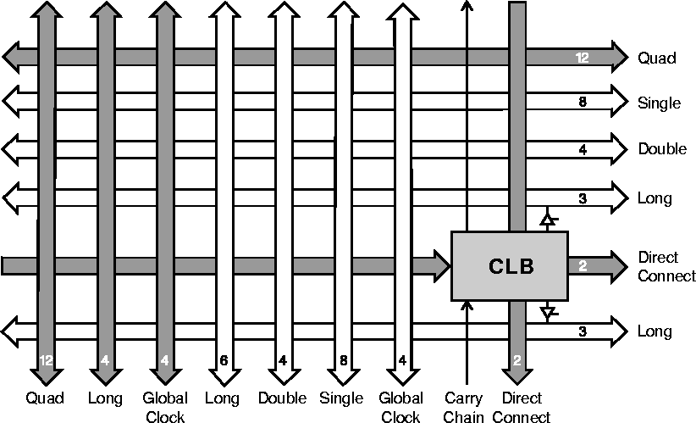
Programmable Interconnect

Slide 25
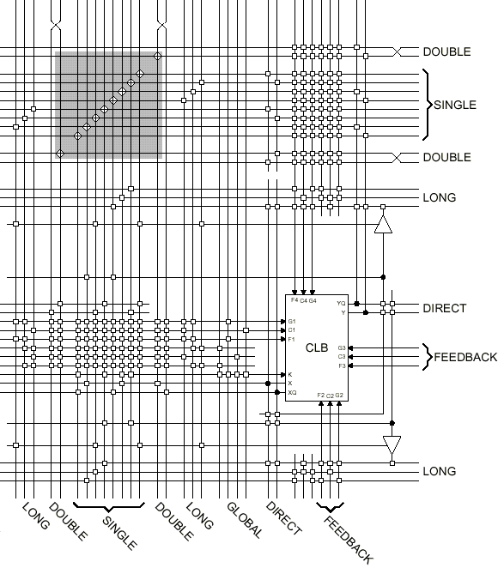
Programmable Interconnect
25

Slide 26
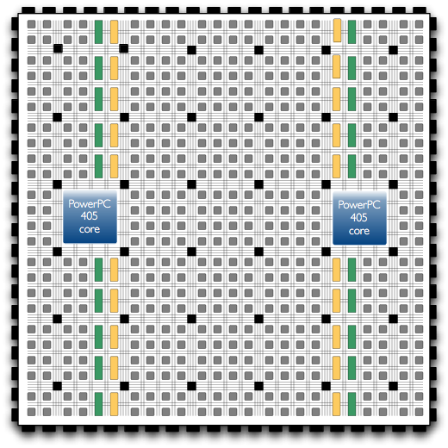
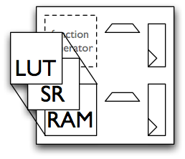
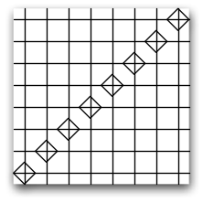
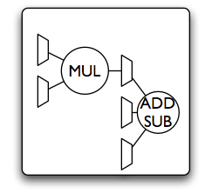
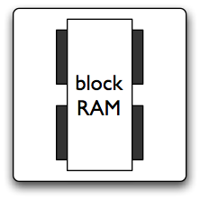
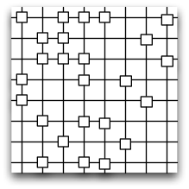
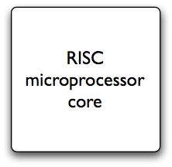
FPGA “Hardening”
FPGA-based reconfigurable devices
Configurable logic blocks
Flexible logic block
Programmable interconnect
Dedicated multipliers
Embedded configurable block RAM
RISC microprocessor cores
Other architectures
Reconfigurable multi-core processor 
Coarse-grained reconfigurable architectures 

Slide 27
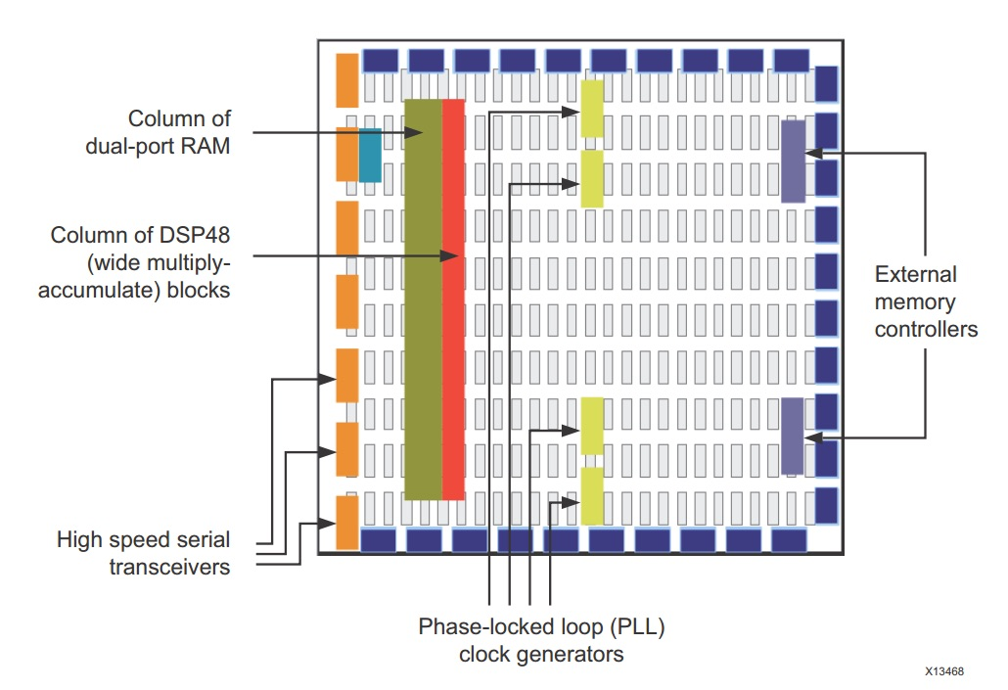
FPGA “Hardening”
Notes:
Source: Xilinx Design documents
Fixed, fast multipliers
MAC, Shifters, counters
Hard/soft processor cores
PowerPC
Nios
Microblaze
Memory
Block RAM
Various sizes and distributions

Slide 28
Embedded RAM
Xilinx – Block RAM
32k x 1 to 512 x 72 in one 36K block
Simple dual-port and true dual-port configurations
Built-in FIFO logic
64-bit error correction coding per 36K block
Adjacent blocks combine to 64K x 1 without extra logic
ADDRA
Port A
36
36
DIA
DOA
4
WEA
CLKA
36 Kb Memory Array
36
ADDRB
36
4
DIB
DOB
WEB
CLKB
Port B

Slide 29
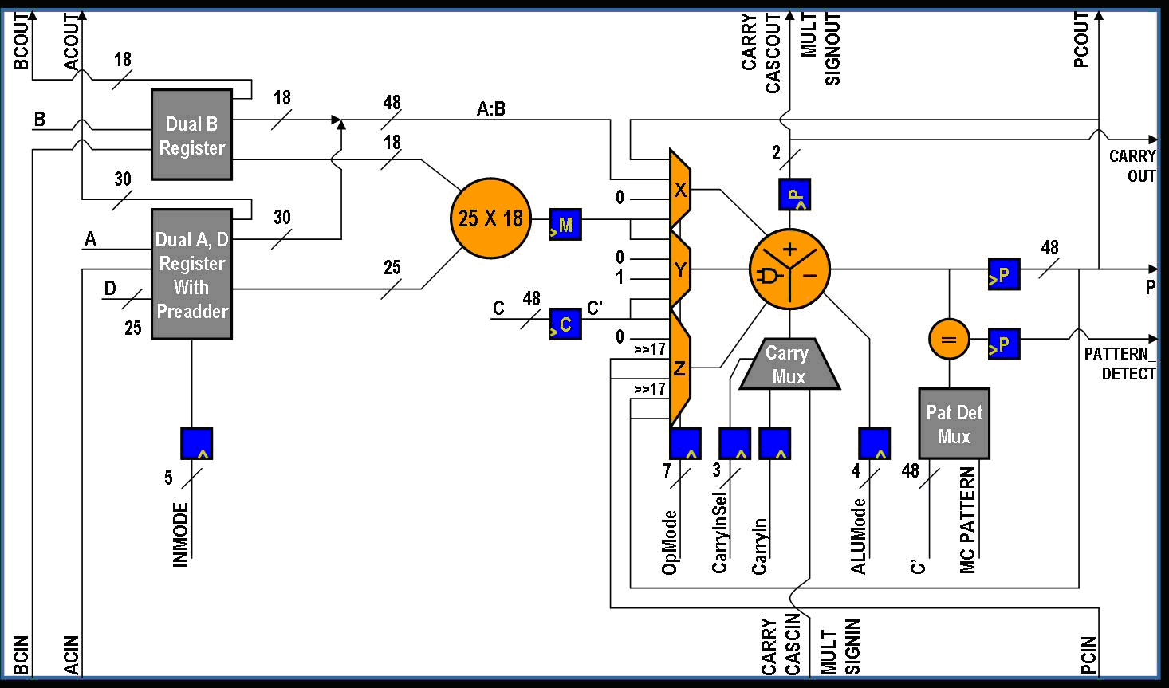
Embedded Functional Unit
Xilinx DSP48
25x18 multiplier
25-bit pre-adder
Flexible pipeline
Cascade in and out
Carry in and out
96-bit MACC
SIMD support
48-bit ALU
Pattern detect
17-bit shifter
Dynamic operation (cycle by cycle)
Notes:
Virtex 7 series DSP slice

Slide 30
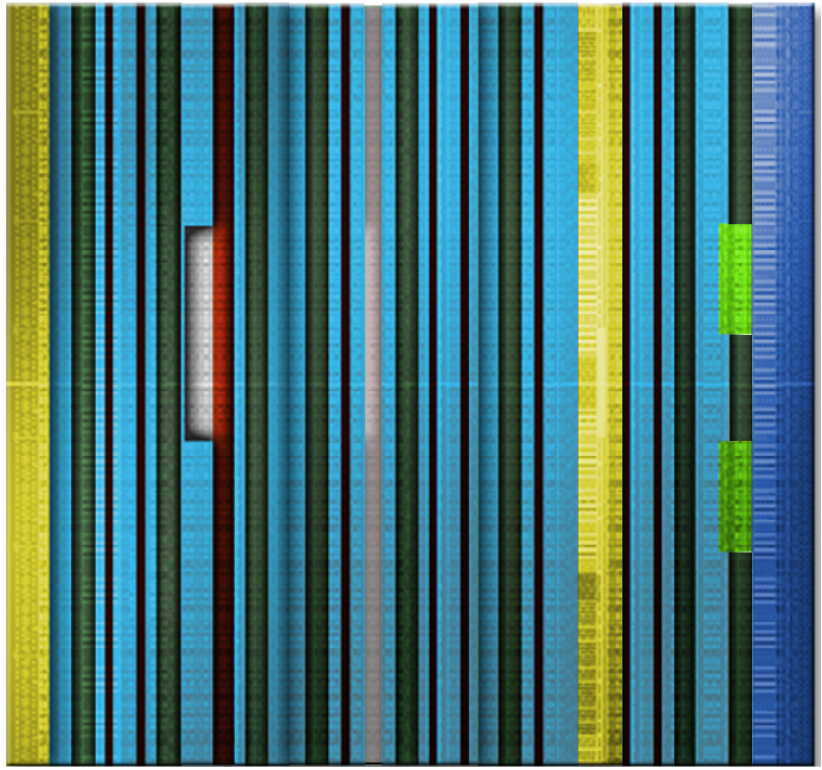
Xilinx 7 Series FPGAs
SelectIO
& CMT
SelectIO
& CMT
Logic
Serial Transceiver
1 GHz ARM Dual Core Cortex A9
96 transceivers @ 28.05 Gb/s peak
3600 DSP Slices @ 5,335 GMAC/s
1,955K logic cells
68 Mb BRAM
1,200 I/Os
DSP
BRAM
Clock Buffers and Routing
PCI Express
Notes:
ARM for Zynq
Rest for highest end Virtex 7 (XC7V2000T)

Slide 31
FPGA System Life Cycle
EDA Design Tools
FPGA Device Vendors:
Altera, Xilinx
Manufacturing Stage
Manufacturing Process
Foundry:
TSMC, UMC, SMIC
Specification:
C/C++, Matlab
Application Development Stage
FPGA
Physical Synthesis
Logic Synthesis
RTL Synthesis
System Synthesis
Memory
Memory
Intellectual Property (IP) Cores
FPGA Board
Codec
Application Engineer using CAD tools developed by:
Cadence, Mentor Graphics, Synopsys, Mathworks, Altera, Xilinx
D/A
A/D
Deployment Stage:
Applications include military, transportation, banking and finance, SCADA, high performance computing, etc
System Developers:
Avnet, Digilent, NuHorizons, …

Slide 32
Tool Chains
Notes:
There are many tools out there. Since most computer scientists are not experts at HDL design, tools are needed to translate algorithms into circuits.
HDL design is tricky. Many proposals for tools for high-performance computing applications that run on hybrid CPU/FPGA systems in which FPGAs handle the most intensive tasks (10%-90% rule).
How do we profile an FPGA application?

Slide 33
Programming the FPGA
Configure logic – CLBs, LUTs, FFs
Configure interconnect – channel, switchbox
Large number of bits – 500 Mb
Configuration bit technology
Antifuse (program once)
SRAM
Floating Gate (Flash)

Slide 34
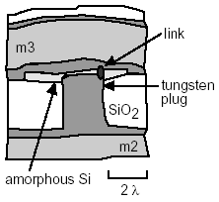
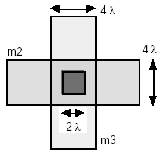
Antifuses
Opposite of fuse (open until blown)
Make a connection with electrical signal
The current melts a thin insulating layer to form a thin permanent and resistive link.
More reliable than breaking a connection (avoids shrapnel)
Permanently programmed (Non-volatile)
Notes:
Metal–metal antifuse. (b) A metal–metal antifuse in a three-level metal process that uses contact plugs. The conductive link usually forms at the corner of the via where the electric field is highest during programming.

Slide 35
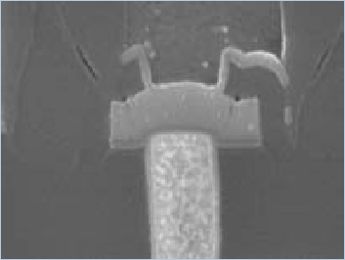
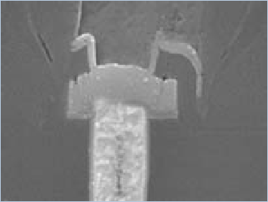
Antifuses
Source: Actel

Slide 36
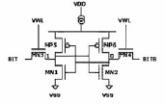
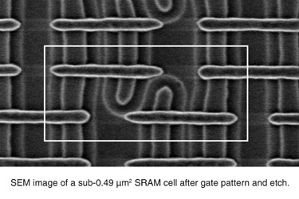
SRAM
SRAM
Configuration
Bit
Mode
(Read/Write)
Input Data
Output
Volatile
6 CMOS transistors
Standard fabrication process
Notes:
Configurable interconnect using a pass gate controlled by single SRAM configuration bit. If the SRAM bit is set, then A is electrically connected to B. Otherwise, A and B are not connected.

Slide 37
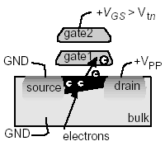
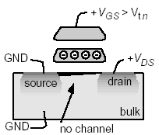
Floating Gate (EPROM/EEPROM/Flash)
By applying proper programming voltages,
electrons “jump” onto floating gate
Electrons on gate raise threshold voltage so transistor always off
Flash switch is comprised of two transistors which share a gate
Notes:
(a) With a high (>12V) programming voltage, VPP, applied to the drain, electrons gain
enough energy to “jump” onto the floating gate (gate1)
(b) Electrons stuck on gate1 raise the threshold voltage so that the transistor is always off
for normal operating voltages
(c) UV light provides enough energy for the electrons stuck on gate1 to “jump” back to the
bulk, allowing the transistor to operate normally

Slide 38
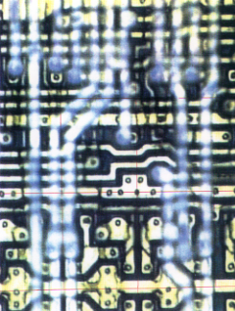
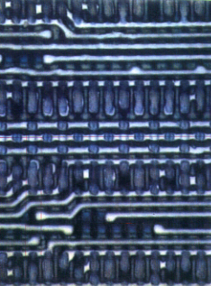
SRAM Versus Flash Switch & Memory Size
SRAM based PLD
FLASH based PLD
Switch
& Routing
Memory
Cell
Memory
Cell
Switch
& Routing

Slide 39
Programming Technology
 | SRAM | Antifuse | Flash
Speed | Medium | Fast | Slow
Power | Poor | Good | Good
Relative Size | 1 | 1/10 | 1/7
Reprogram | Yes | No | Yes
Size | Large | Small | Moderate
Volatile | Yes | No | No

Slide 40
FPGA System Life Cycle
EDA Design Tools
FPGA Device Vendors:
Altera, Xilinx
Manufacturing Stage
Manufacturing Process
Foundry:
TSMC, UMC, SMIC
Specification:
C/C++, Matlab
Application Development Stage
FPGA
Physical Synthesis
Logic Synthesis
RTL Synthesis
System Synthesis
Memory
Memory
Intellectual Property (IP) Cores
FPGA Board
Codec
Application Engineer using CAD tools developed by:
Cadence, Mentor Graphics, Synopsys, Mathworks, Altera, Xilinx
D/A
A/D
Deployment Stage:
Applications include military, transportation, banking and finance, SCADA, high performance computing, etc
System Developers:
Avnet, Digilent, NuHorizons, …

Slide 41
Tool Chains
Notes:
There are many tools out there. Since most computer scientists are not experts at HDL design, tools are needed to translate algorithms into circuits.
HDL design is tricky. Many proposals for tools for high-performance computing applications that run on hybrid CPU/FPGA systems in which FPGAs handle the most intensive tasks (10%-90% rule).
How do we profile an FPGA application?

